Slide 1
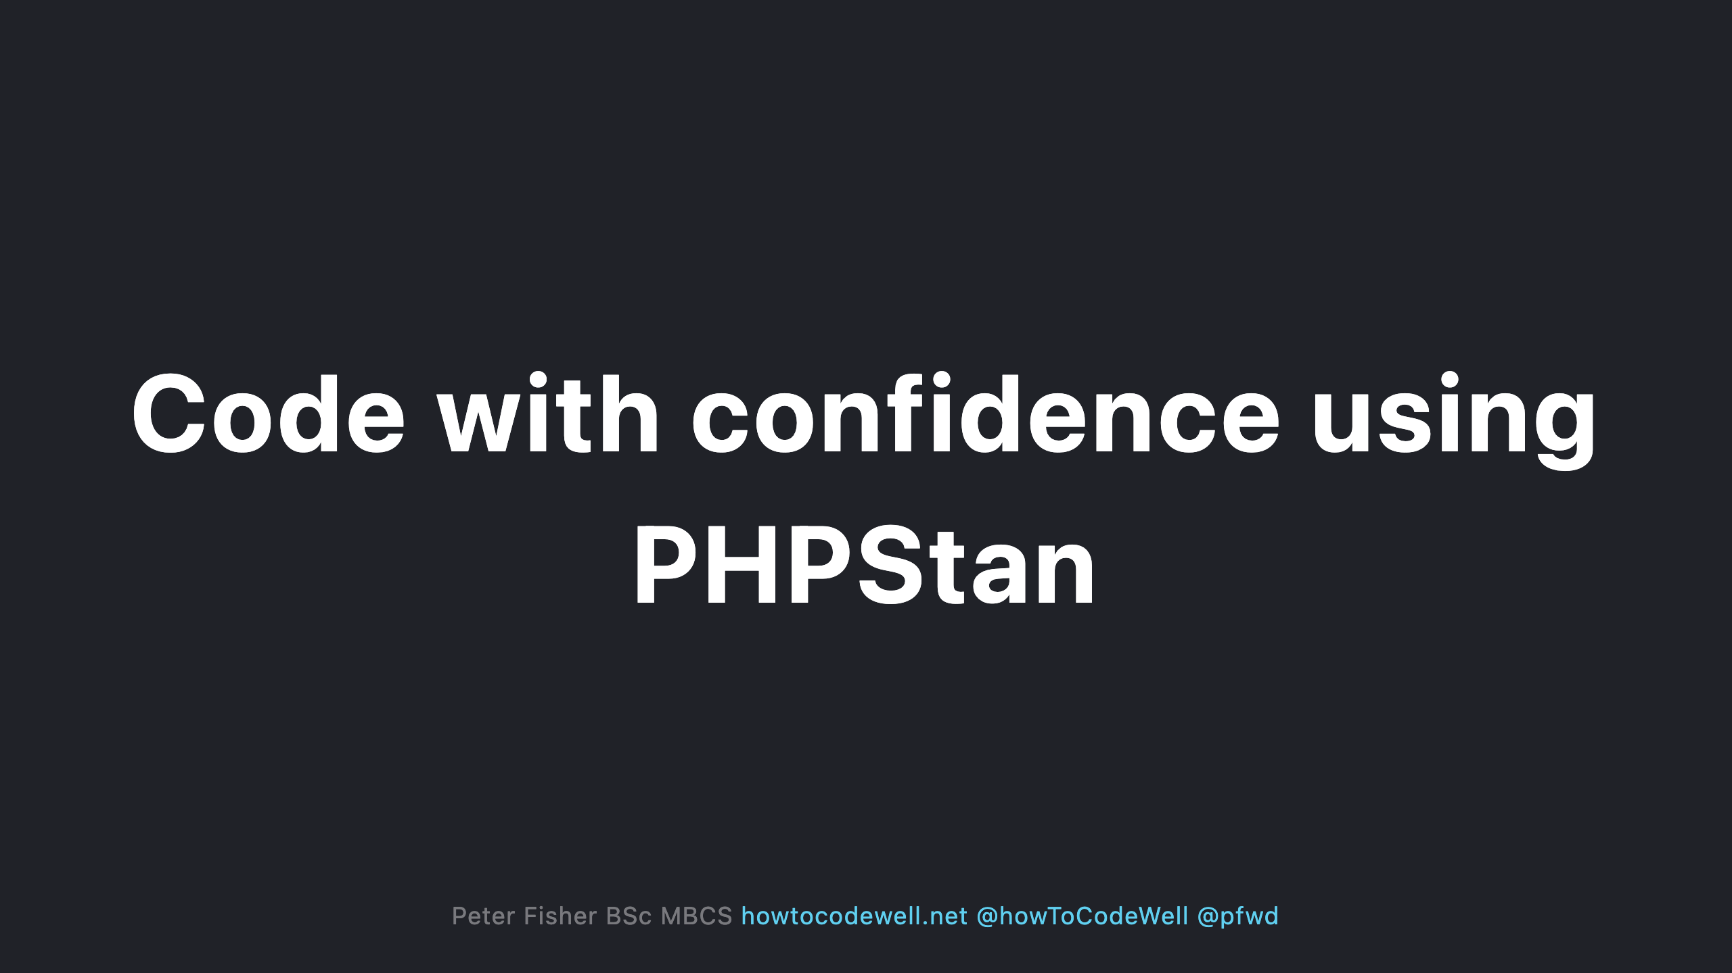

Slide 2
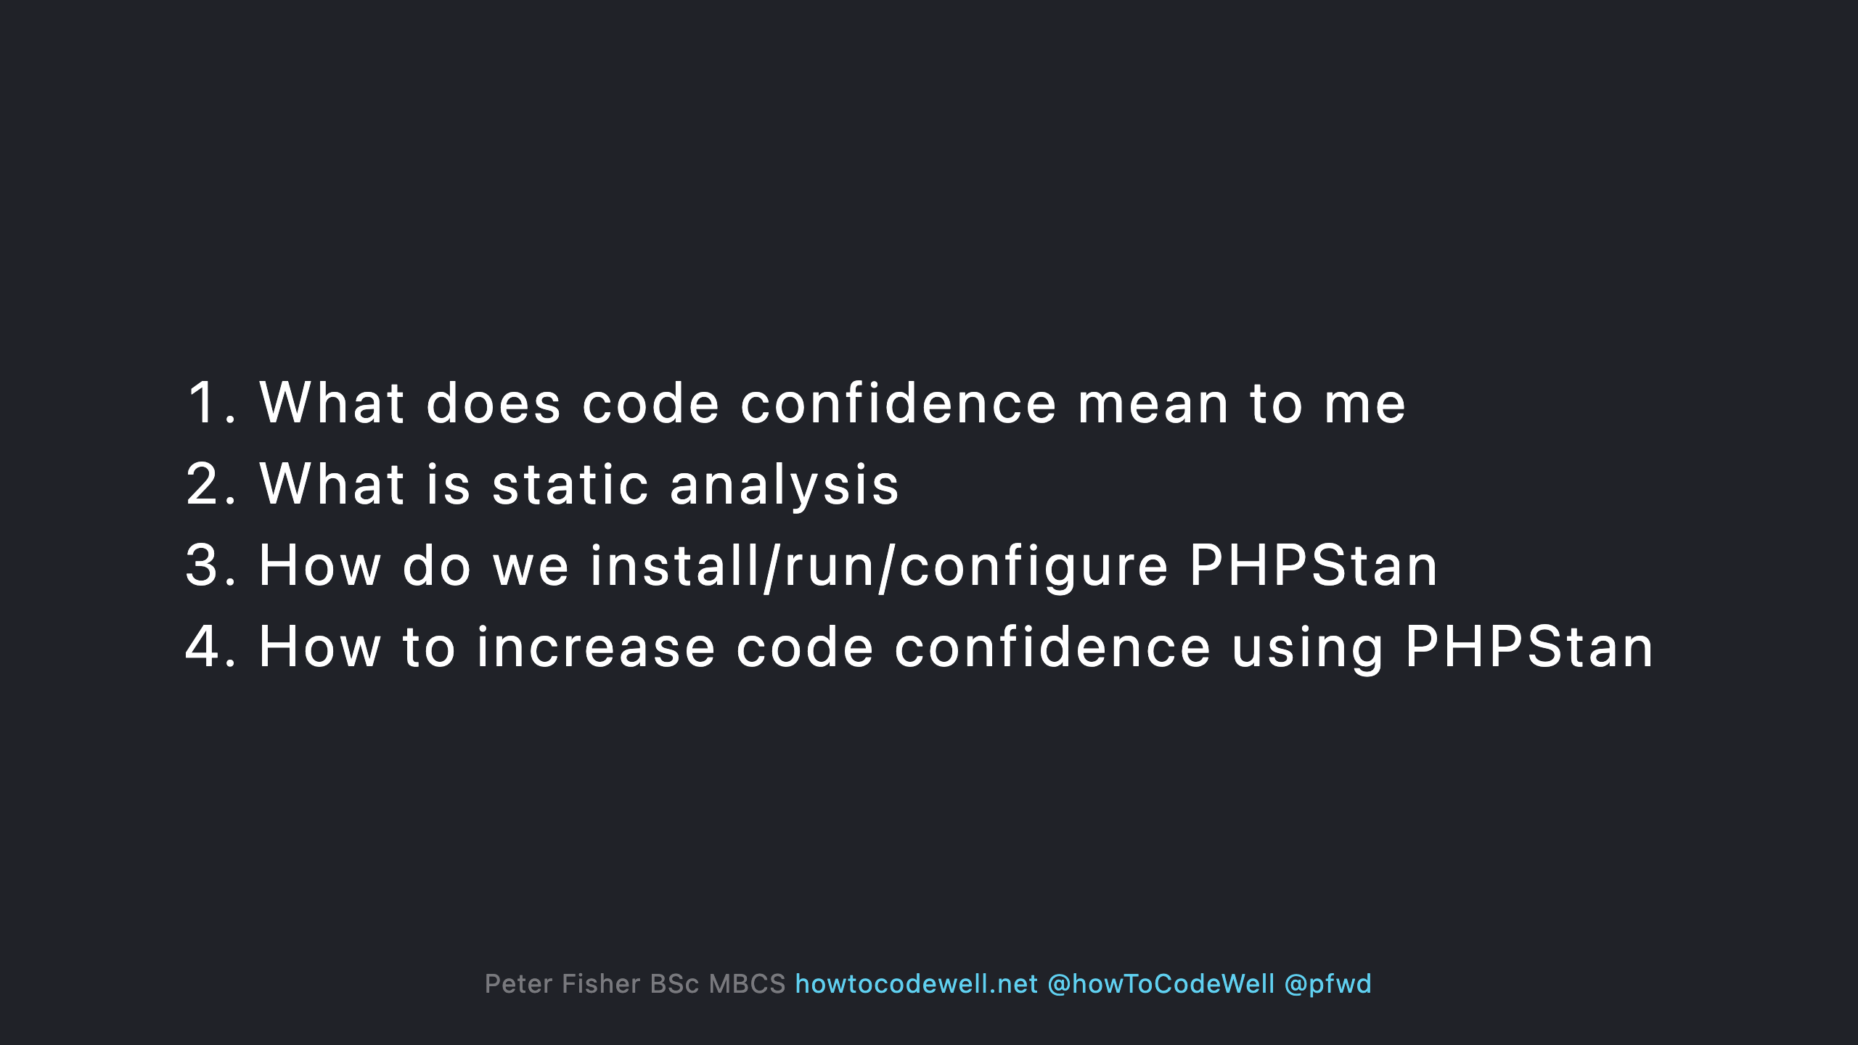

Slide 3
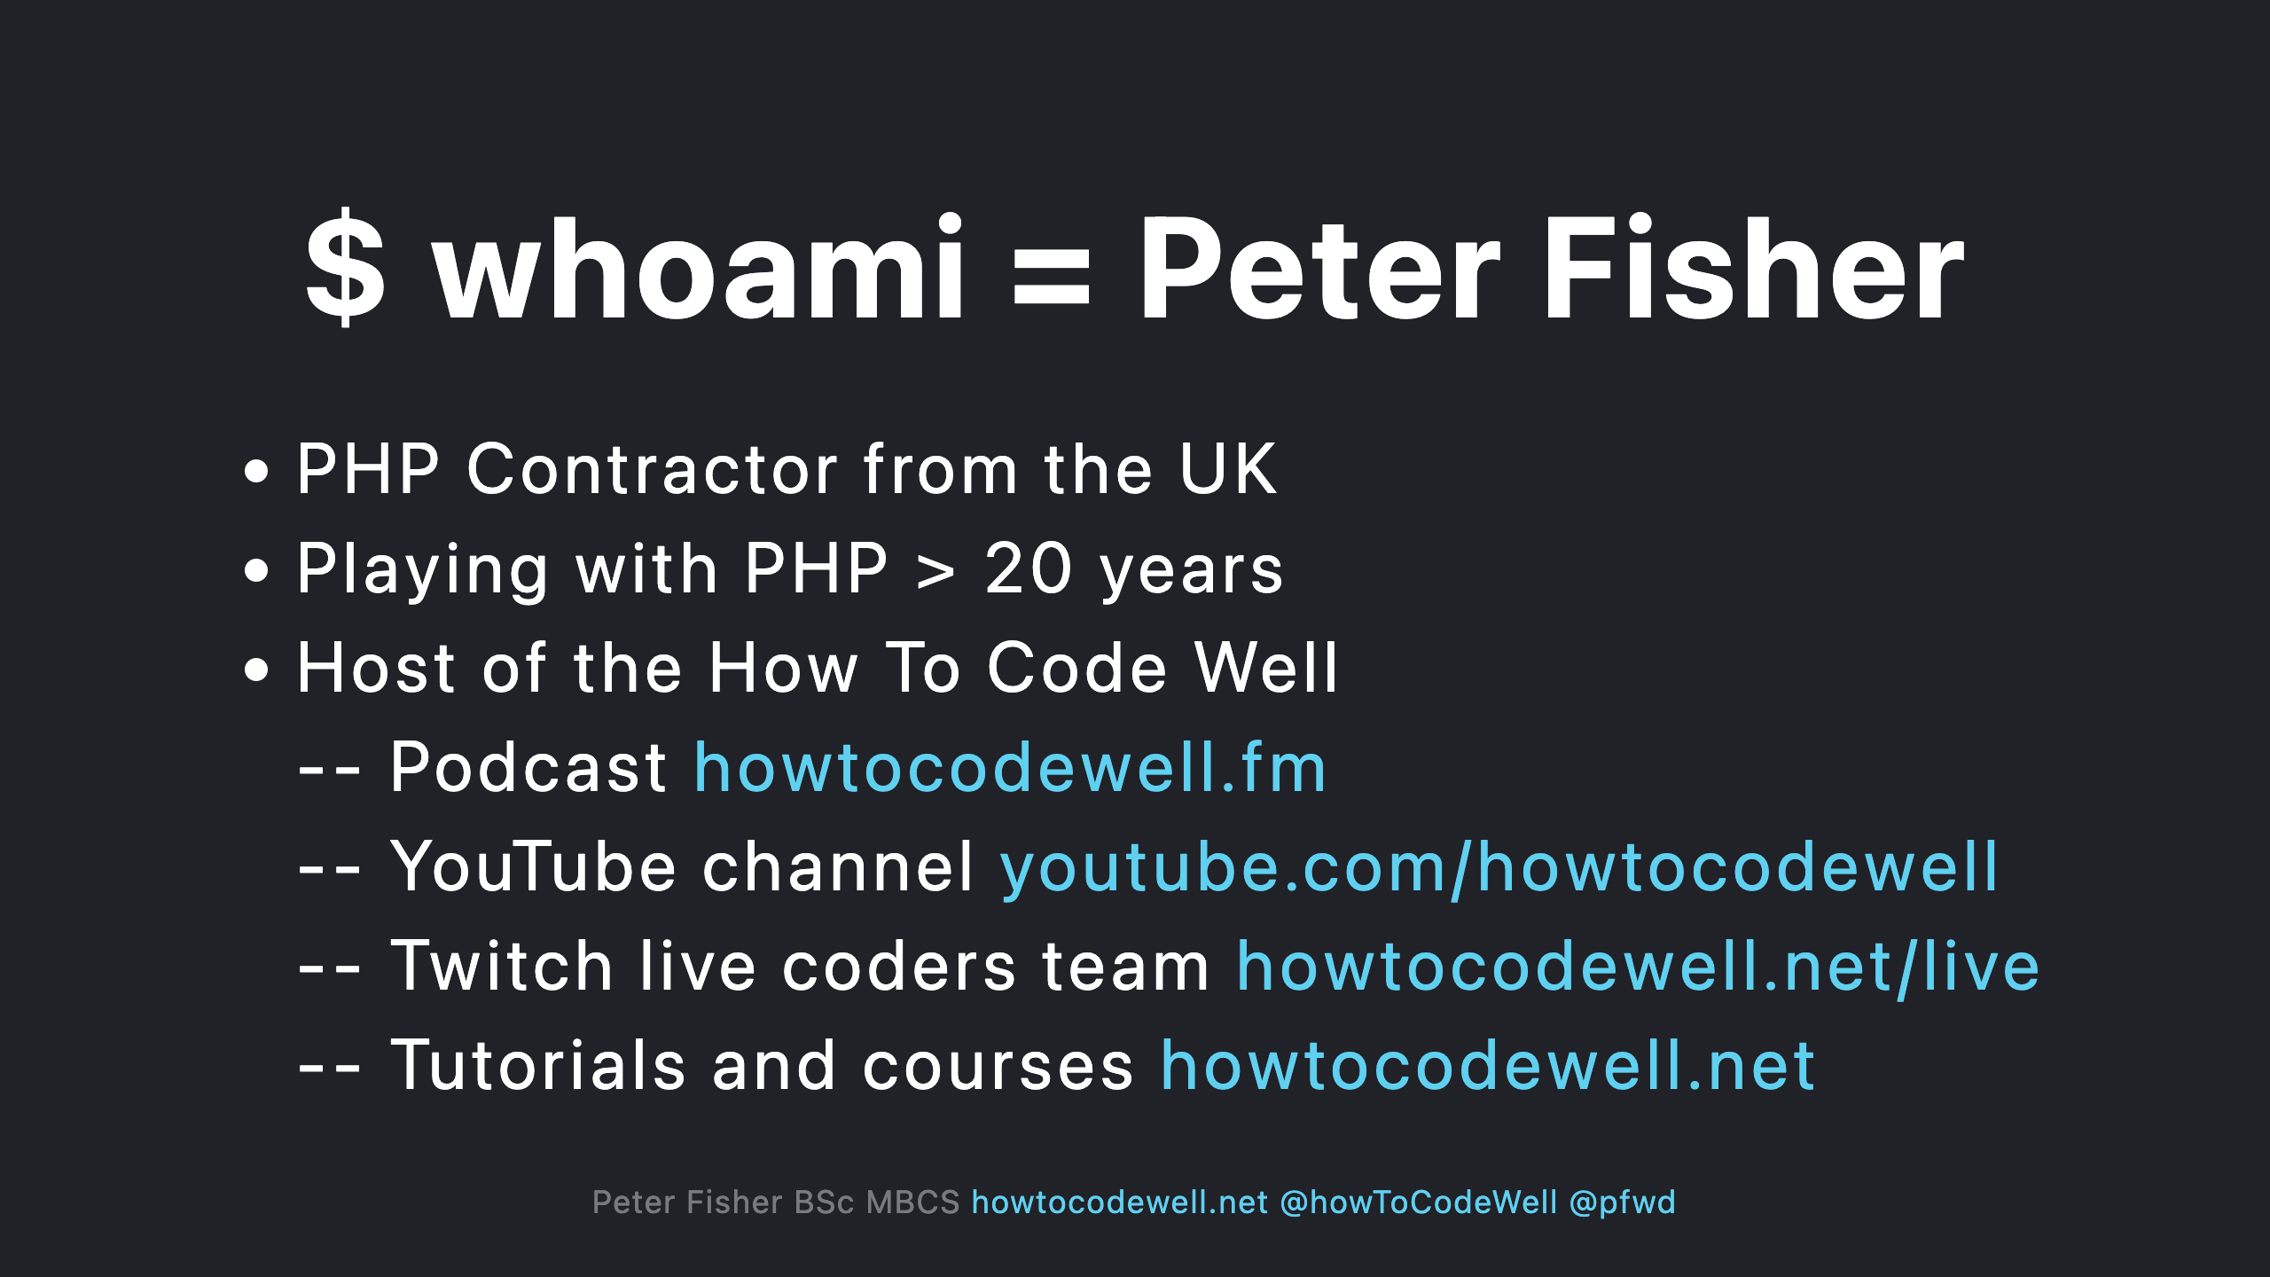

Slide 4
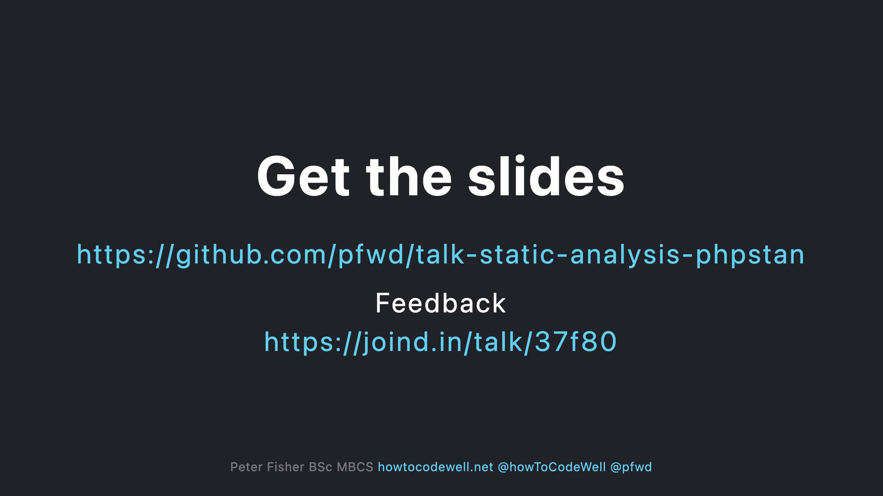

Slide 5
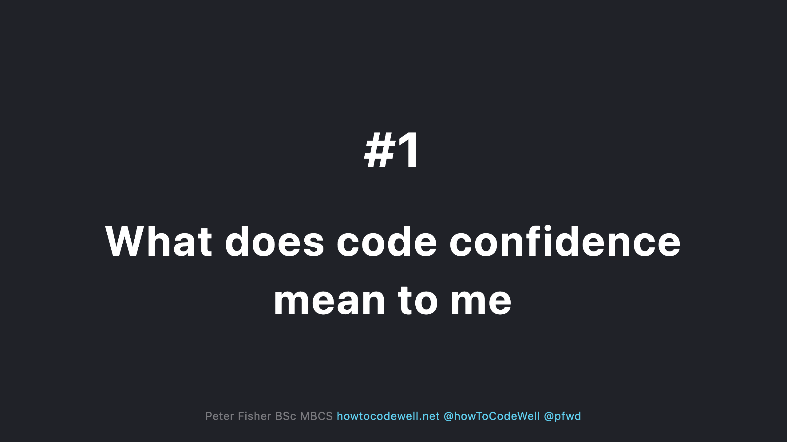

Slide 6
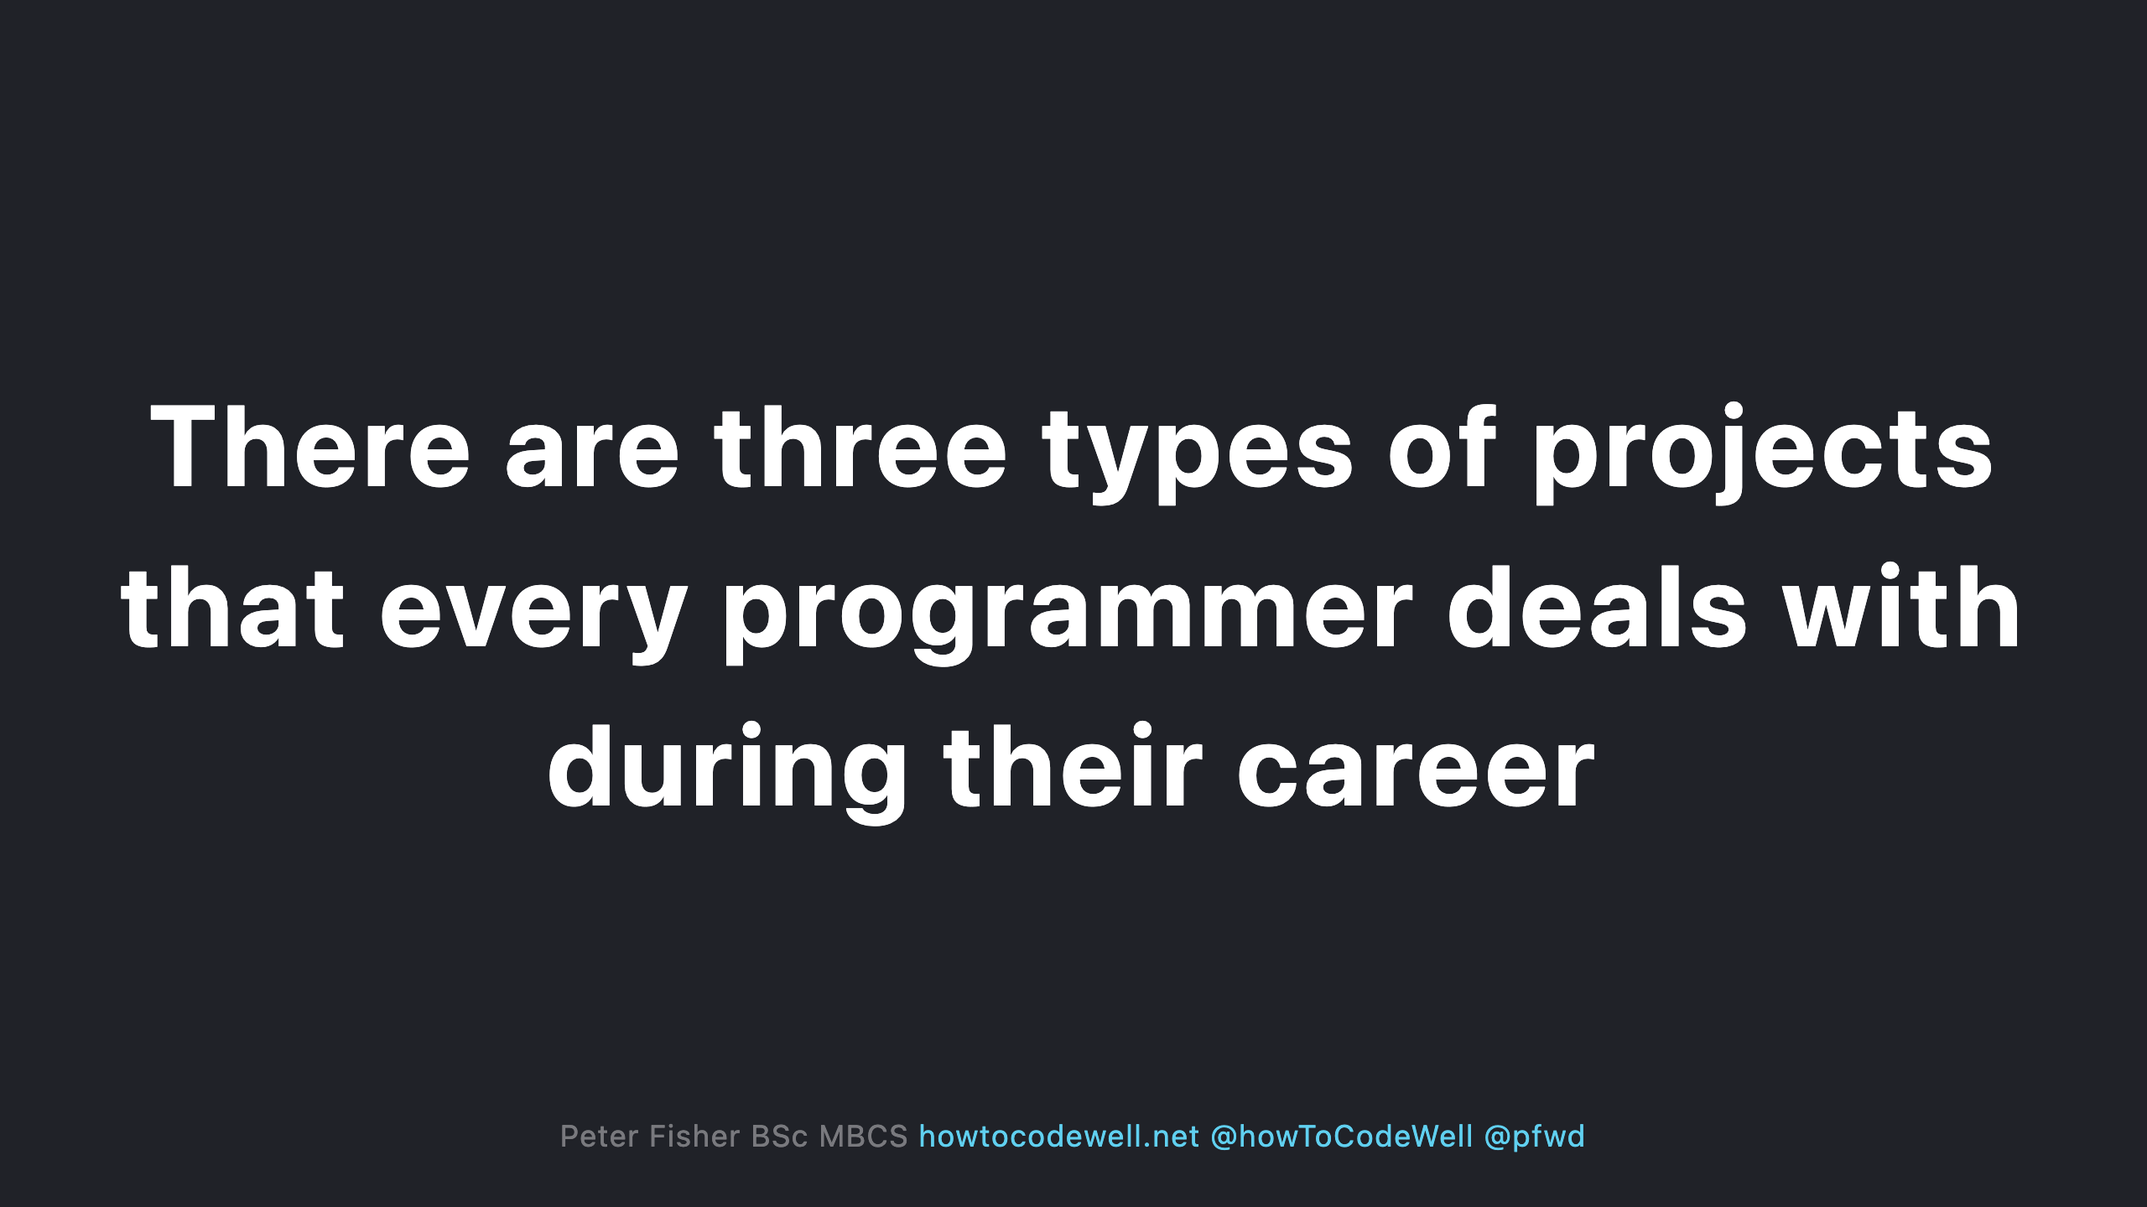

Slide 7
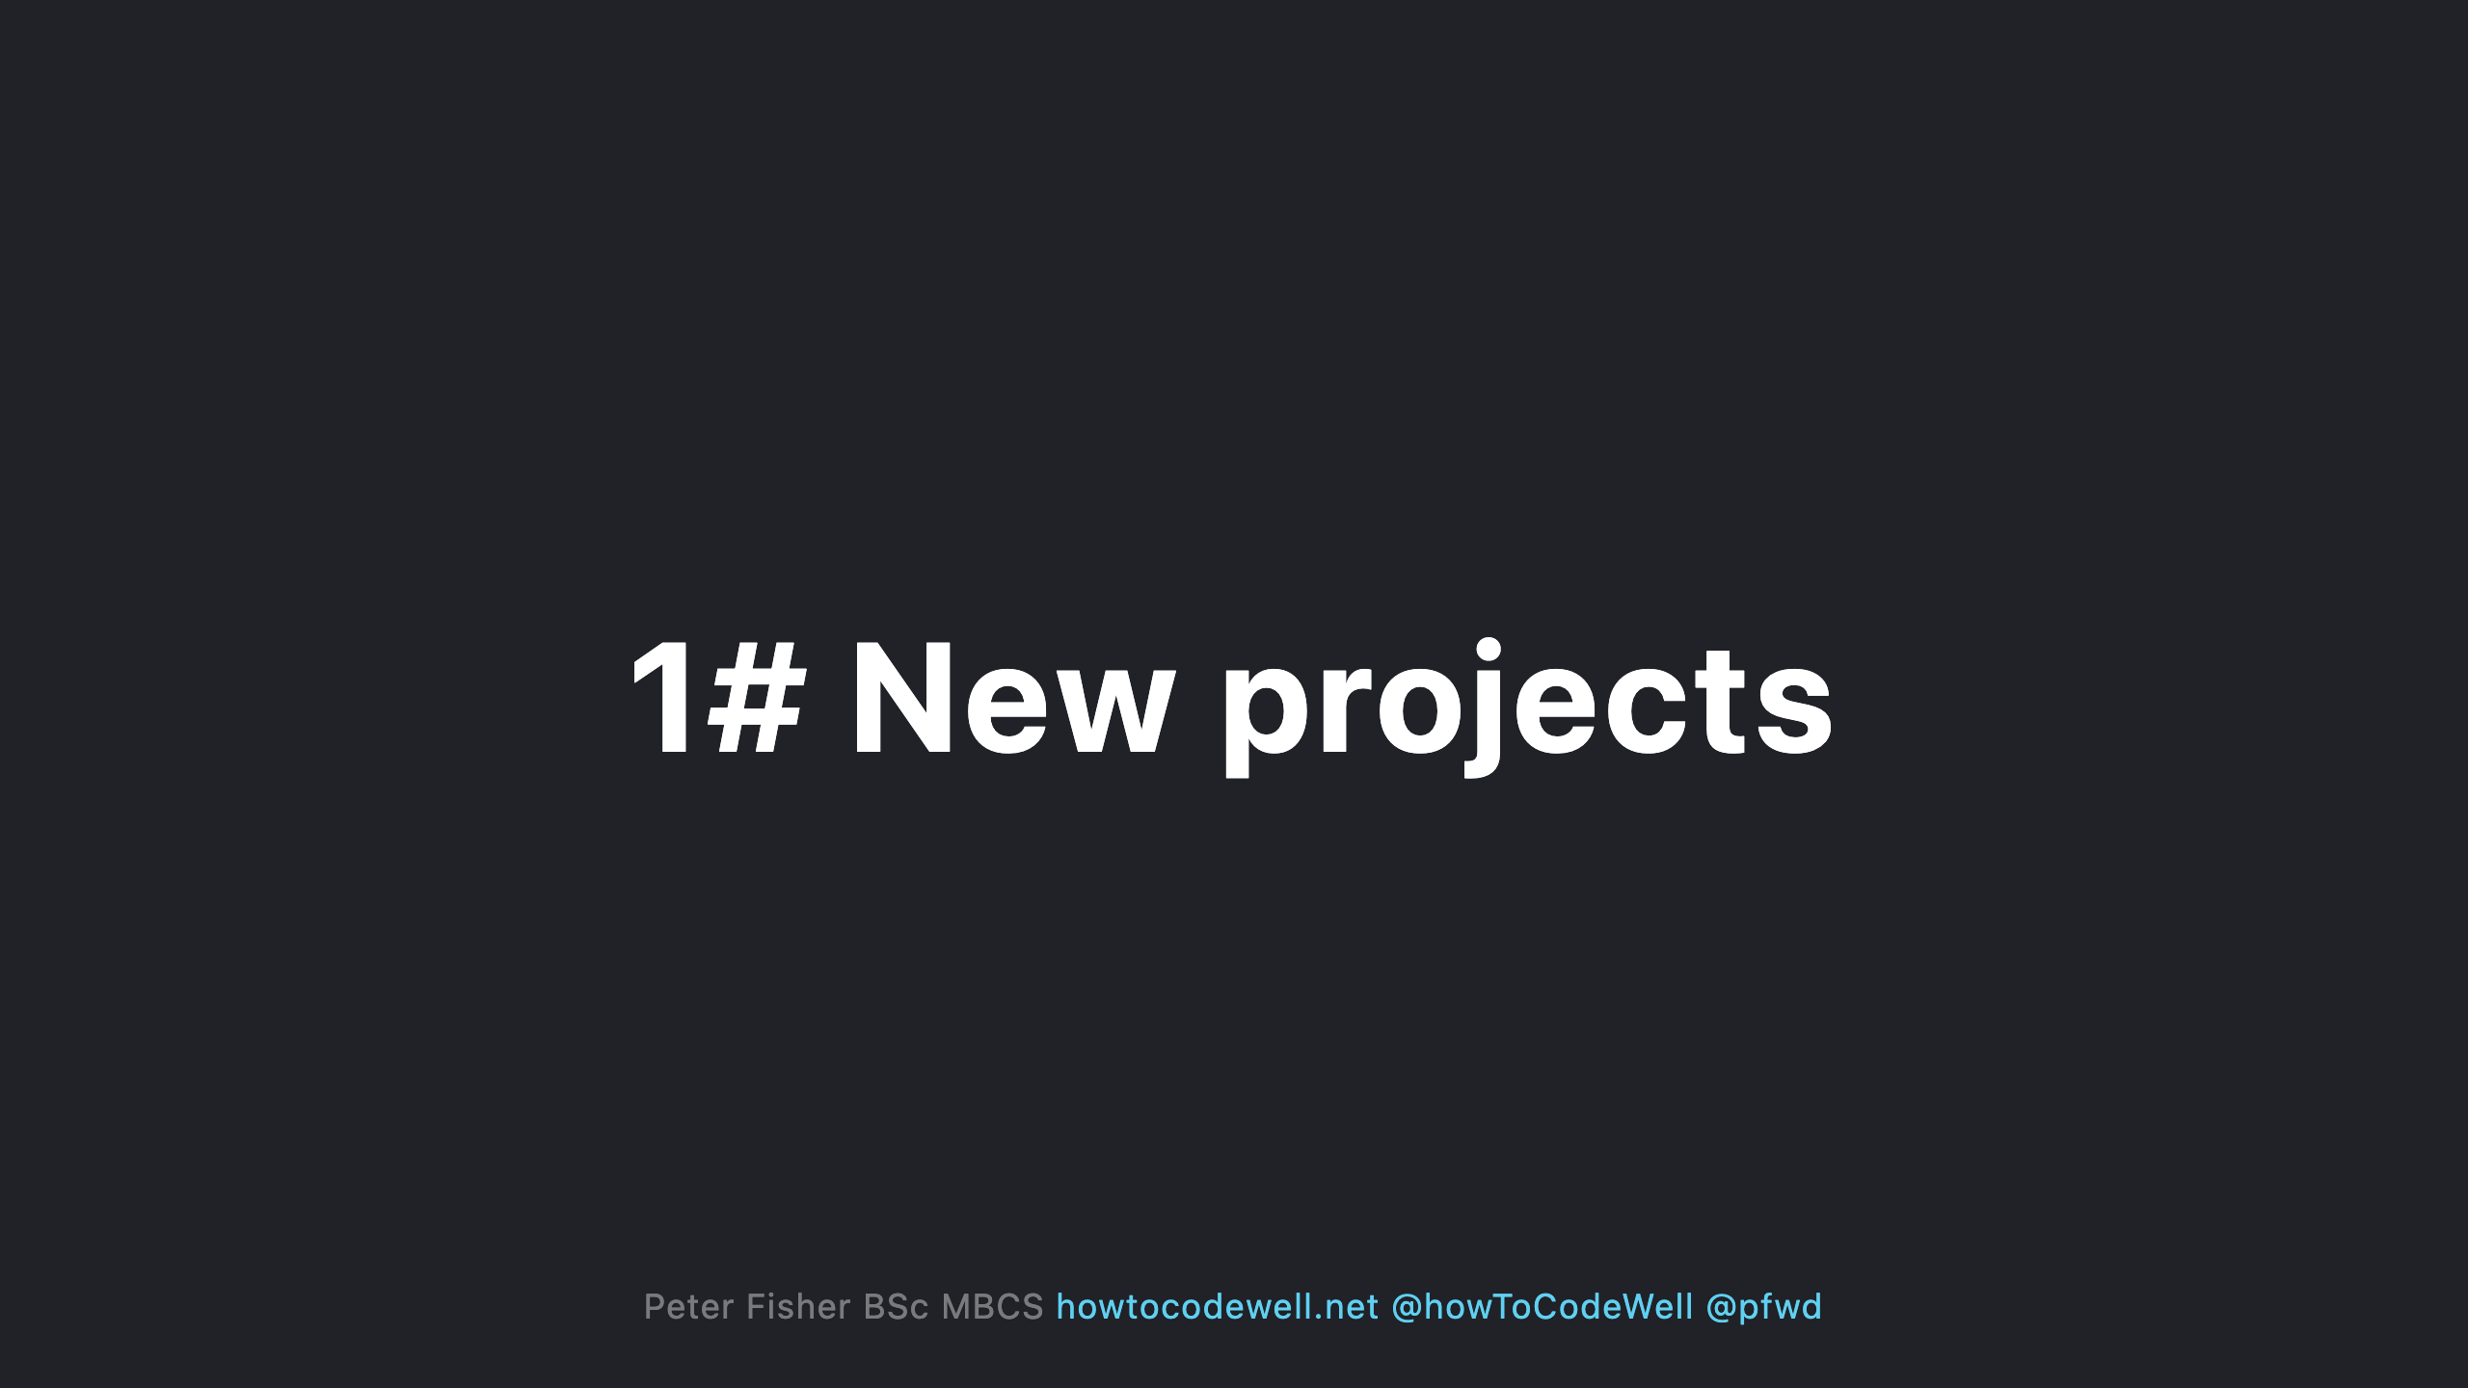
Notes:
- Start from scratch, no code (yet) - No architectural decisions have been made (yet) - No frameworks or library’s chosen (yet) - No bugs (yet) - No end users (yet) - Shopping list of new requirements

Slide 8
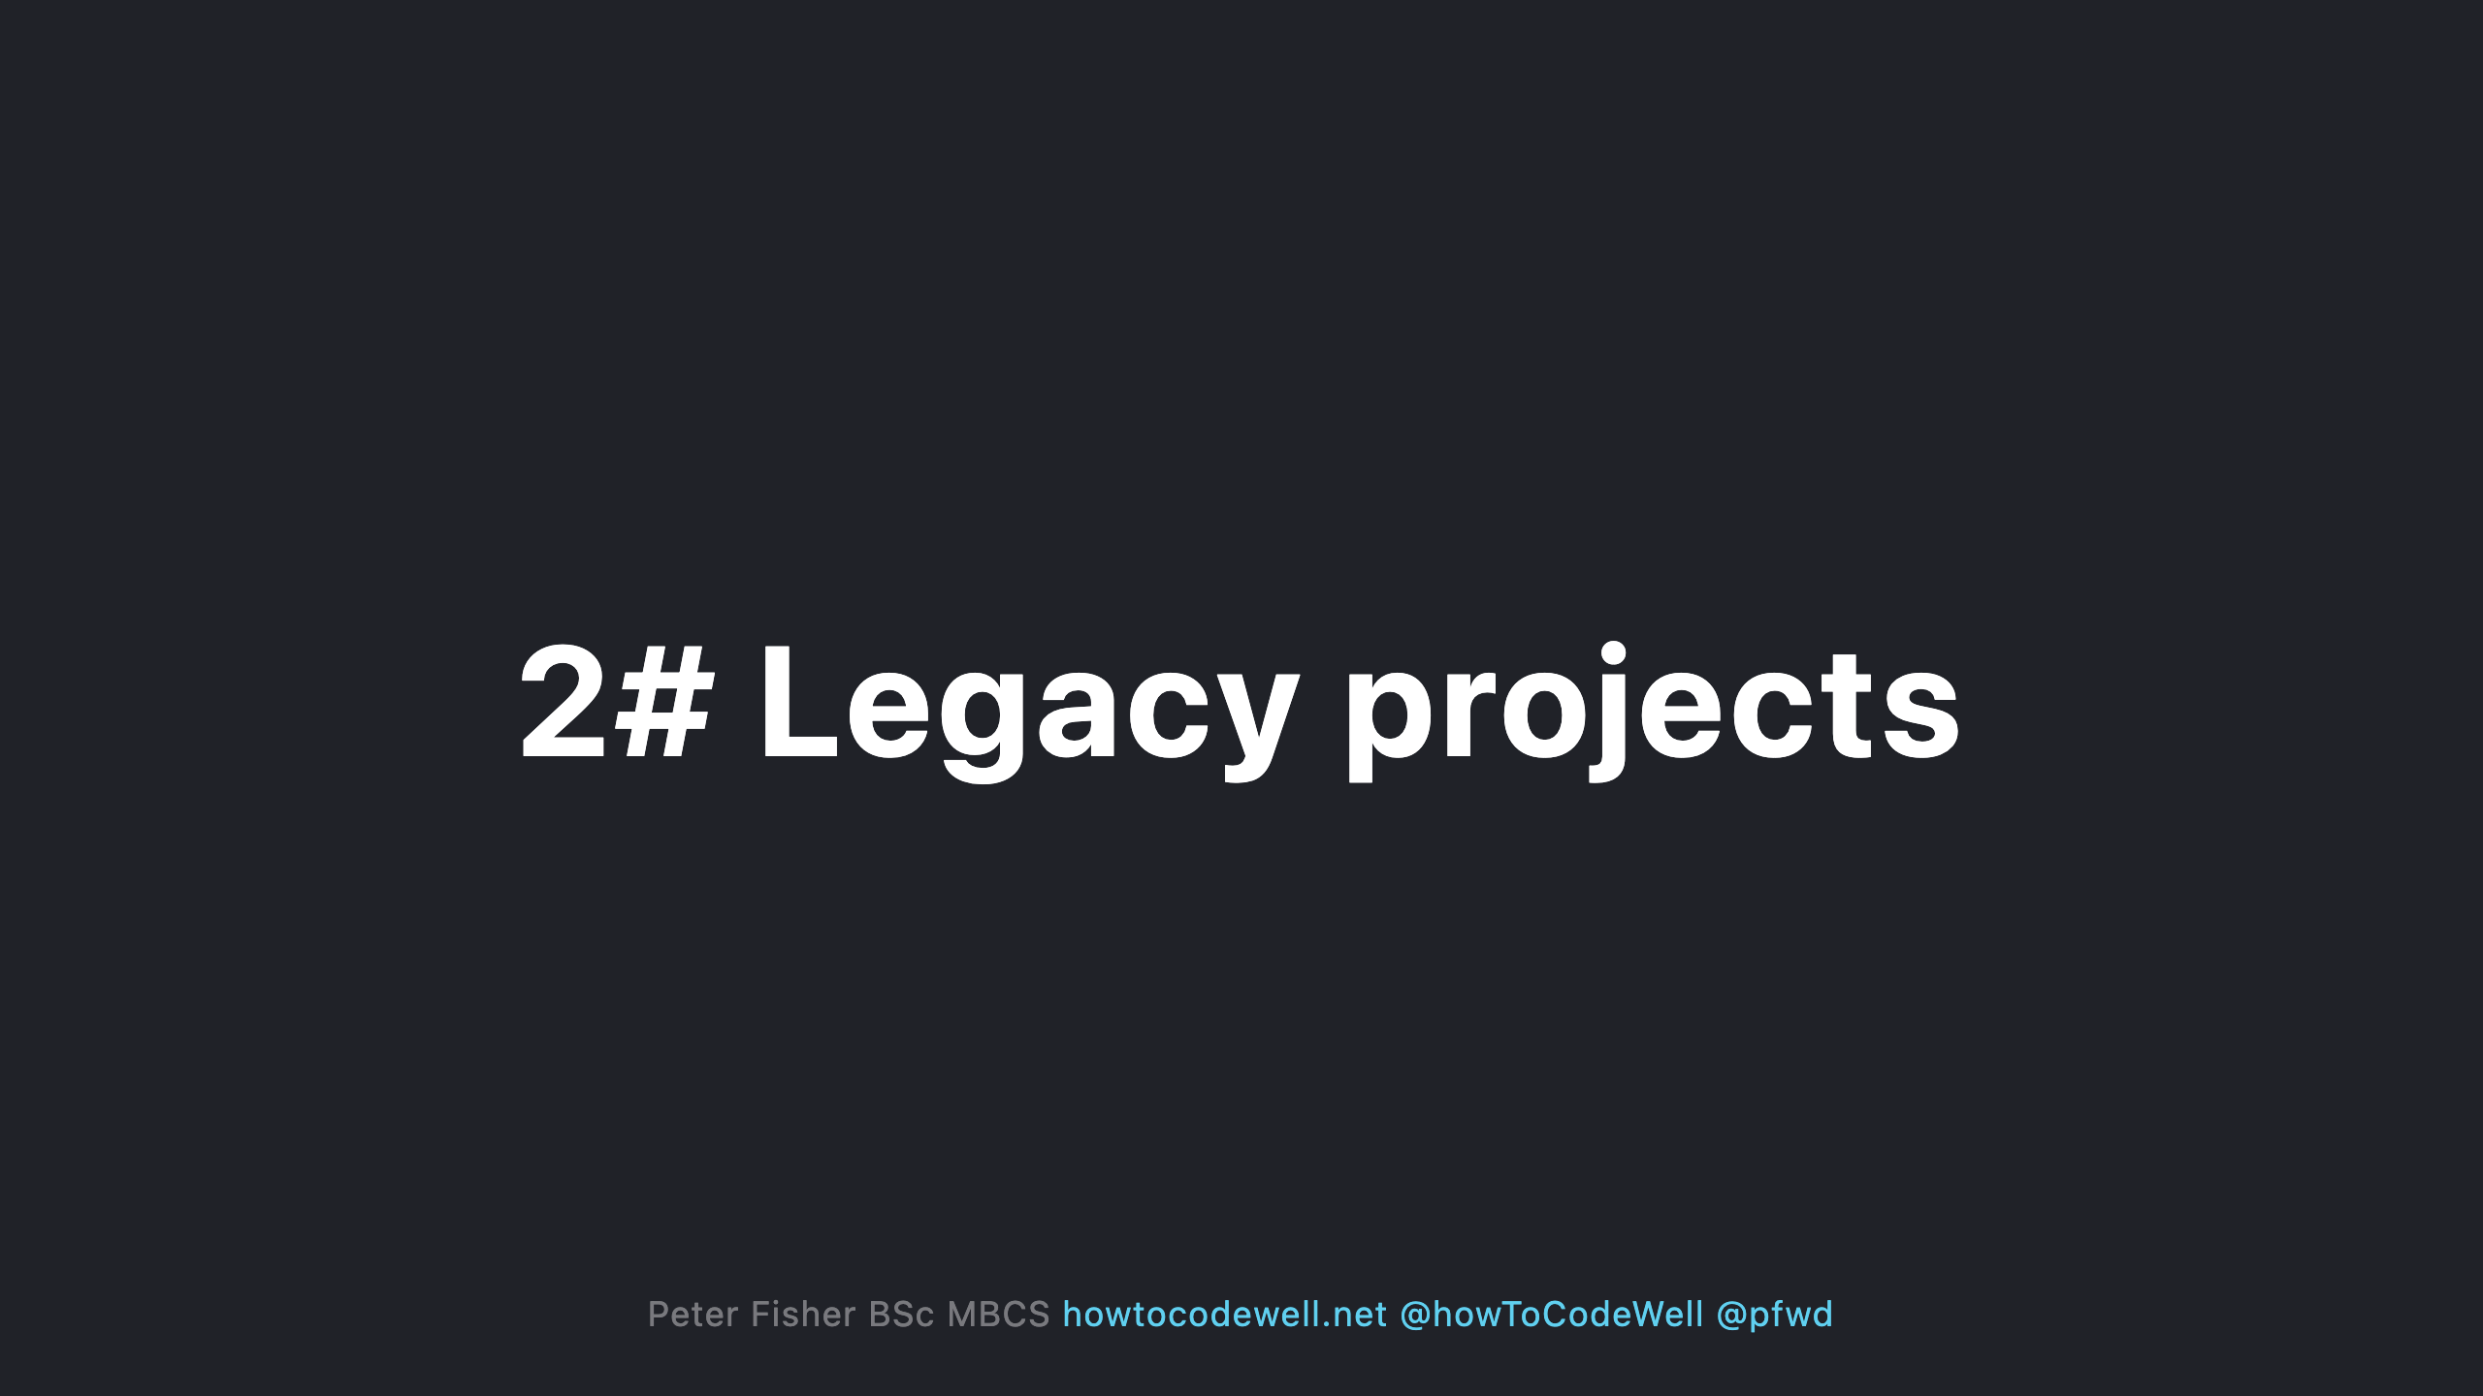
Notes:
- It could be a spaghetti code base - It could have mixture of frameworks and library's - The code could be out of date - It could be using an older version of PHP - It could have incoming change requests - It could have poor technical documentation - There might be 0 tests - There could be lots of known bugs - There could be lots of unknown bugs - There could be many end users. Some might be complaining - There could be performance, security, and data integrity issues - You could have a low confidence that an upgrading or improving something will work

Slide 9
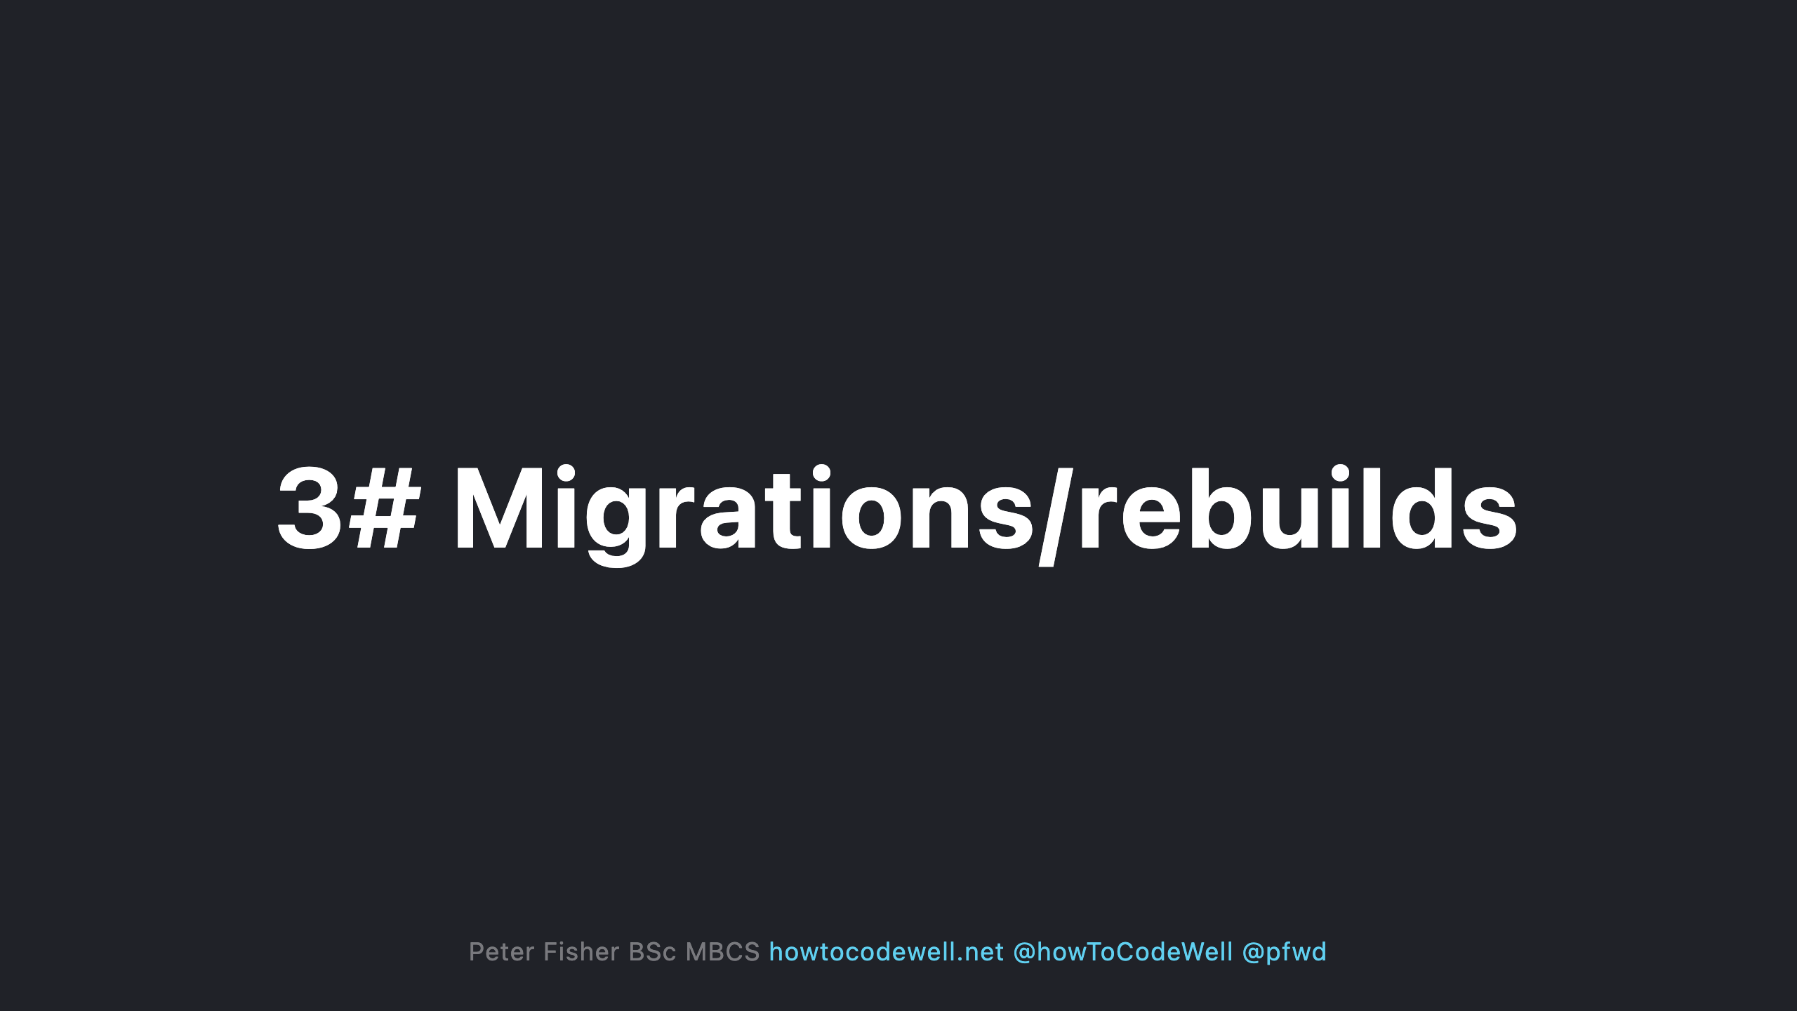
Notes:
- Data integrity could be poor - Existing user base - Downtime issues - There could be many reasons why a migration is needed - Work arounds

Slide 10


Slide 11
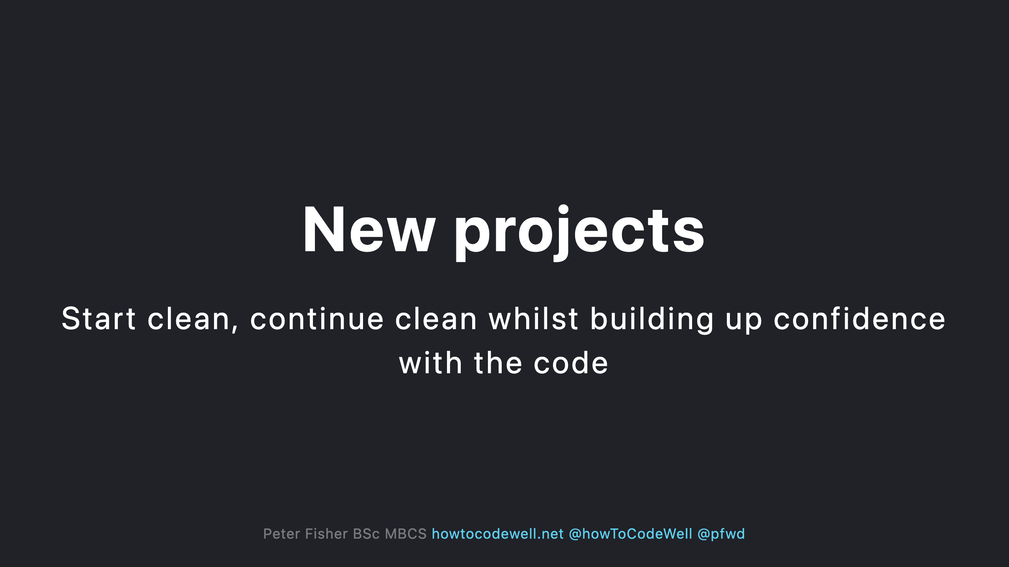
Notes:
- Be aware of known issues before 1st deployment - Gain visual feedback on what parts of code needs to be fixed - Spot potential gotchas in the new architecture - Create a CI that reports errors quickly - Ensure the team follows the same rules - Move quickly whilst building stability

Slide 12
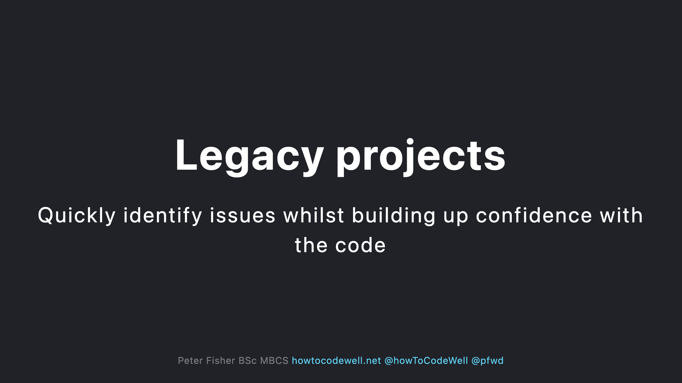
Notes:
- Be aware of known issues before deployment - Clean up existing code smells - Enforce coding standards and rules in the CI - Standardize the codebase - Make the devs happy

Slide 13
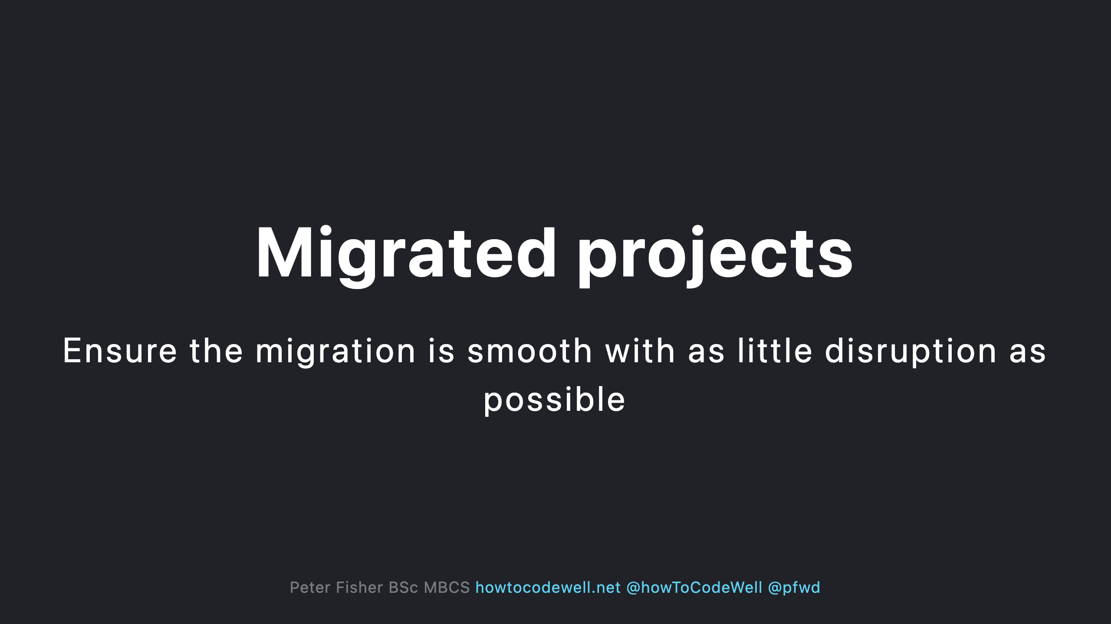
Notes:
- End users should only experience positive changes - Be aware of the risky areas - Keep data secure

Slide 14
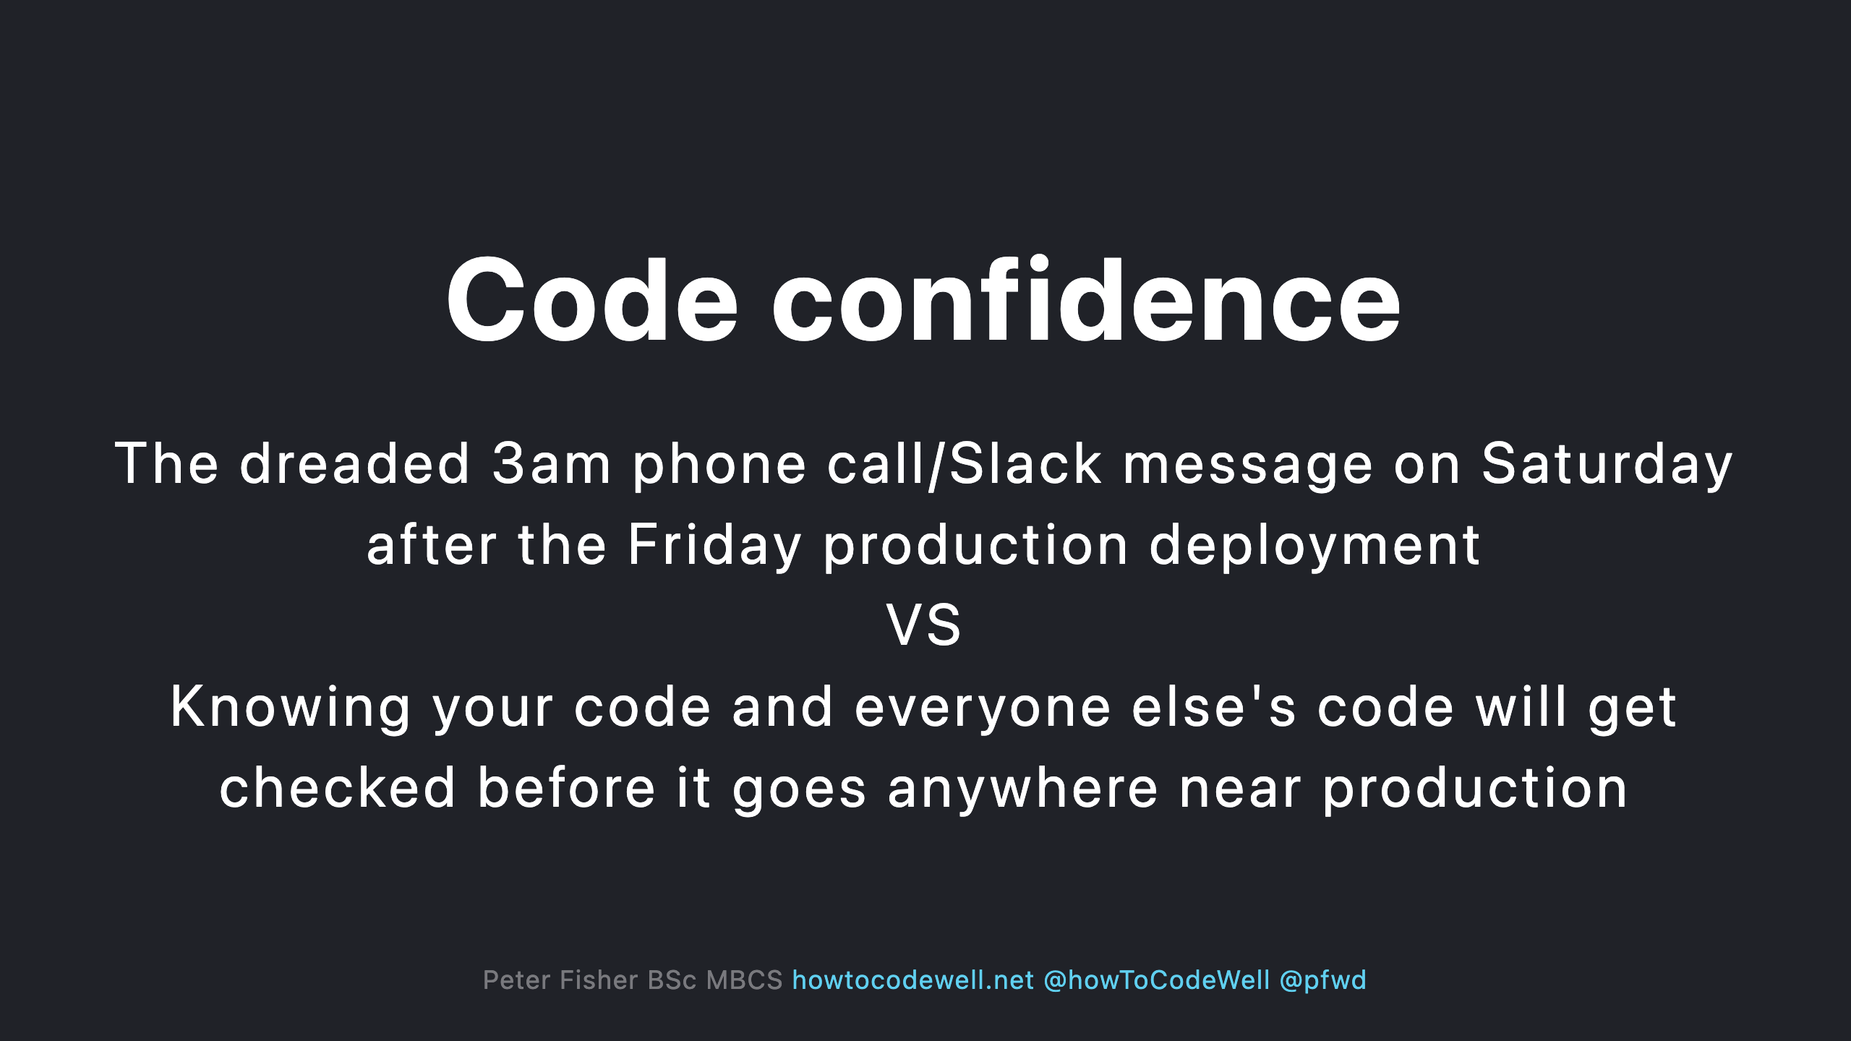

Slide 15
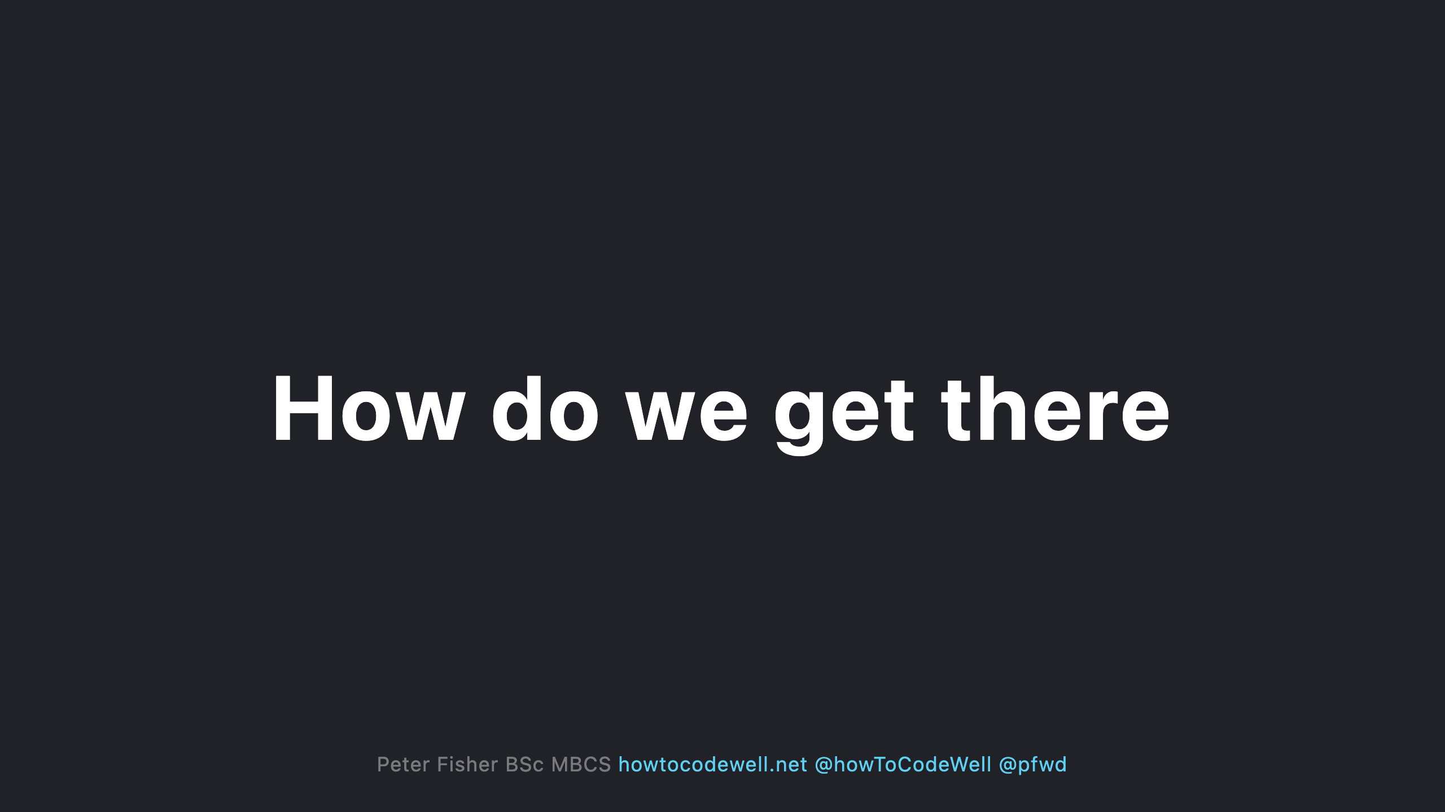

Slide 16

Notes:
- Static Analysis is just one of many tools - PHP mess detection - PHP code sniffers - PHP unit tests

Slide 17
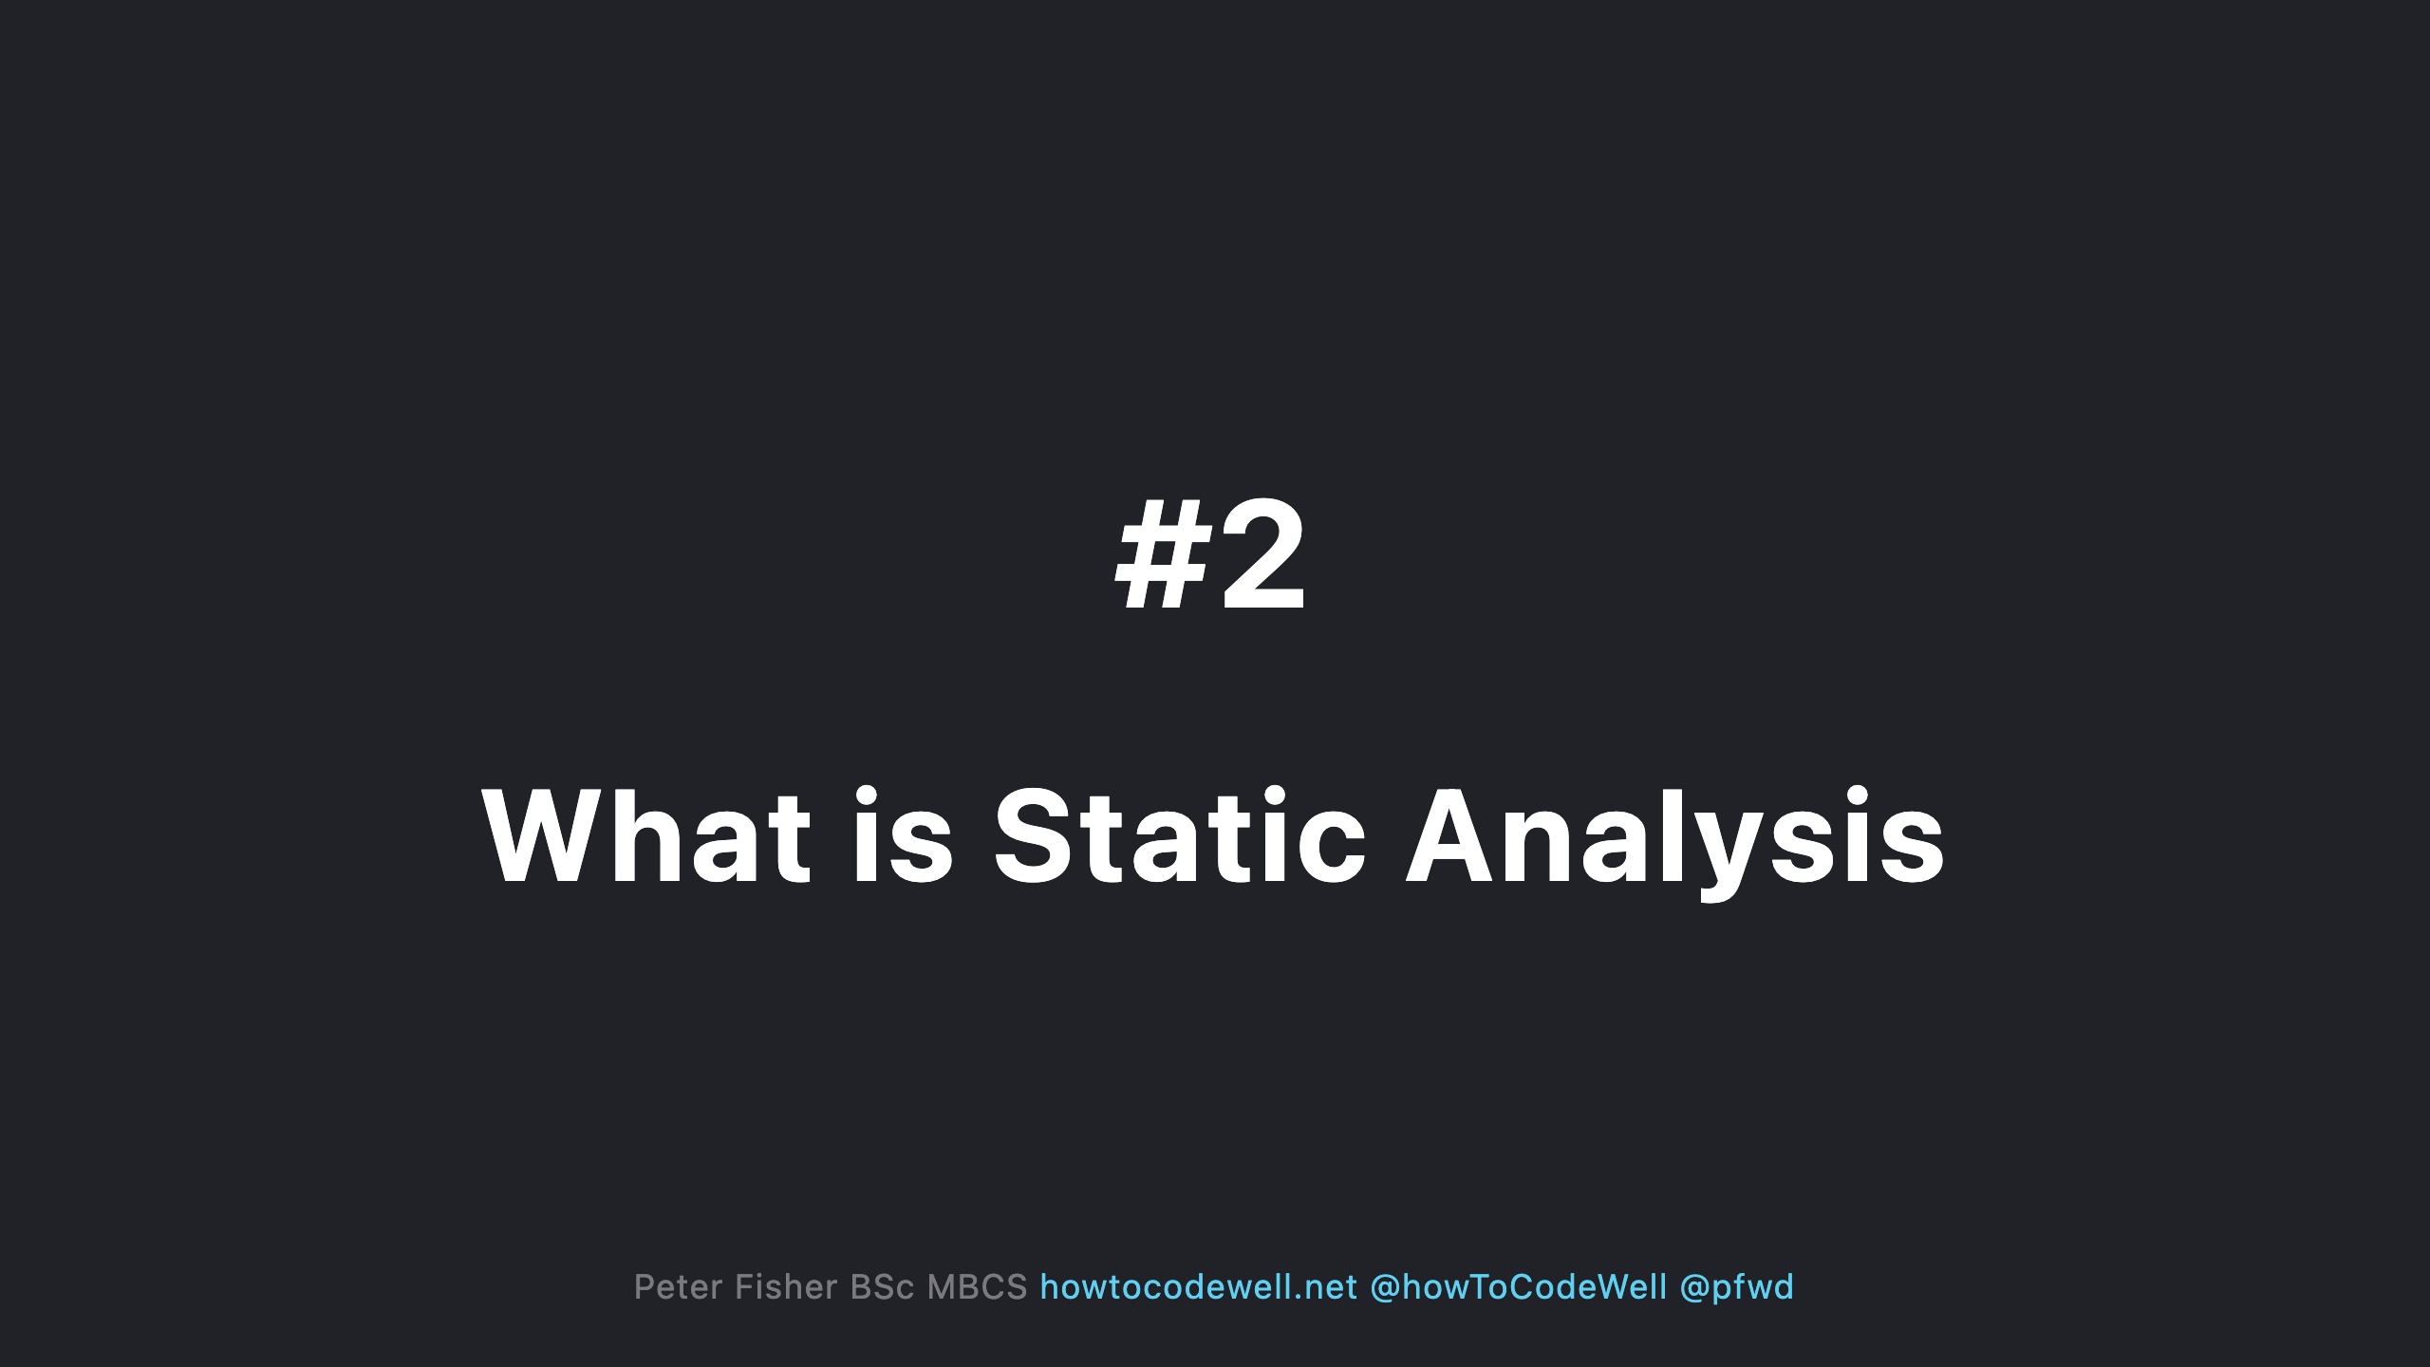

Slide 18
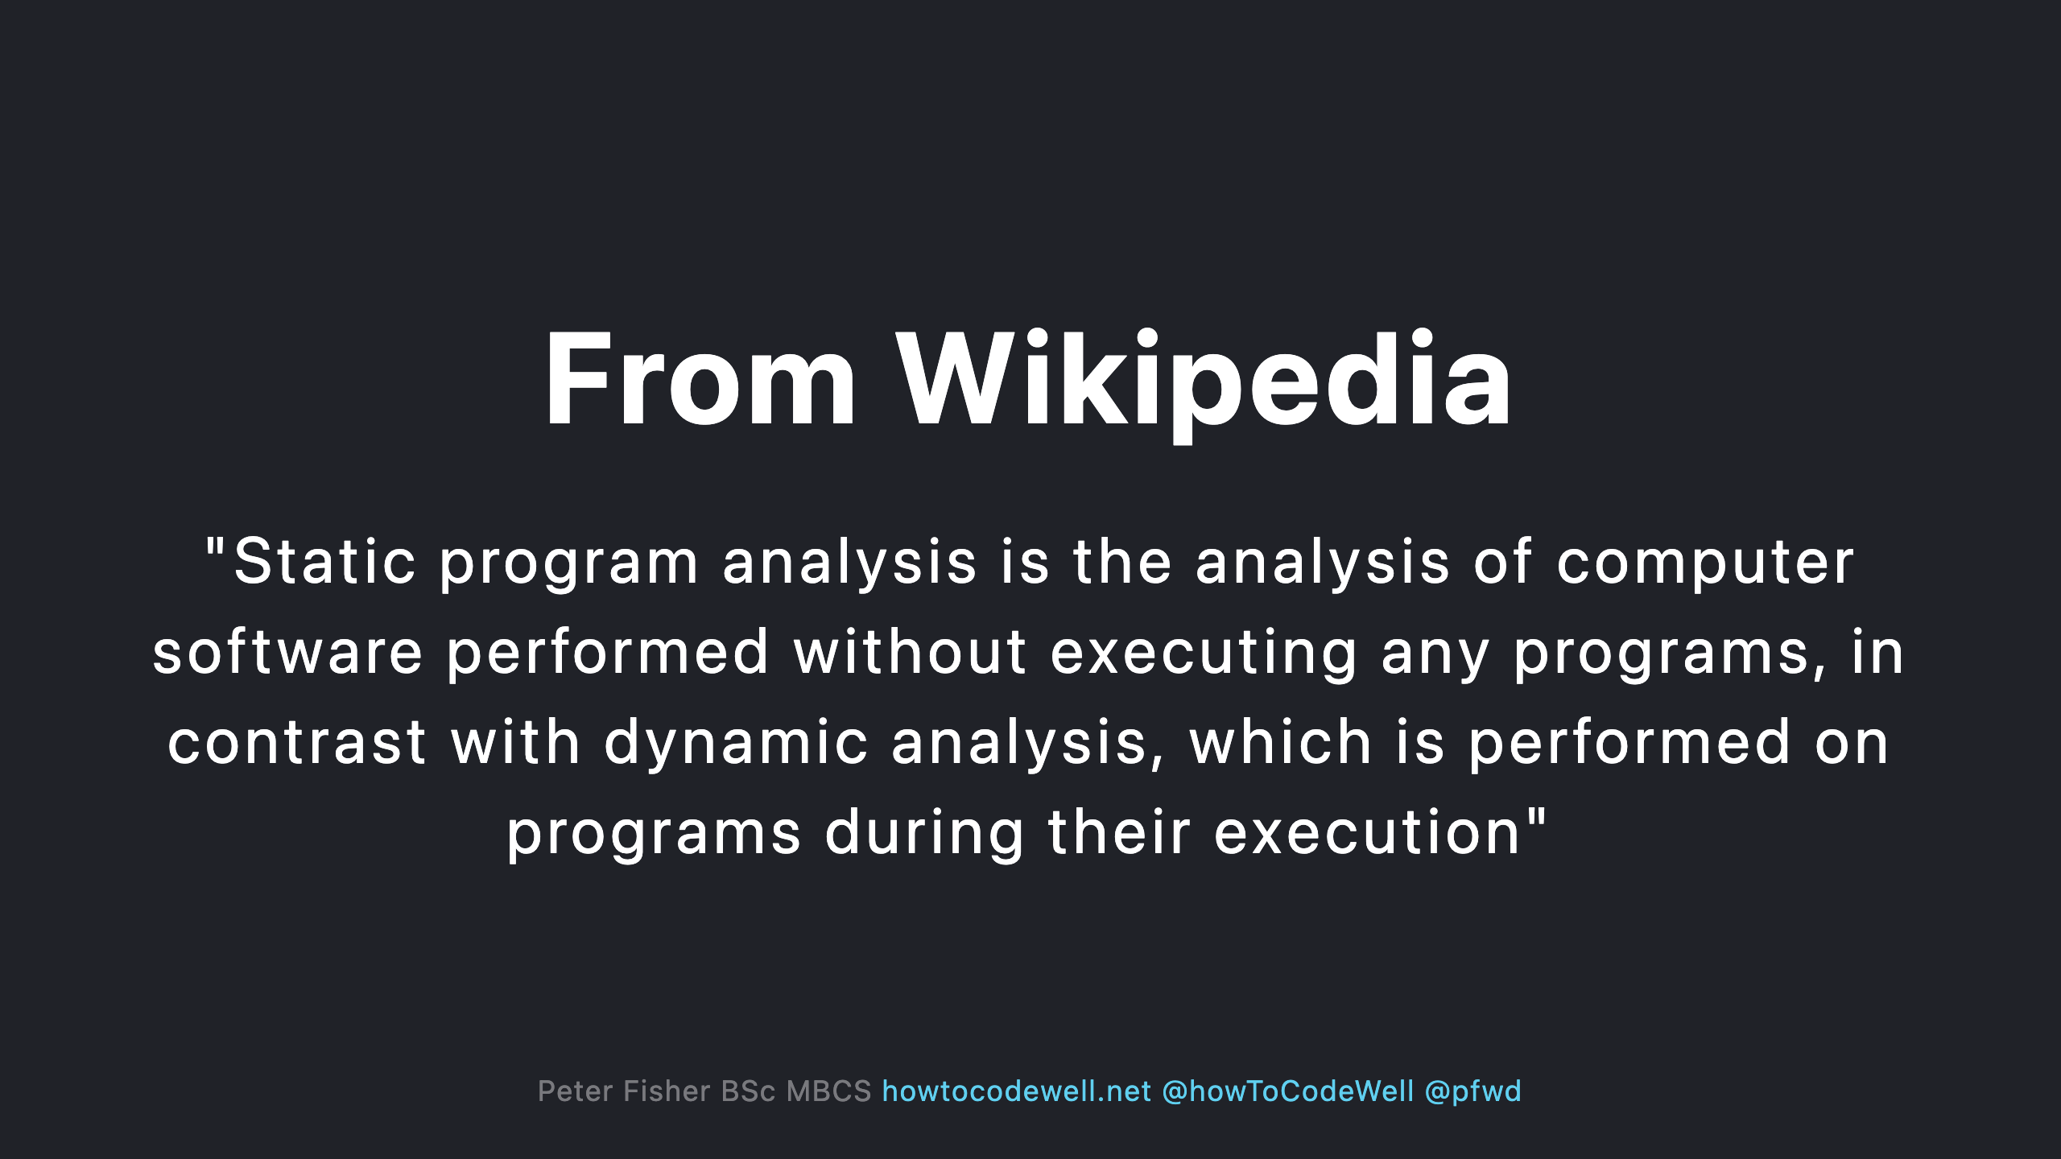

Slide 19
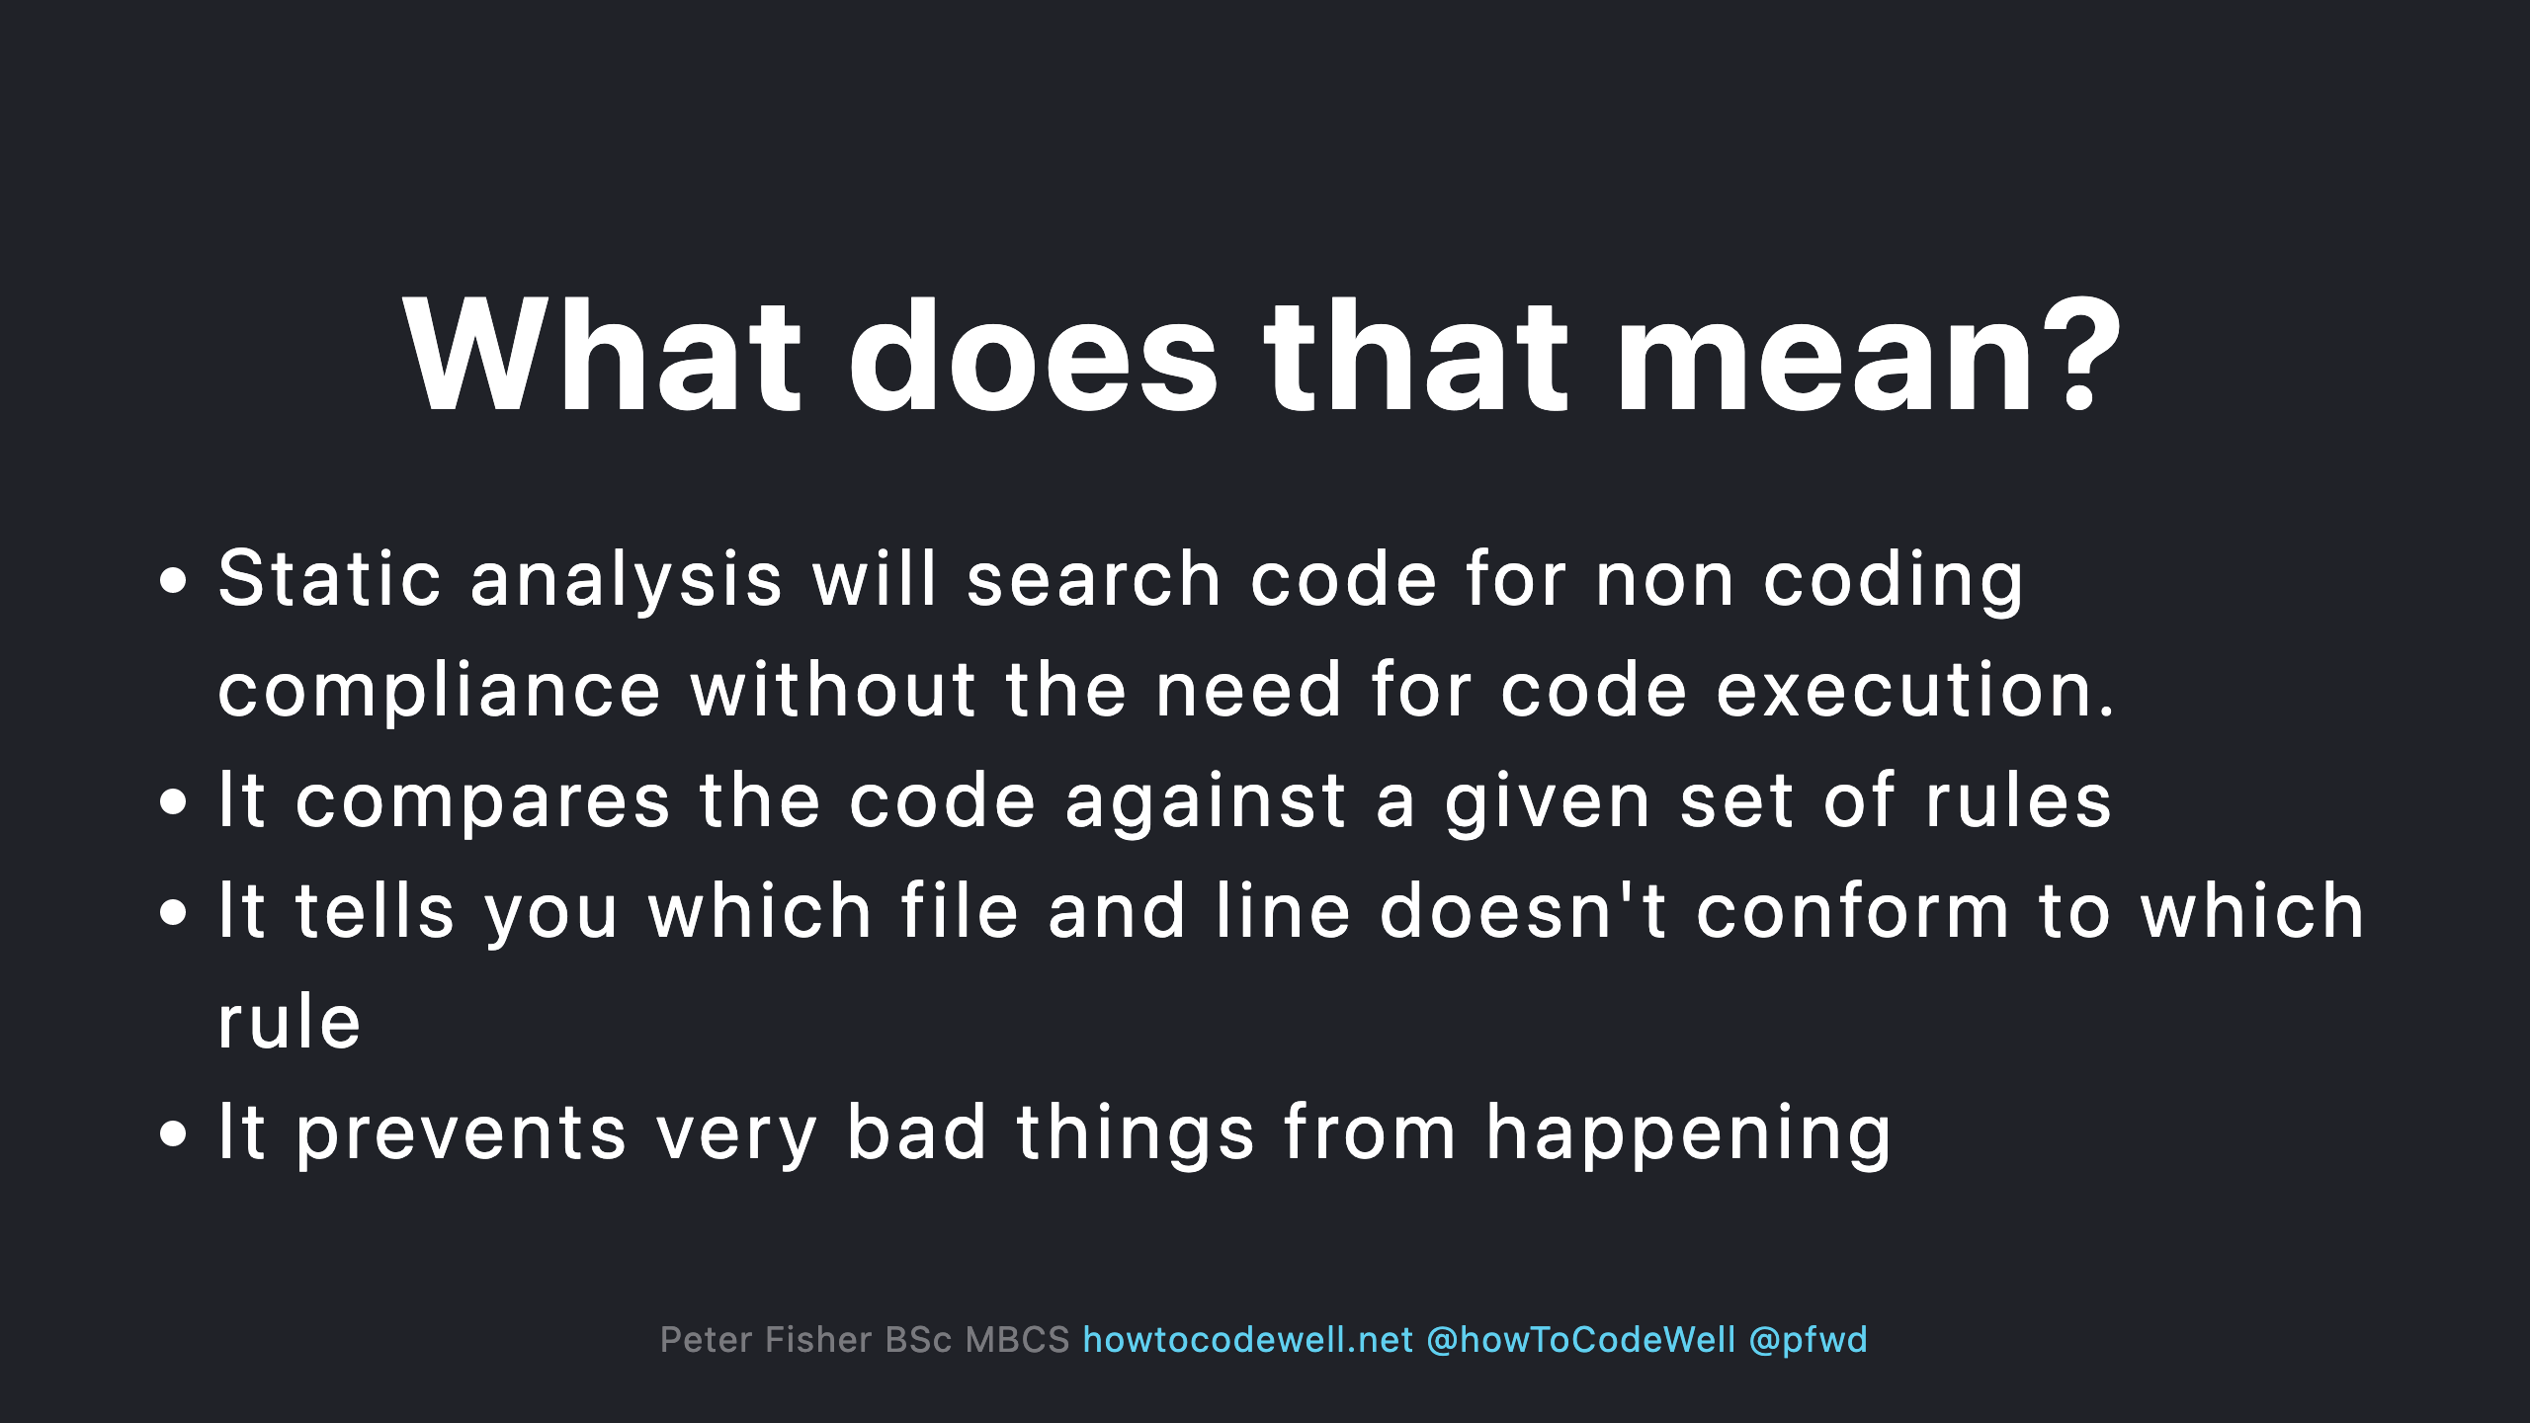

Slide 20
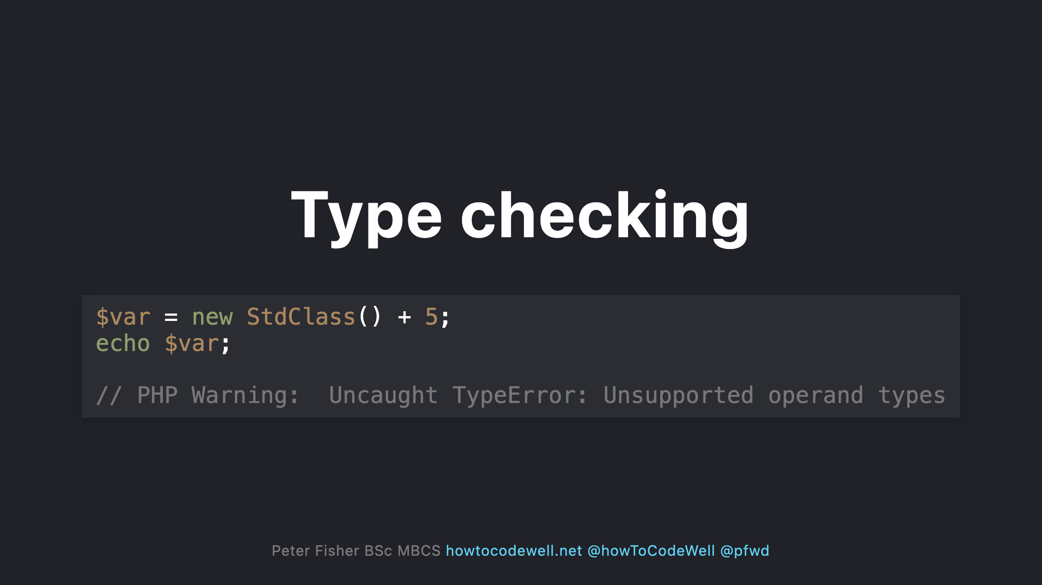

Slide 21
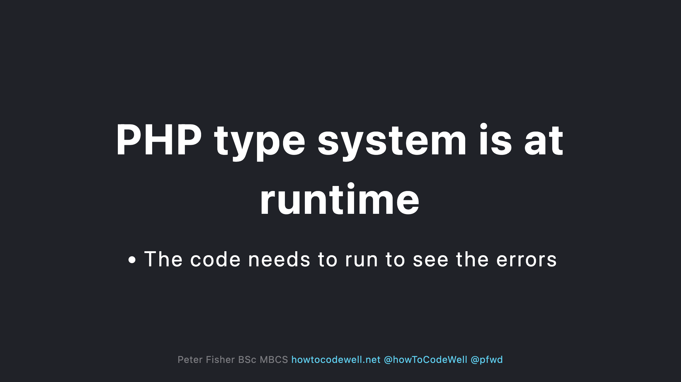

Slide 22
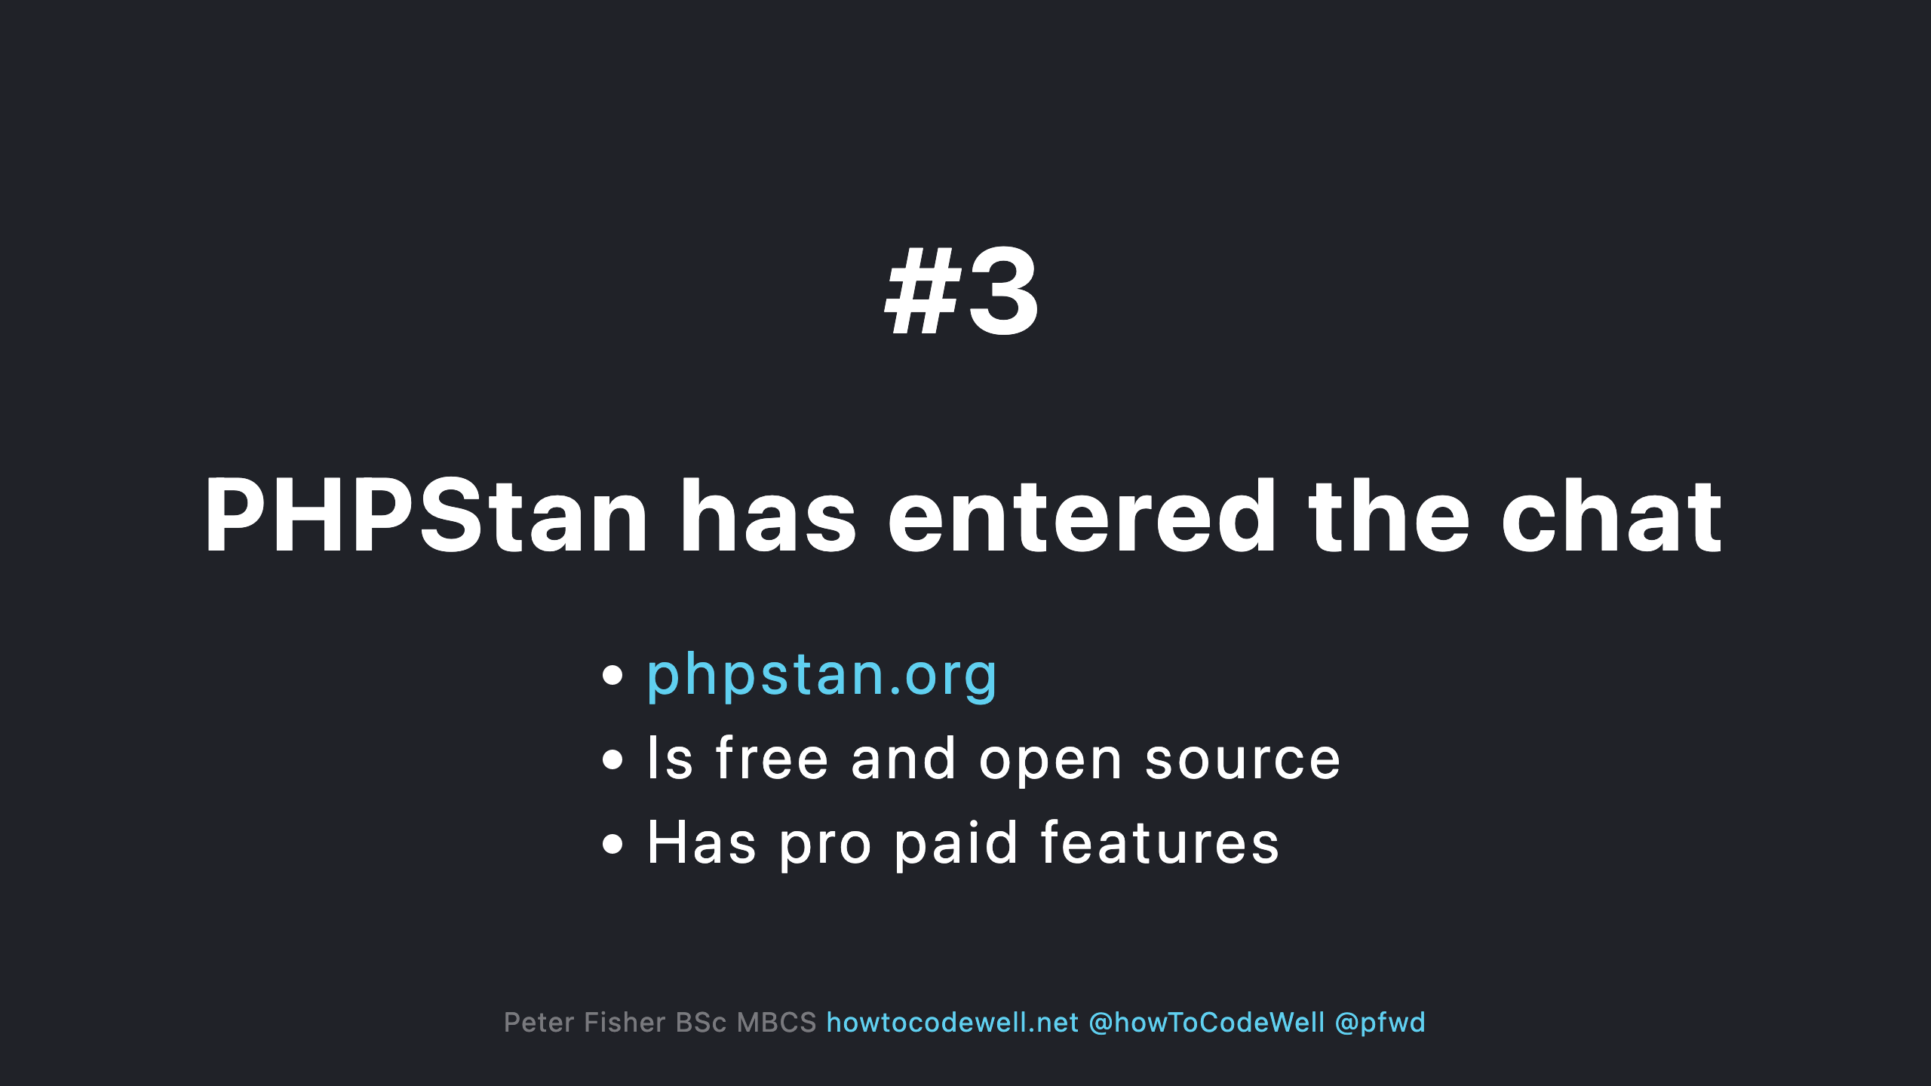

Slide 23
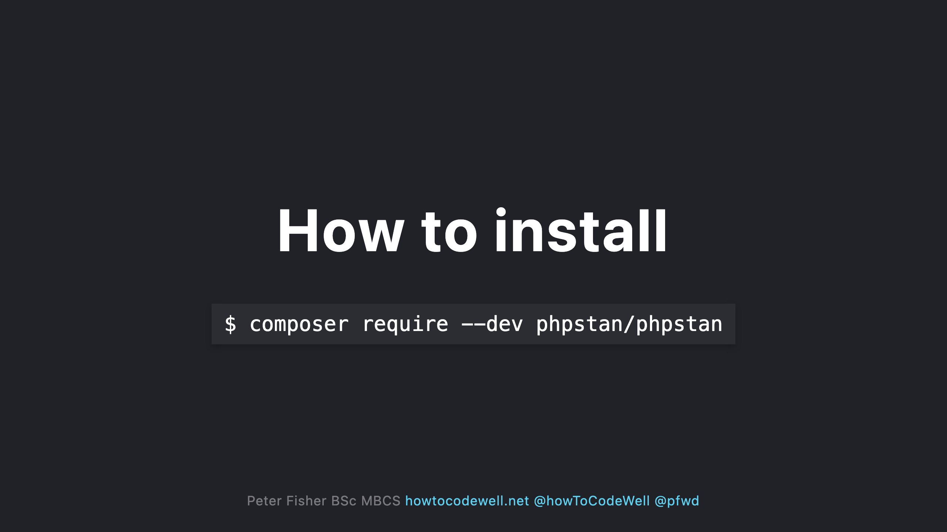
Notes:
- PHPStan should be a dev dependency. Don't install it in production

Slide 24
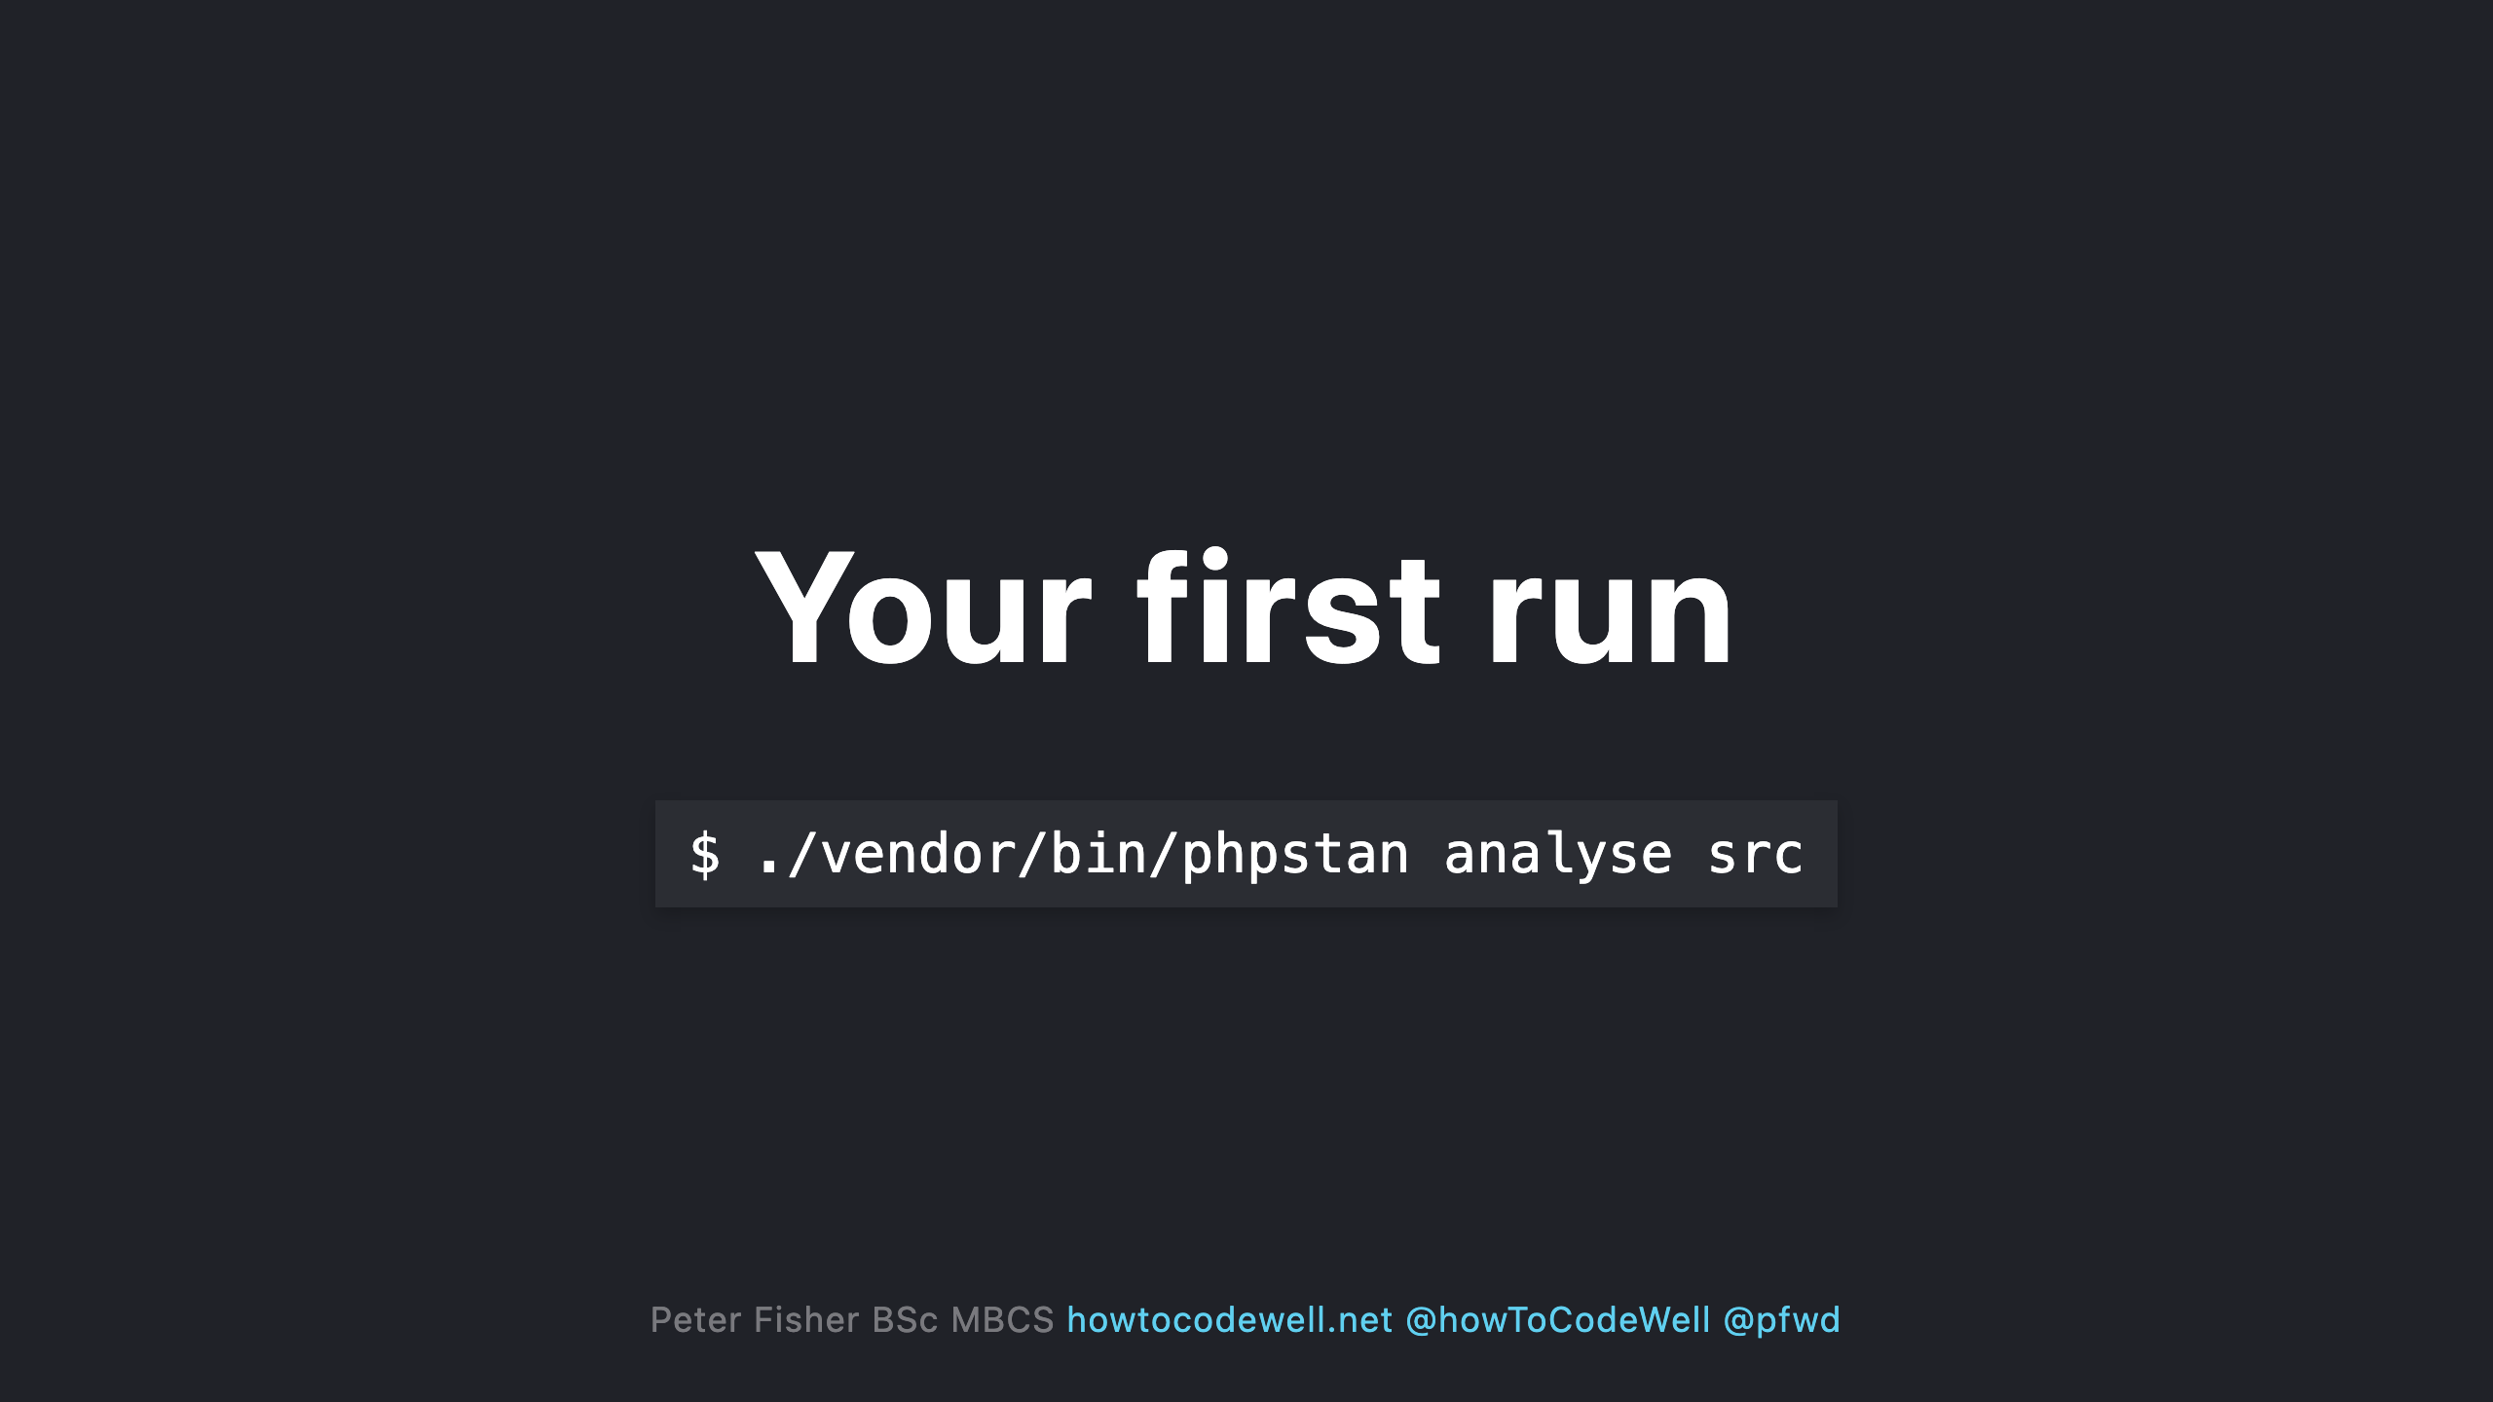
Notes:
- You can provide multiple folders or files to analyse in the command

Slide 25
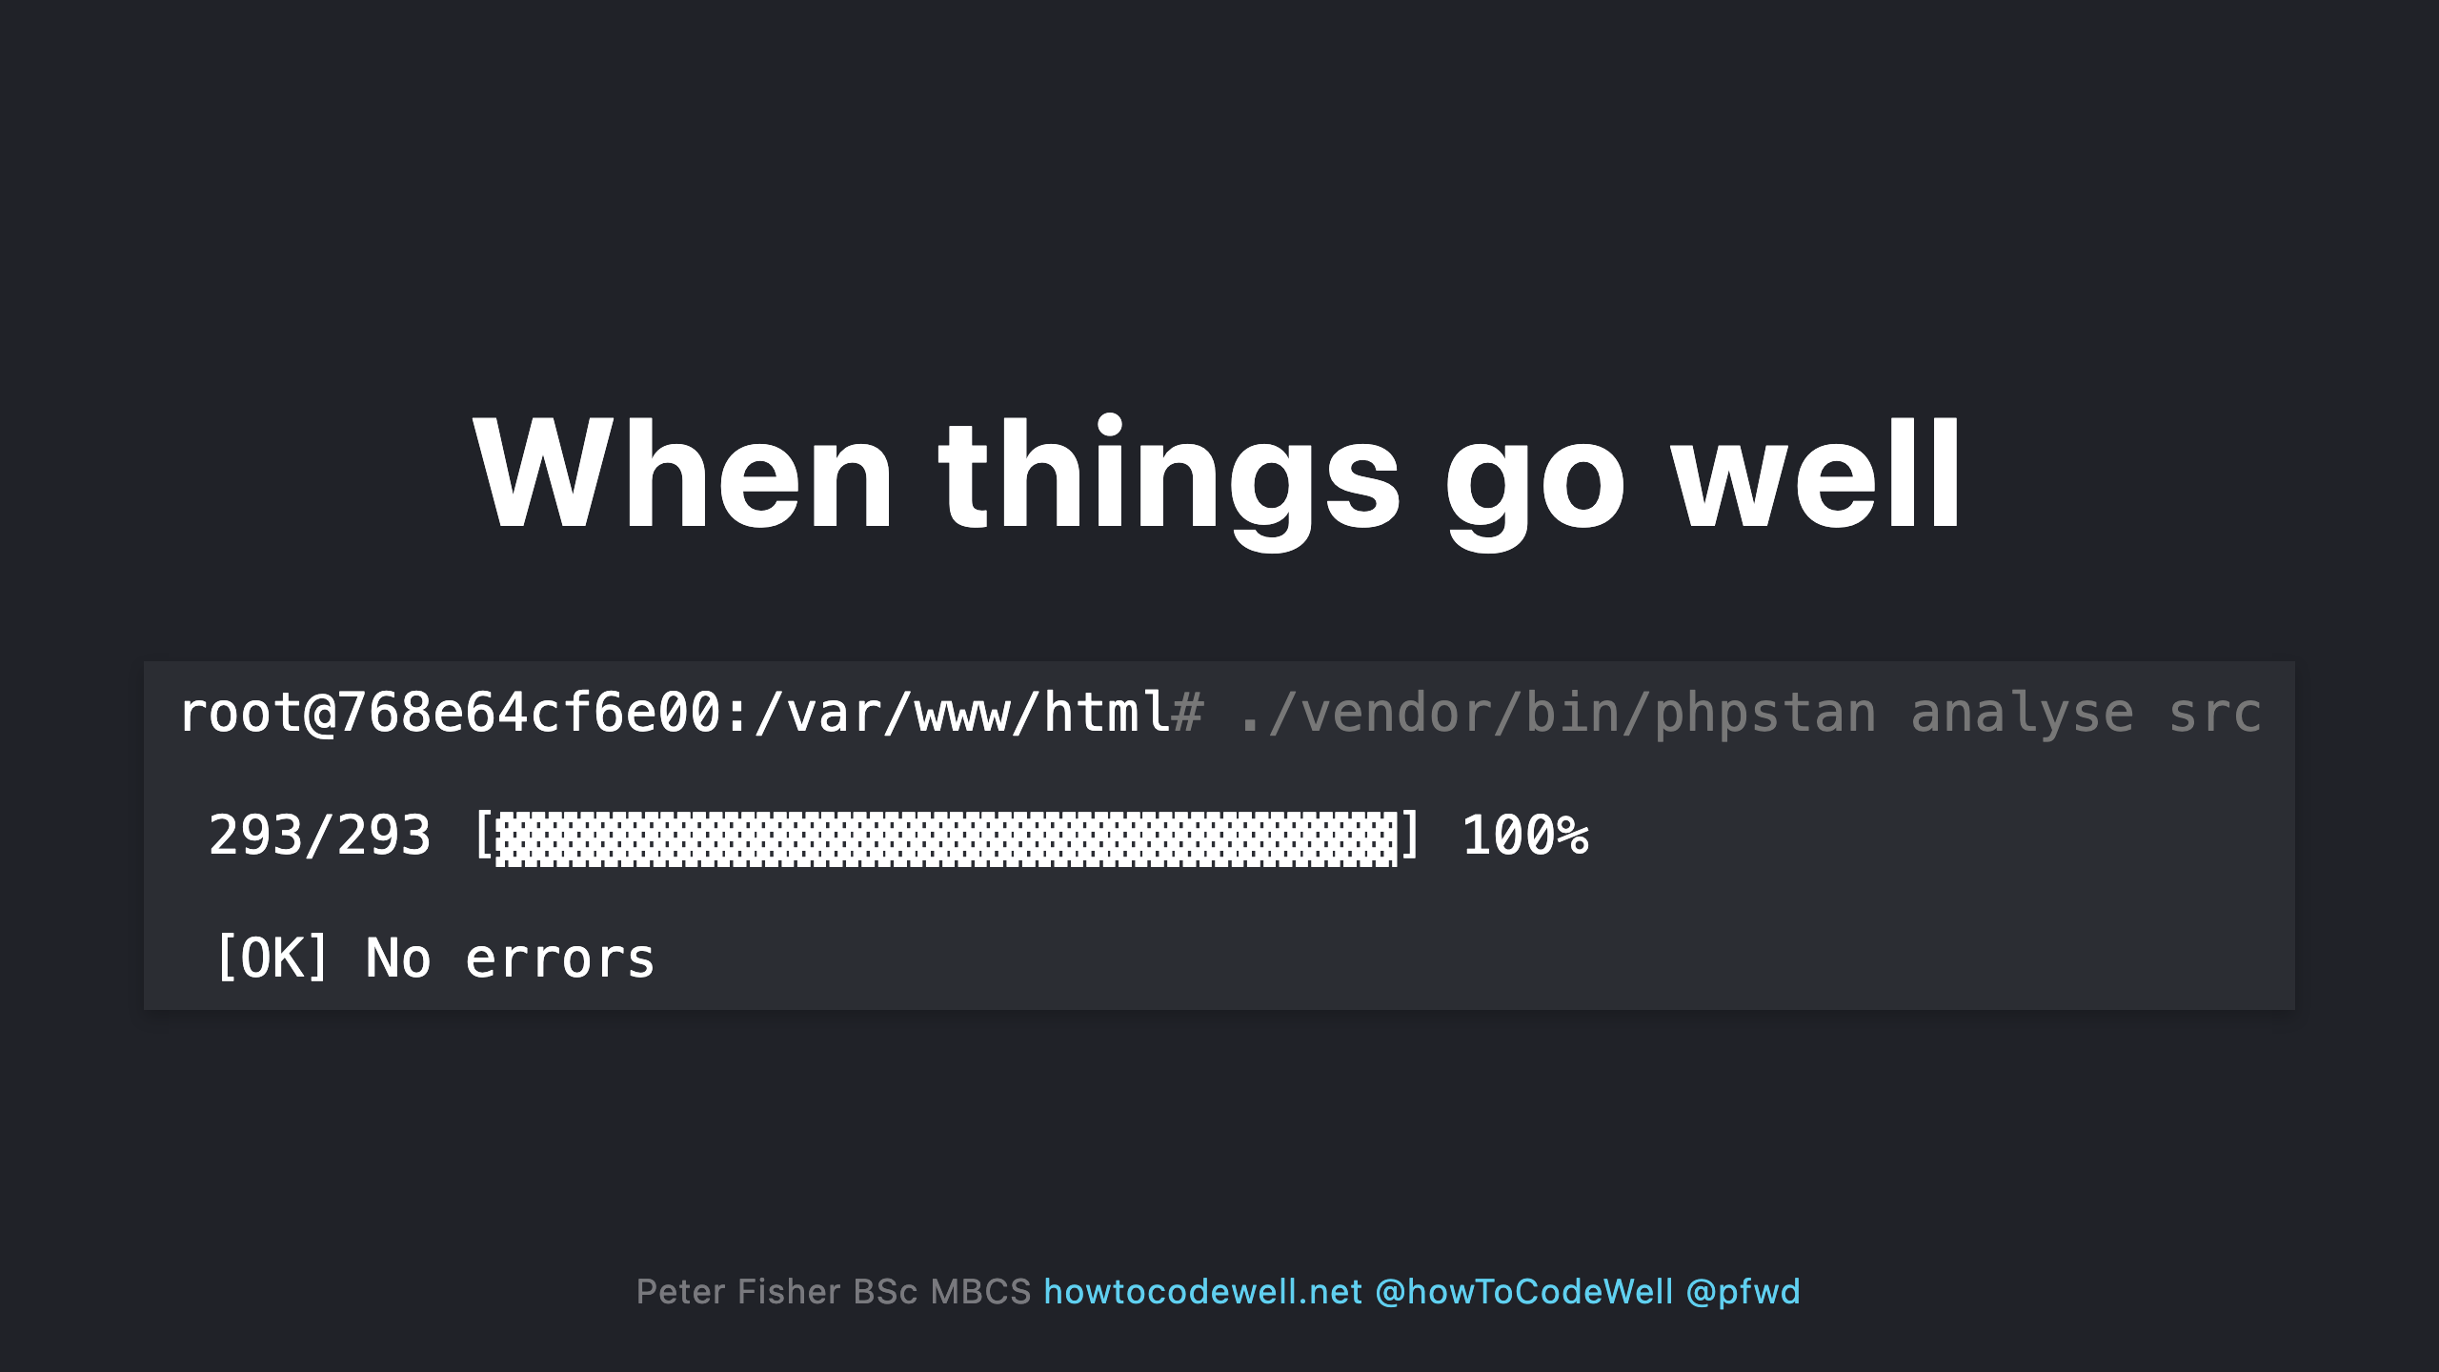

Slide 26
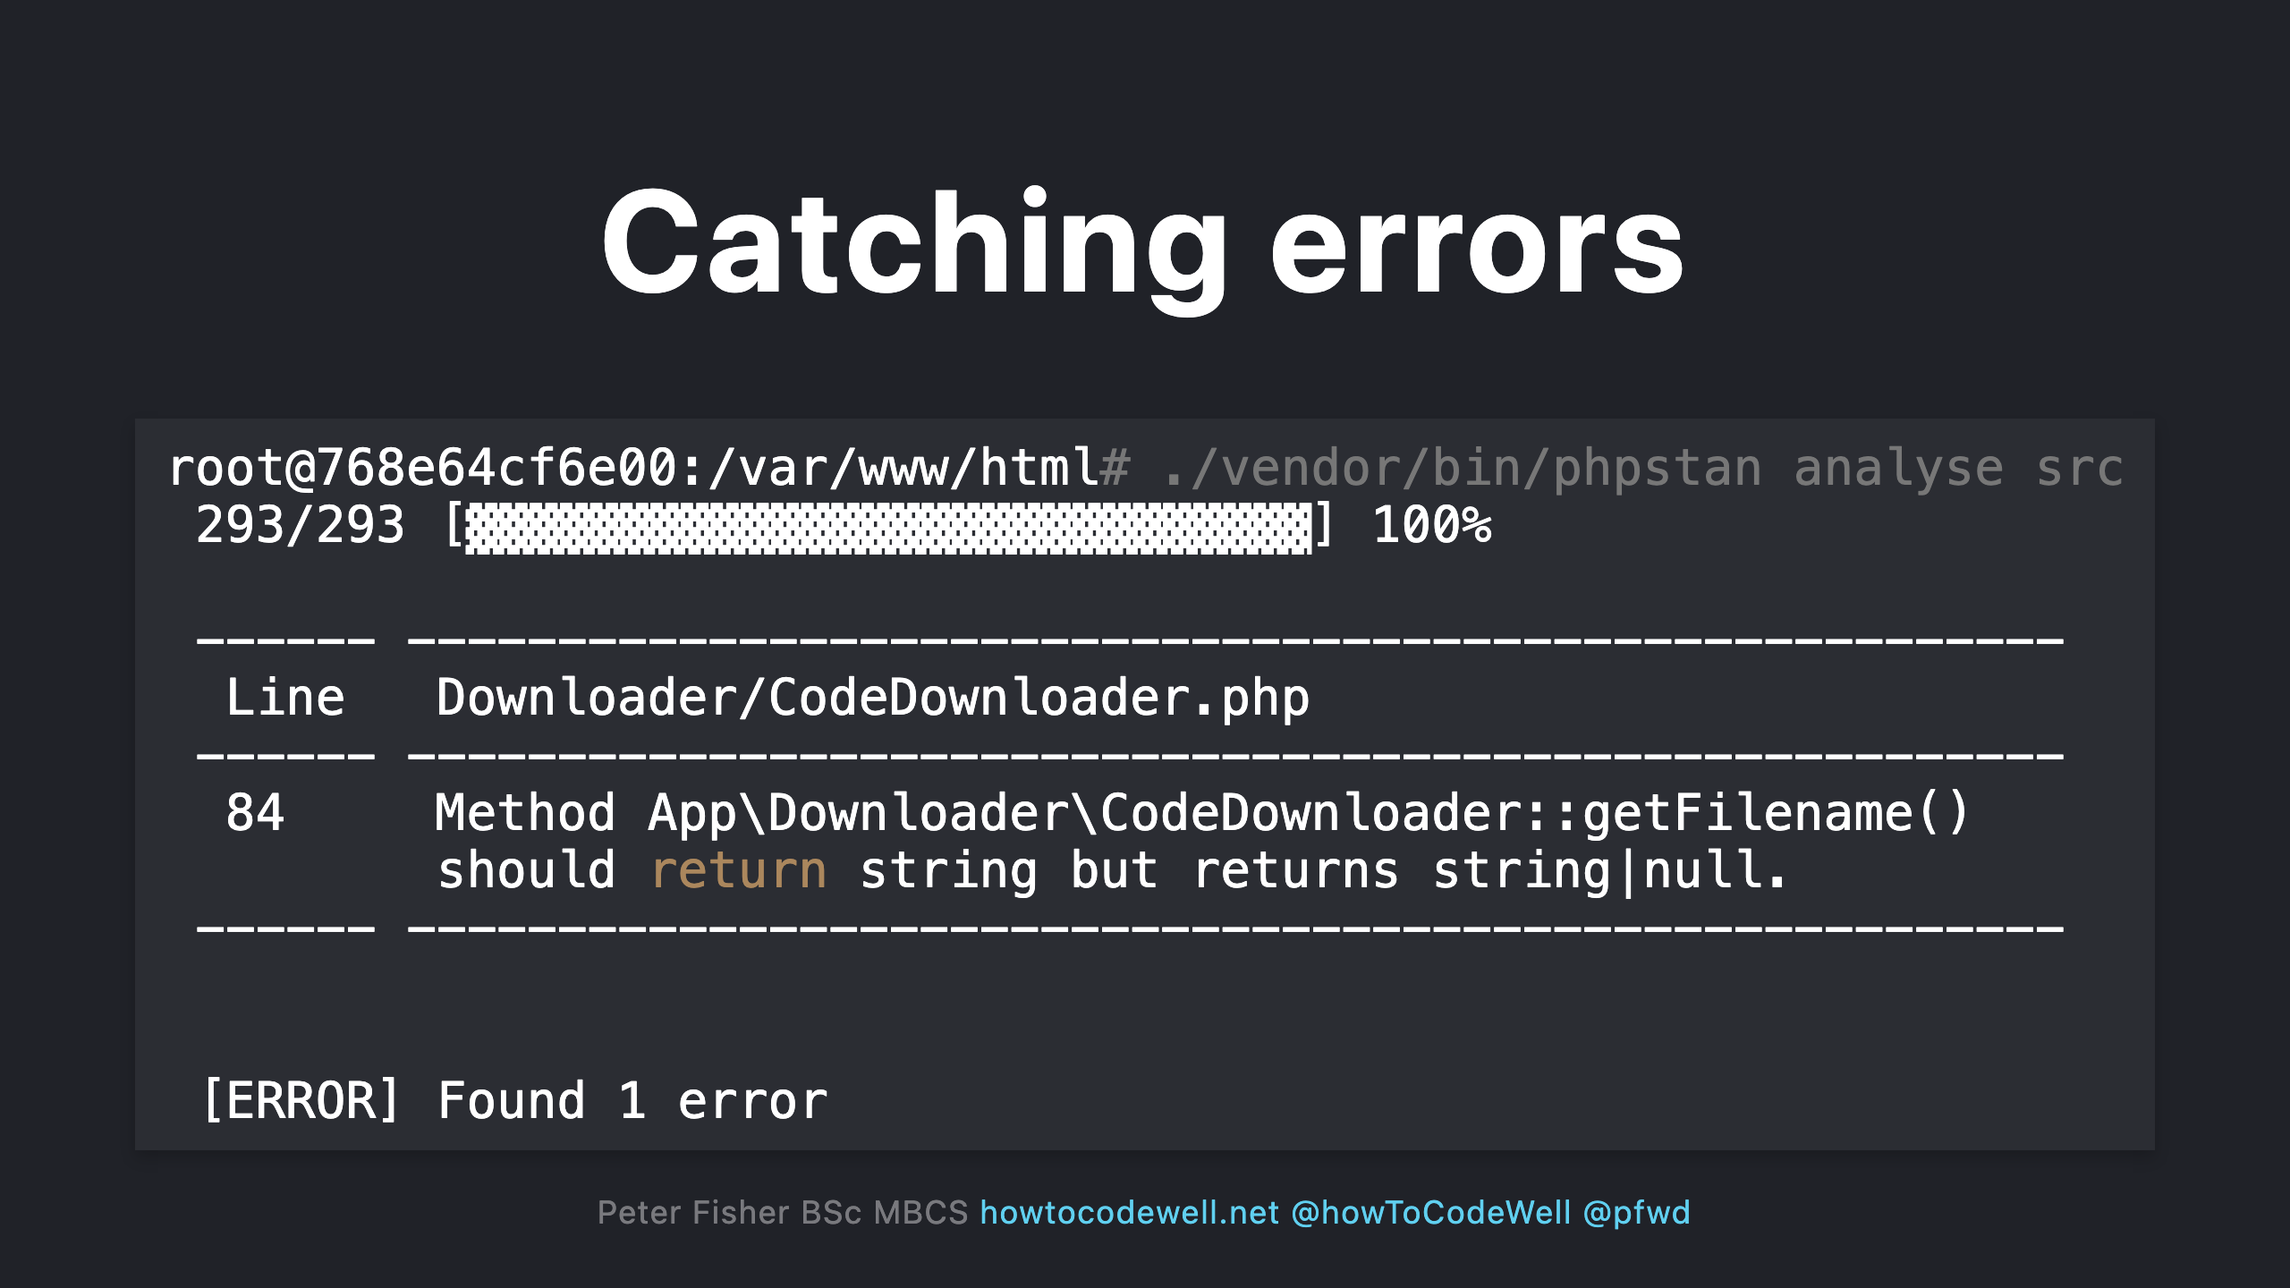

Slide 27
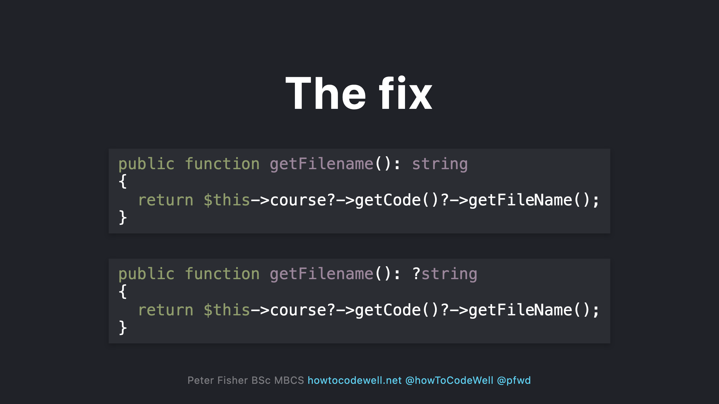
Notes:
- Updating the return type to allow for nullable values (:?string)

Slide 28
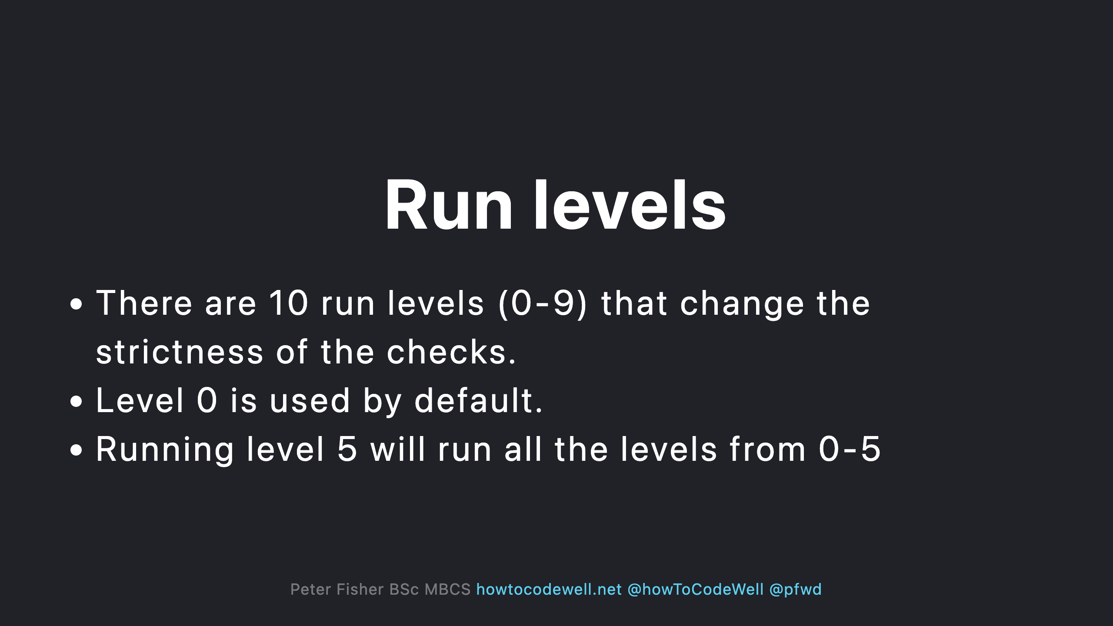
Notes:
Level 0 - Basic checks - unknown classes - unknown functions - unknown methods called on $this - wrong number of arguments passed to those methods and functions - always undefined variables Level 1 - possibly undefined variables - unknown magic methods and properties on classes with __call and __get Level 2 - unknown methods checked on all expressions (not just $this) - validating PHPDocs Level 3 - Return types - types assigned to properties Level 4 - Dead code checking - always false instanceof and other type checks - Unreachable code after Level 5 - Checking types of arguments passed to methods and functions Level 6 - Missing typehints Level 7 - Report partially wrong union types Level 8 - Report calling methods and accessing properties on nullable types Level 9 - 9 be strict about the mixed type

Slide 29
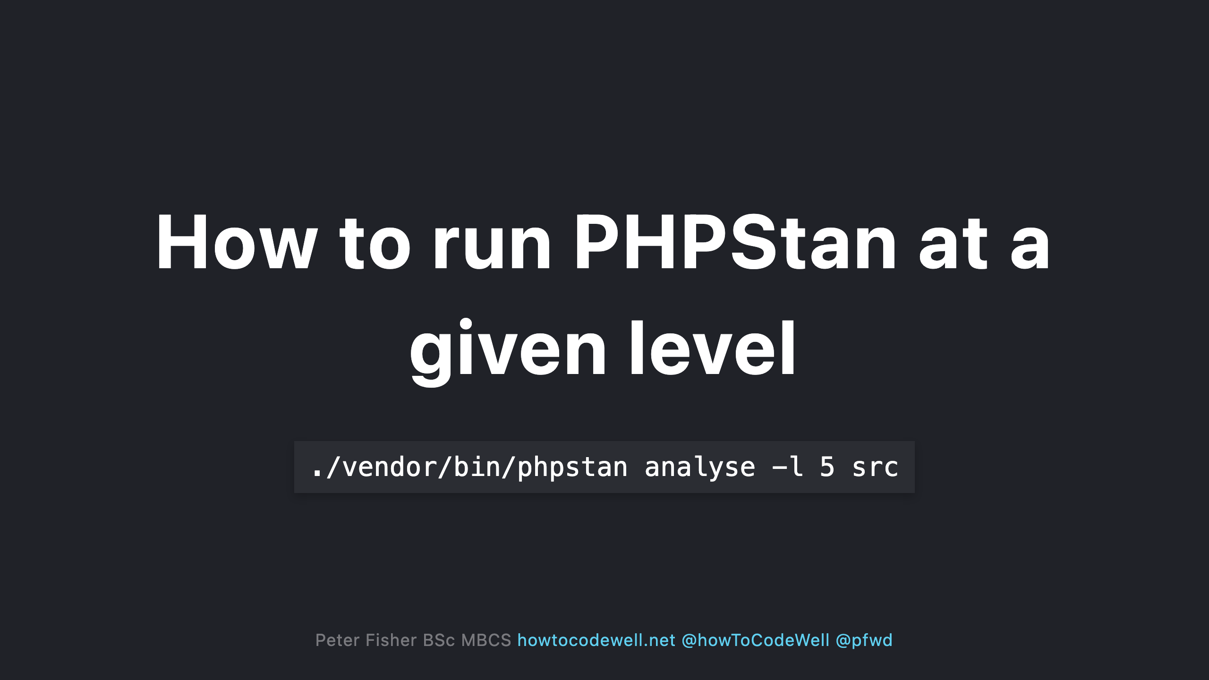

Slide 30
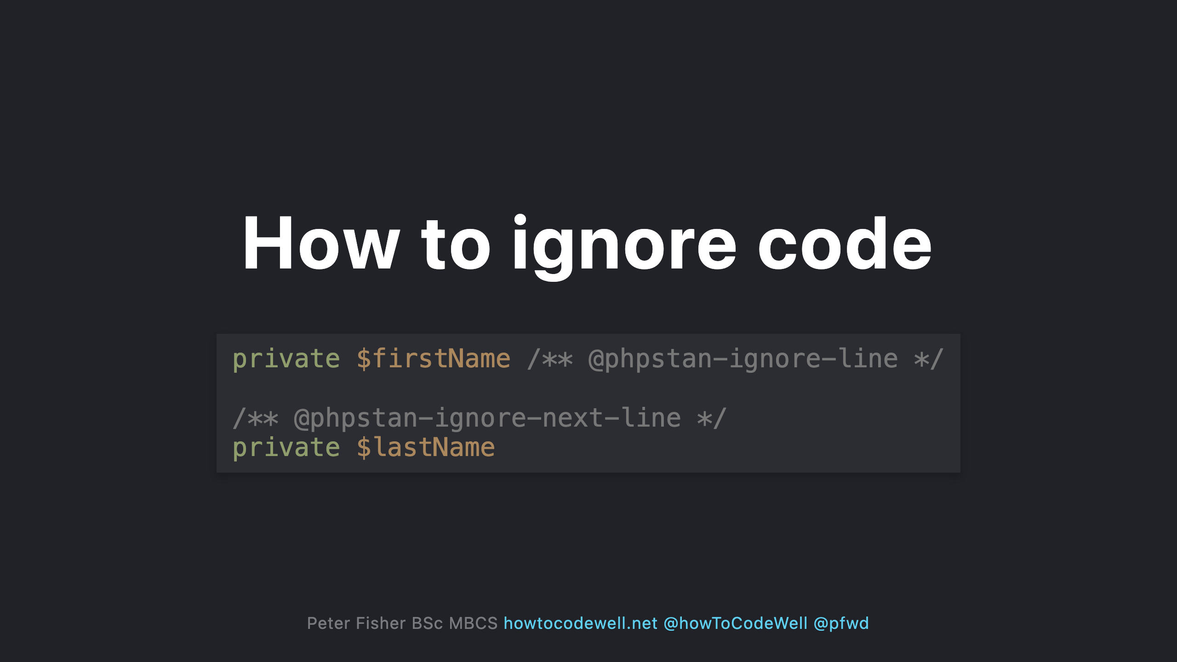
Notes:
- This would normally error as both $firstName and $lastName have no data types - You can also use two forward slashes (//)

Slide 31
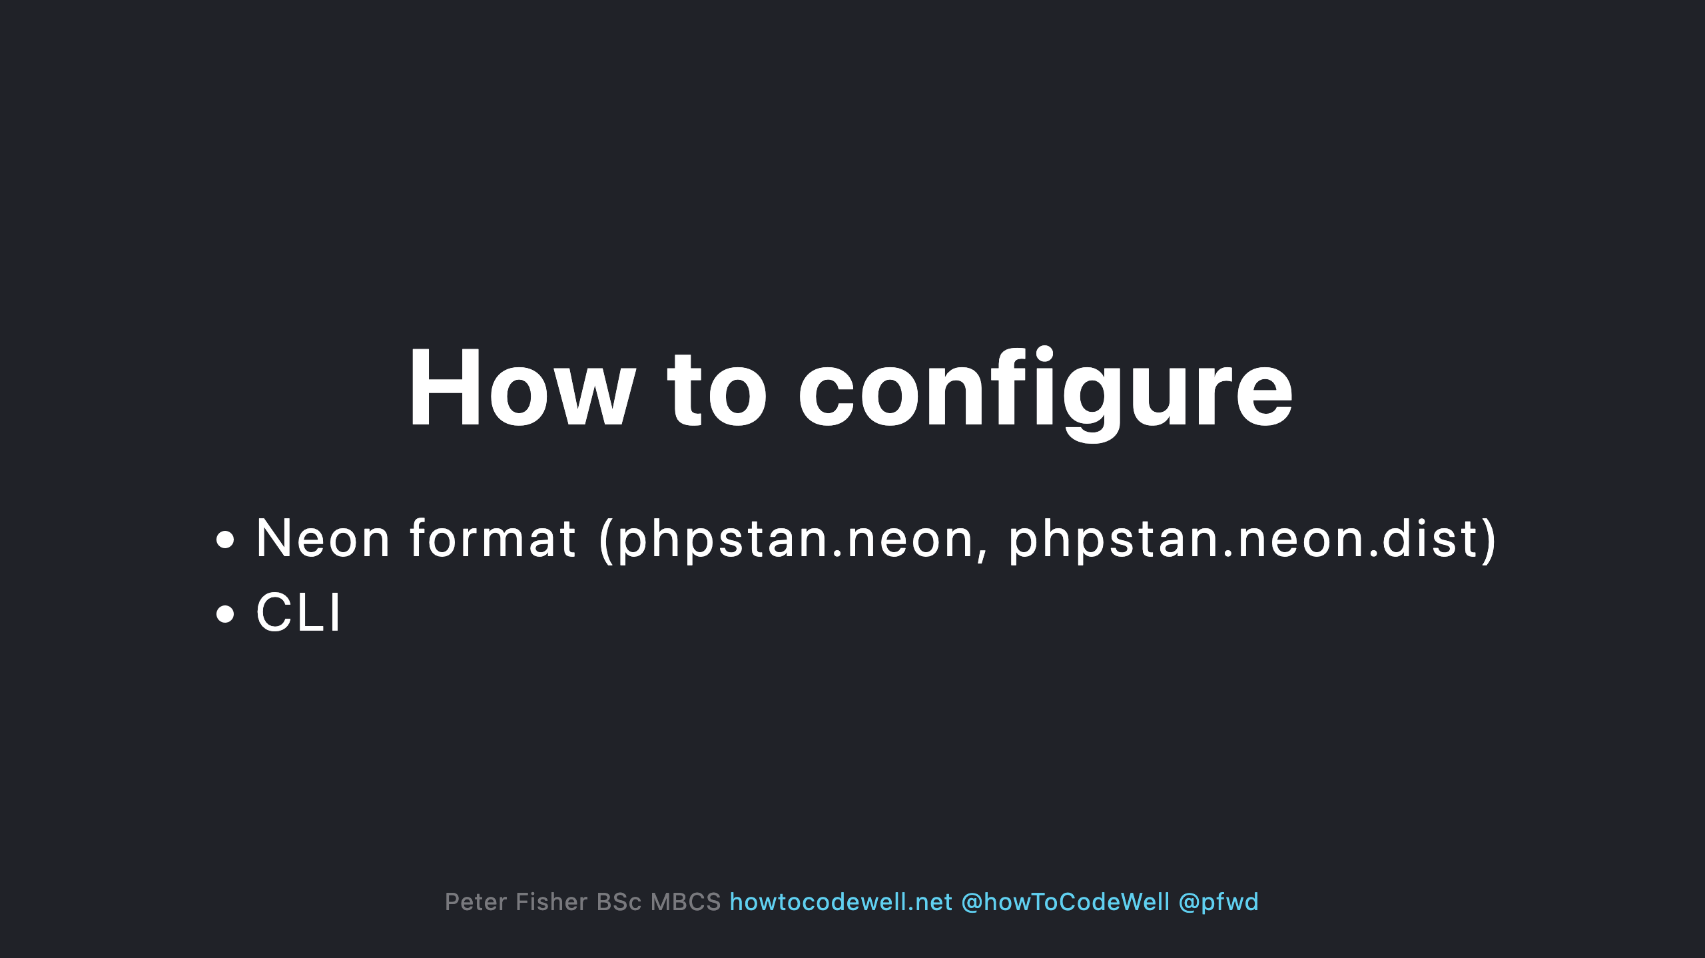

Slide 32
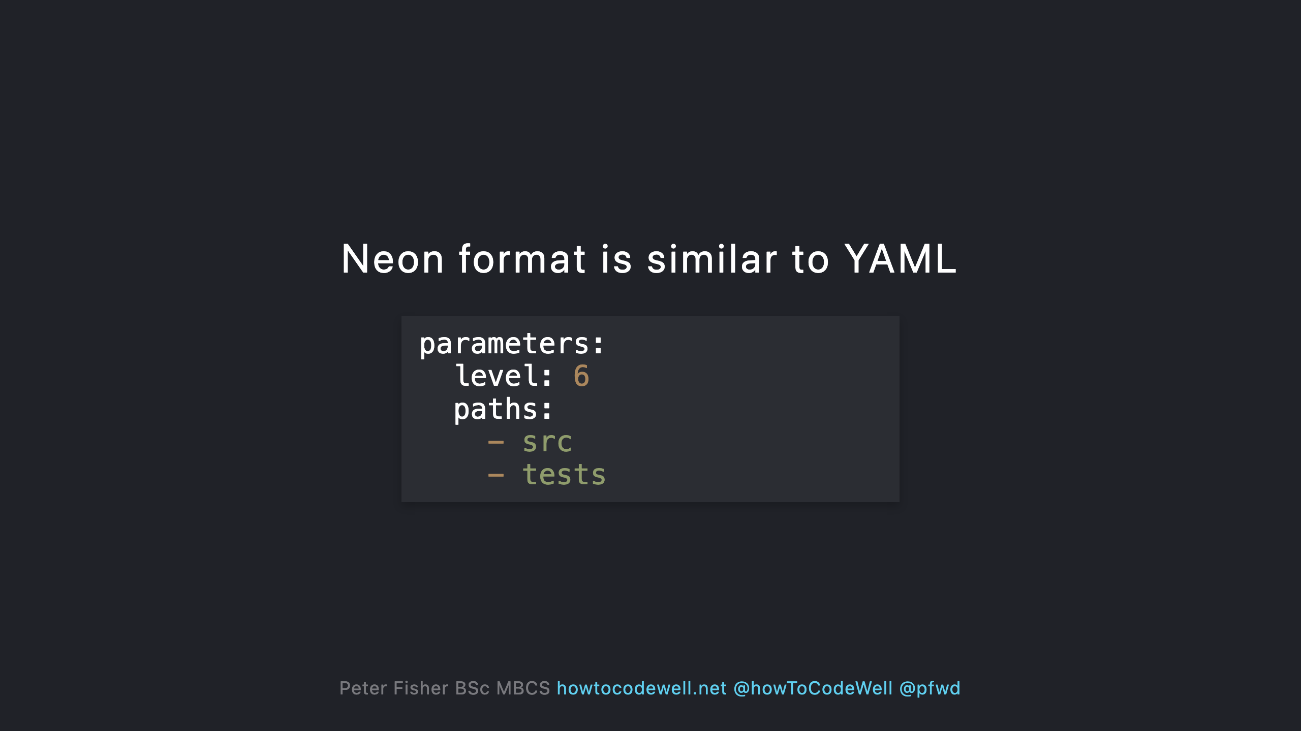

Slide 33
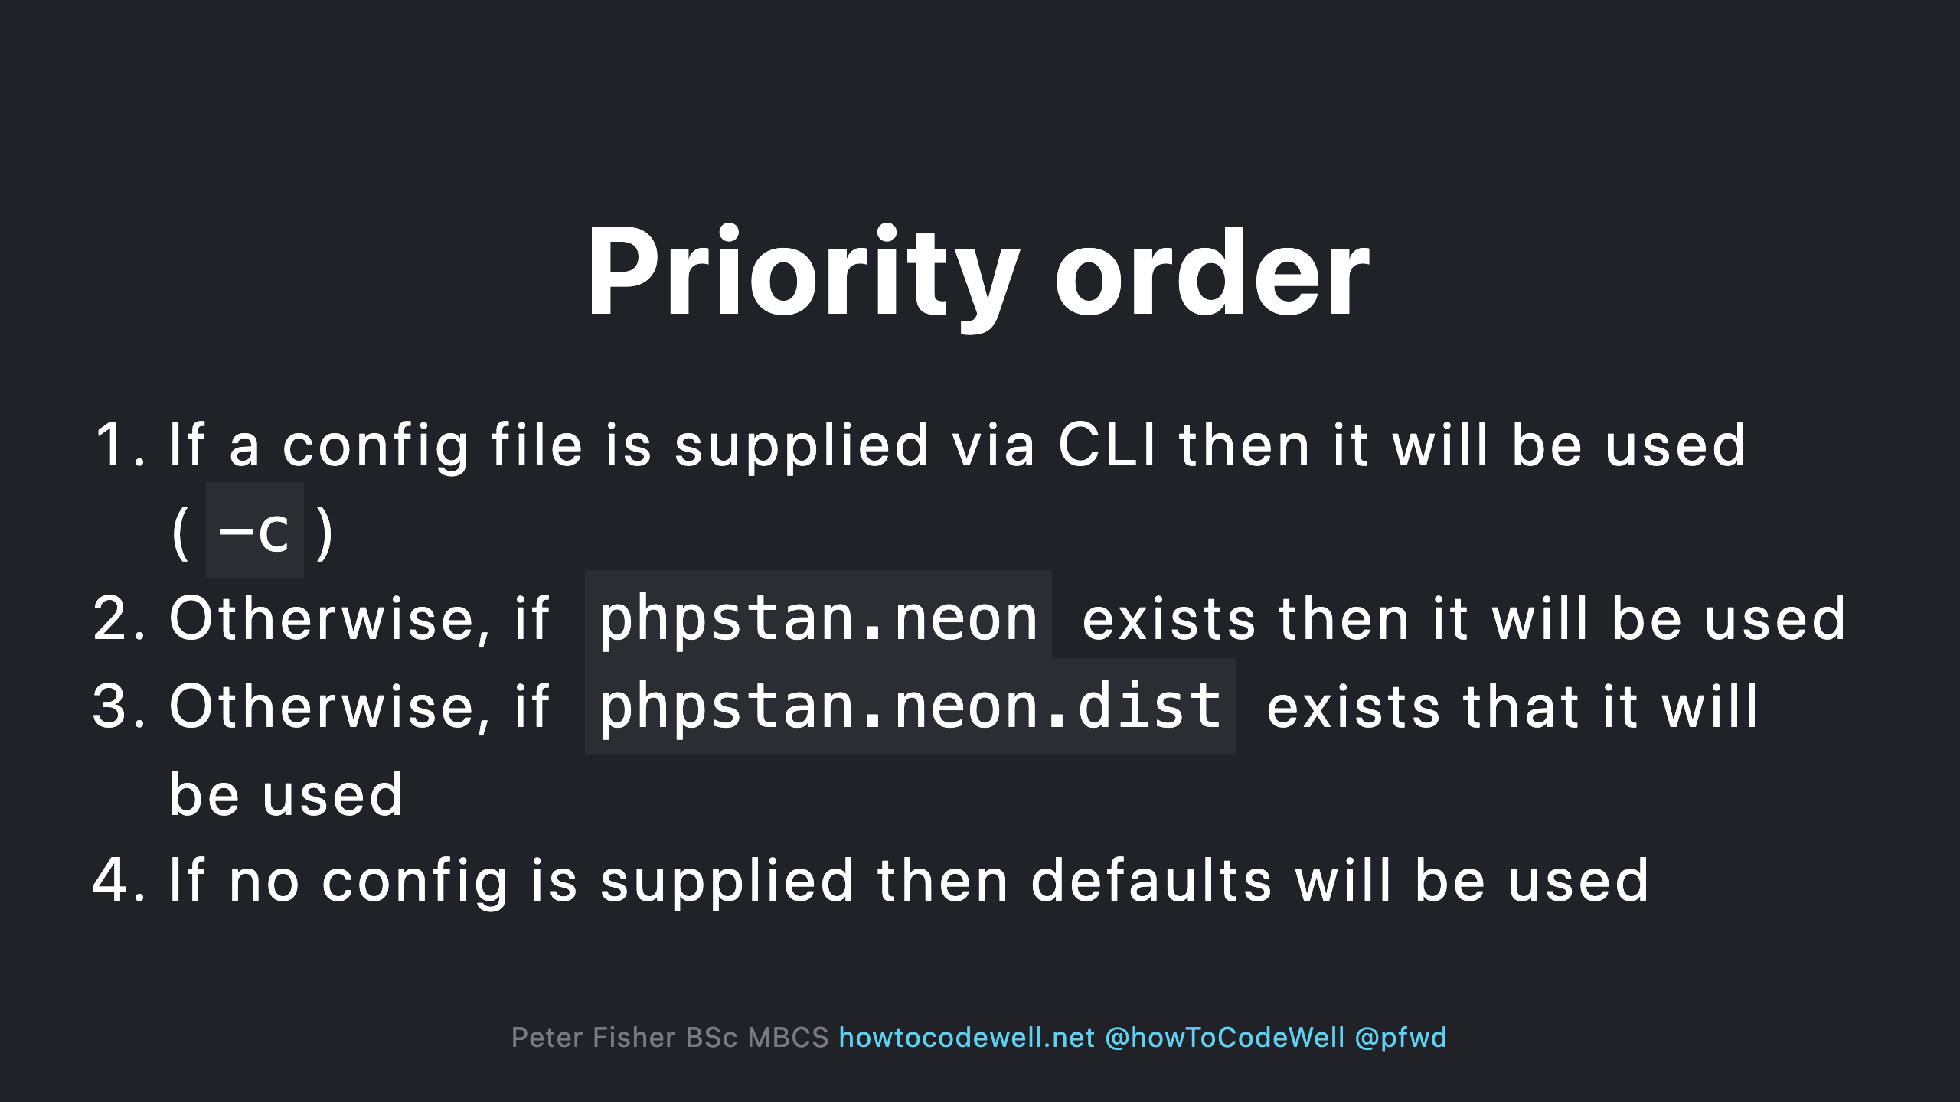

Slide 34
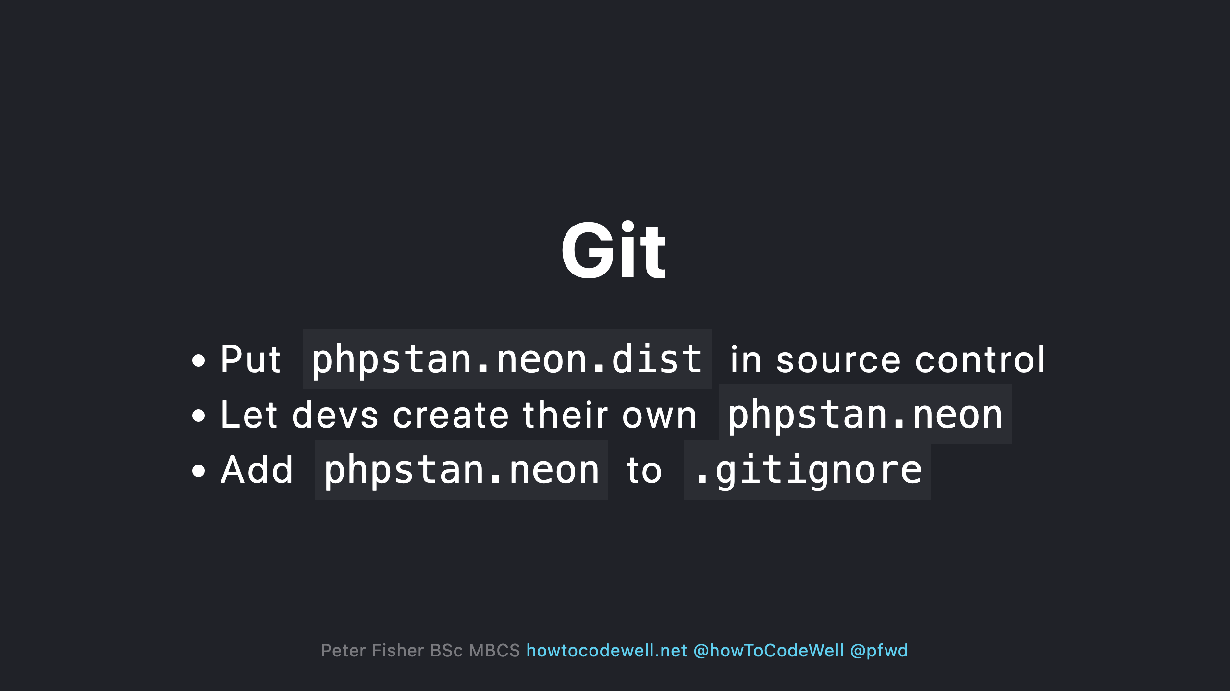

Slide 35
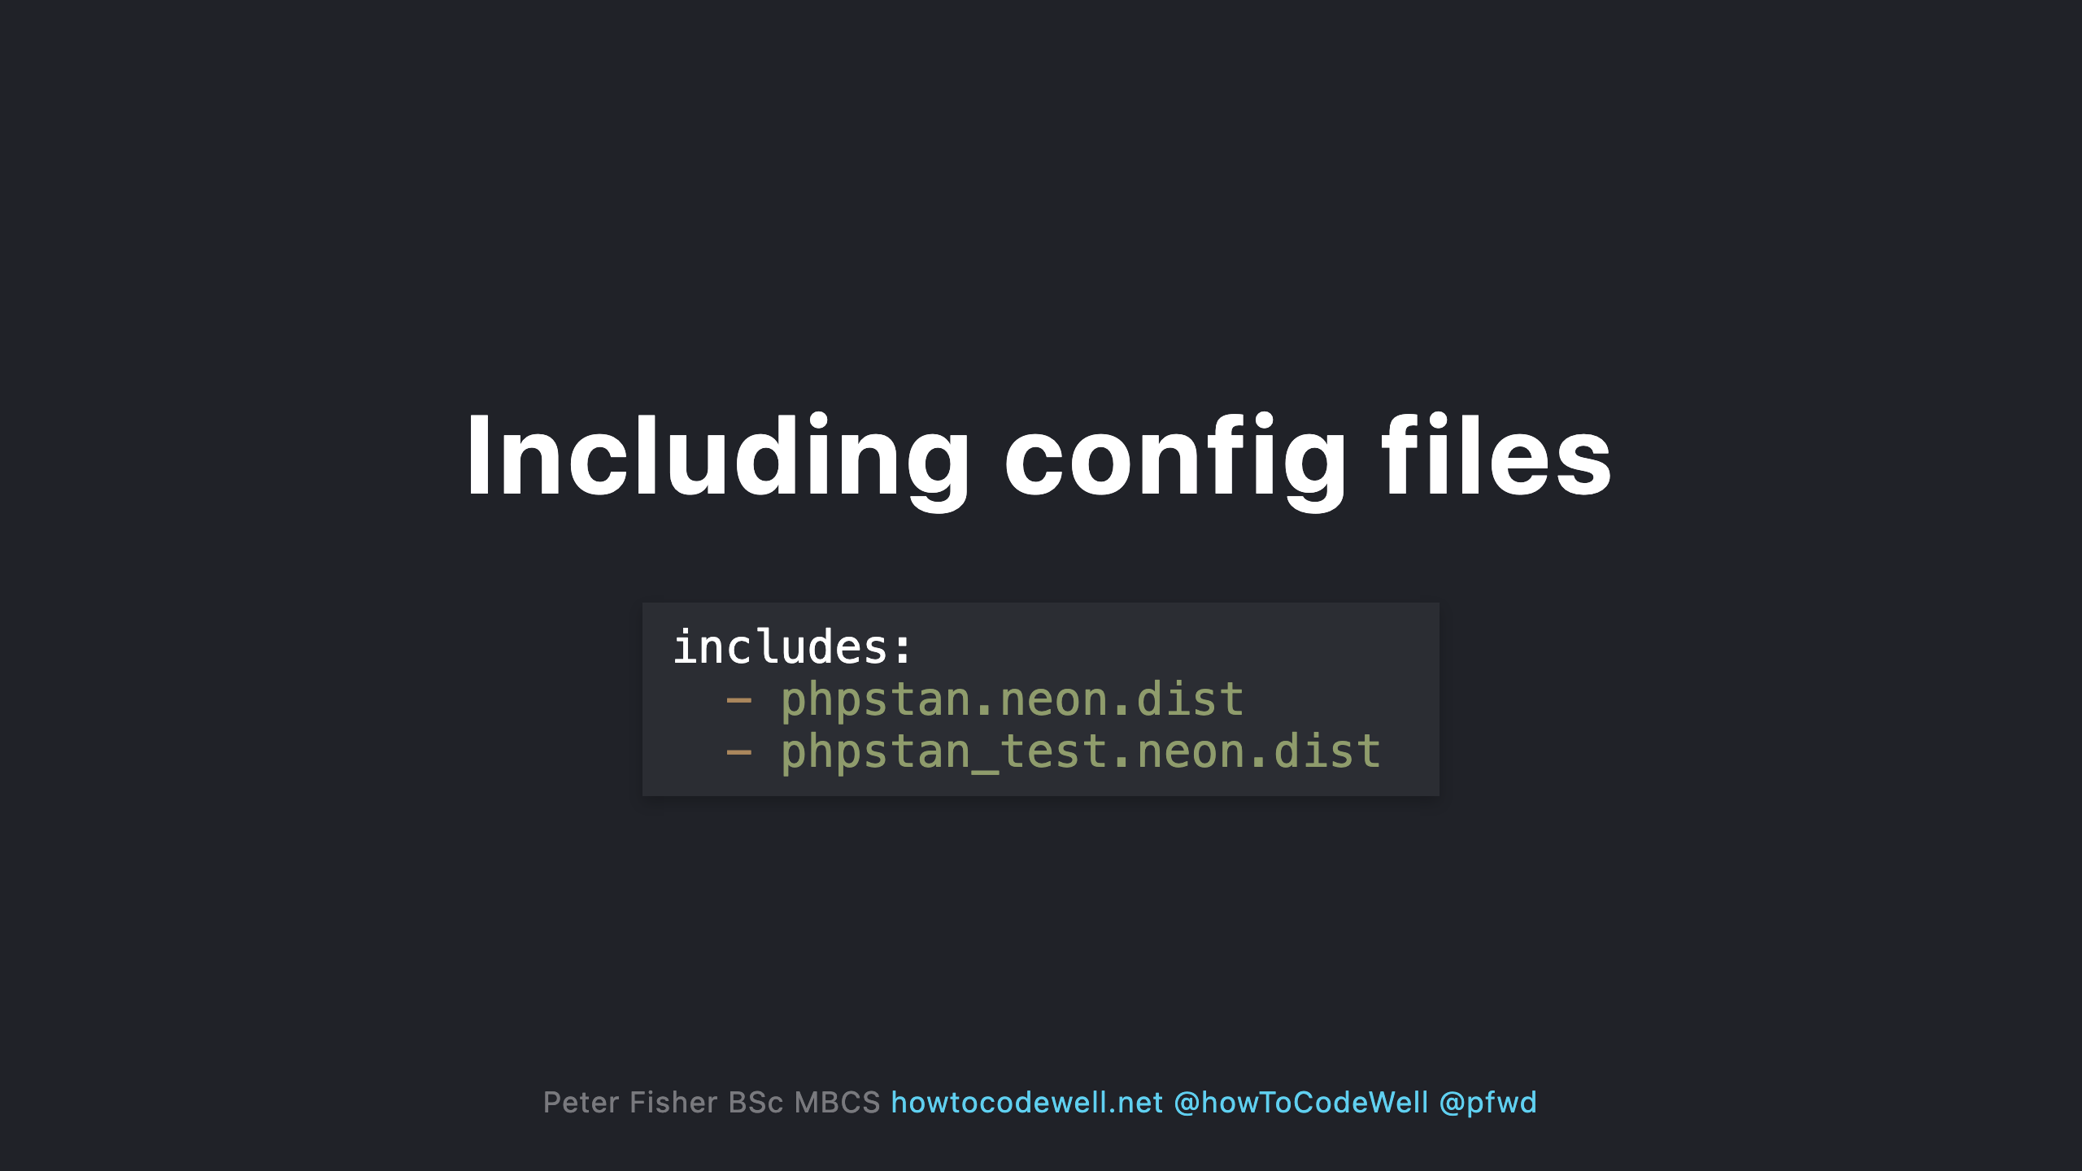

Slide 36
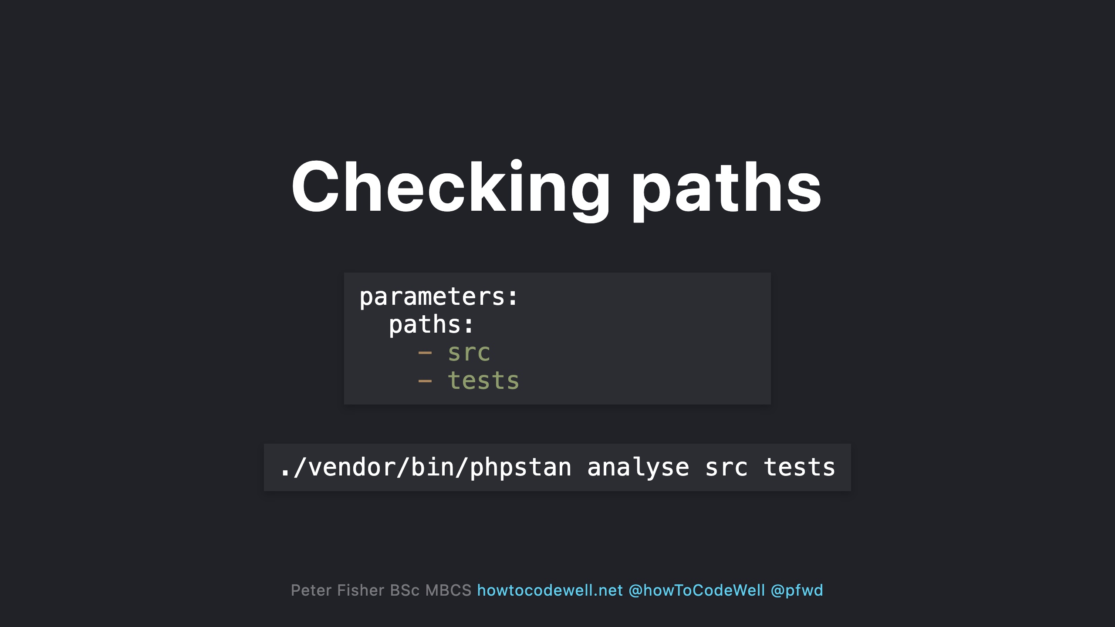

Slide 37
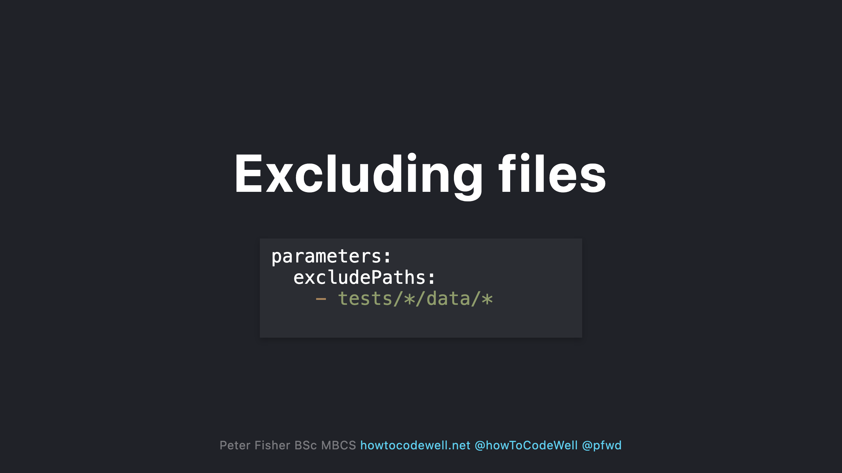

Slide 38
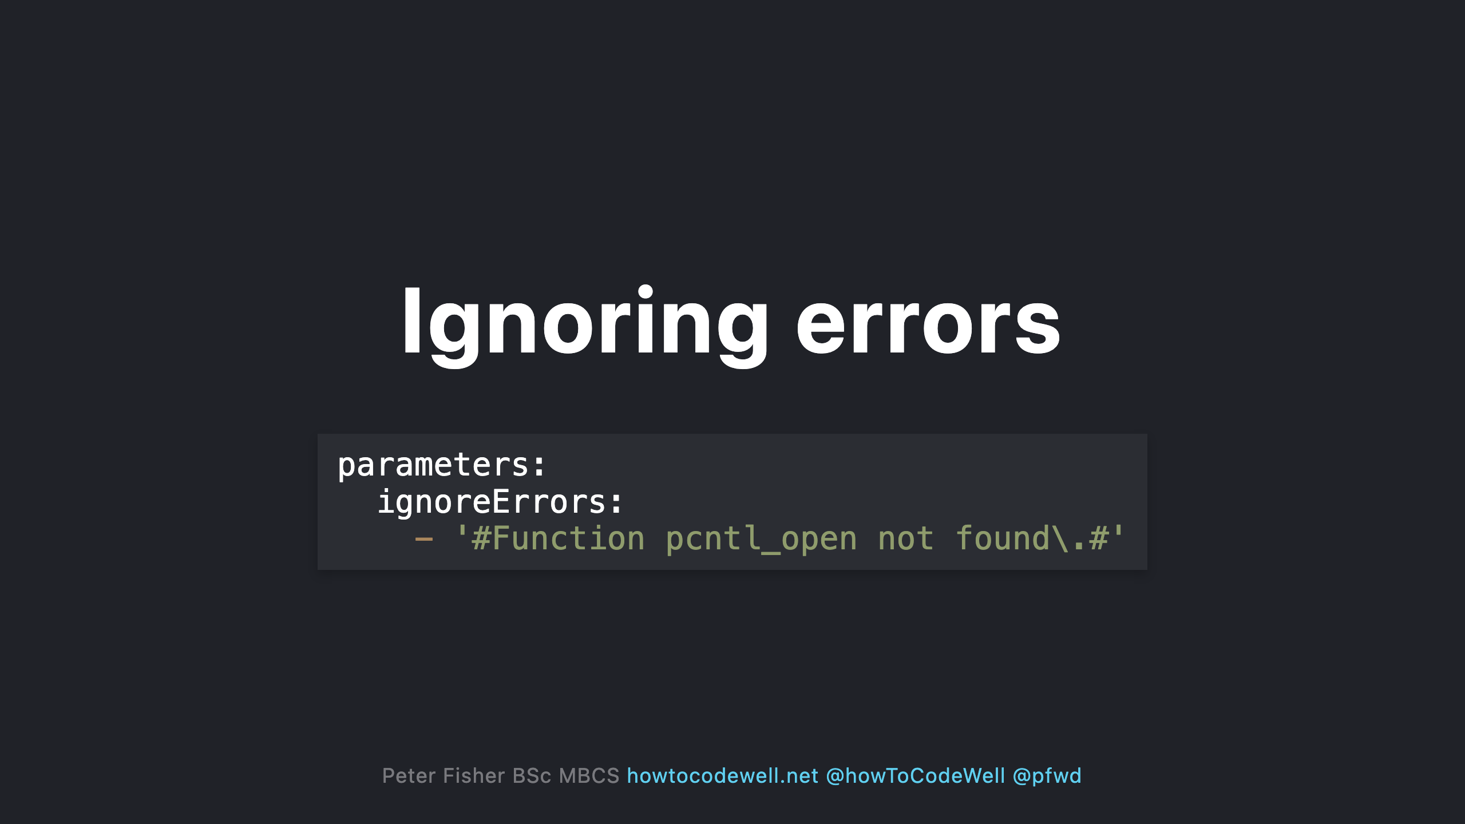

Slide 39
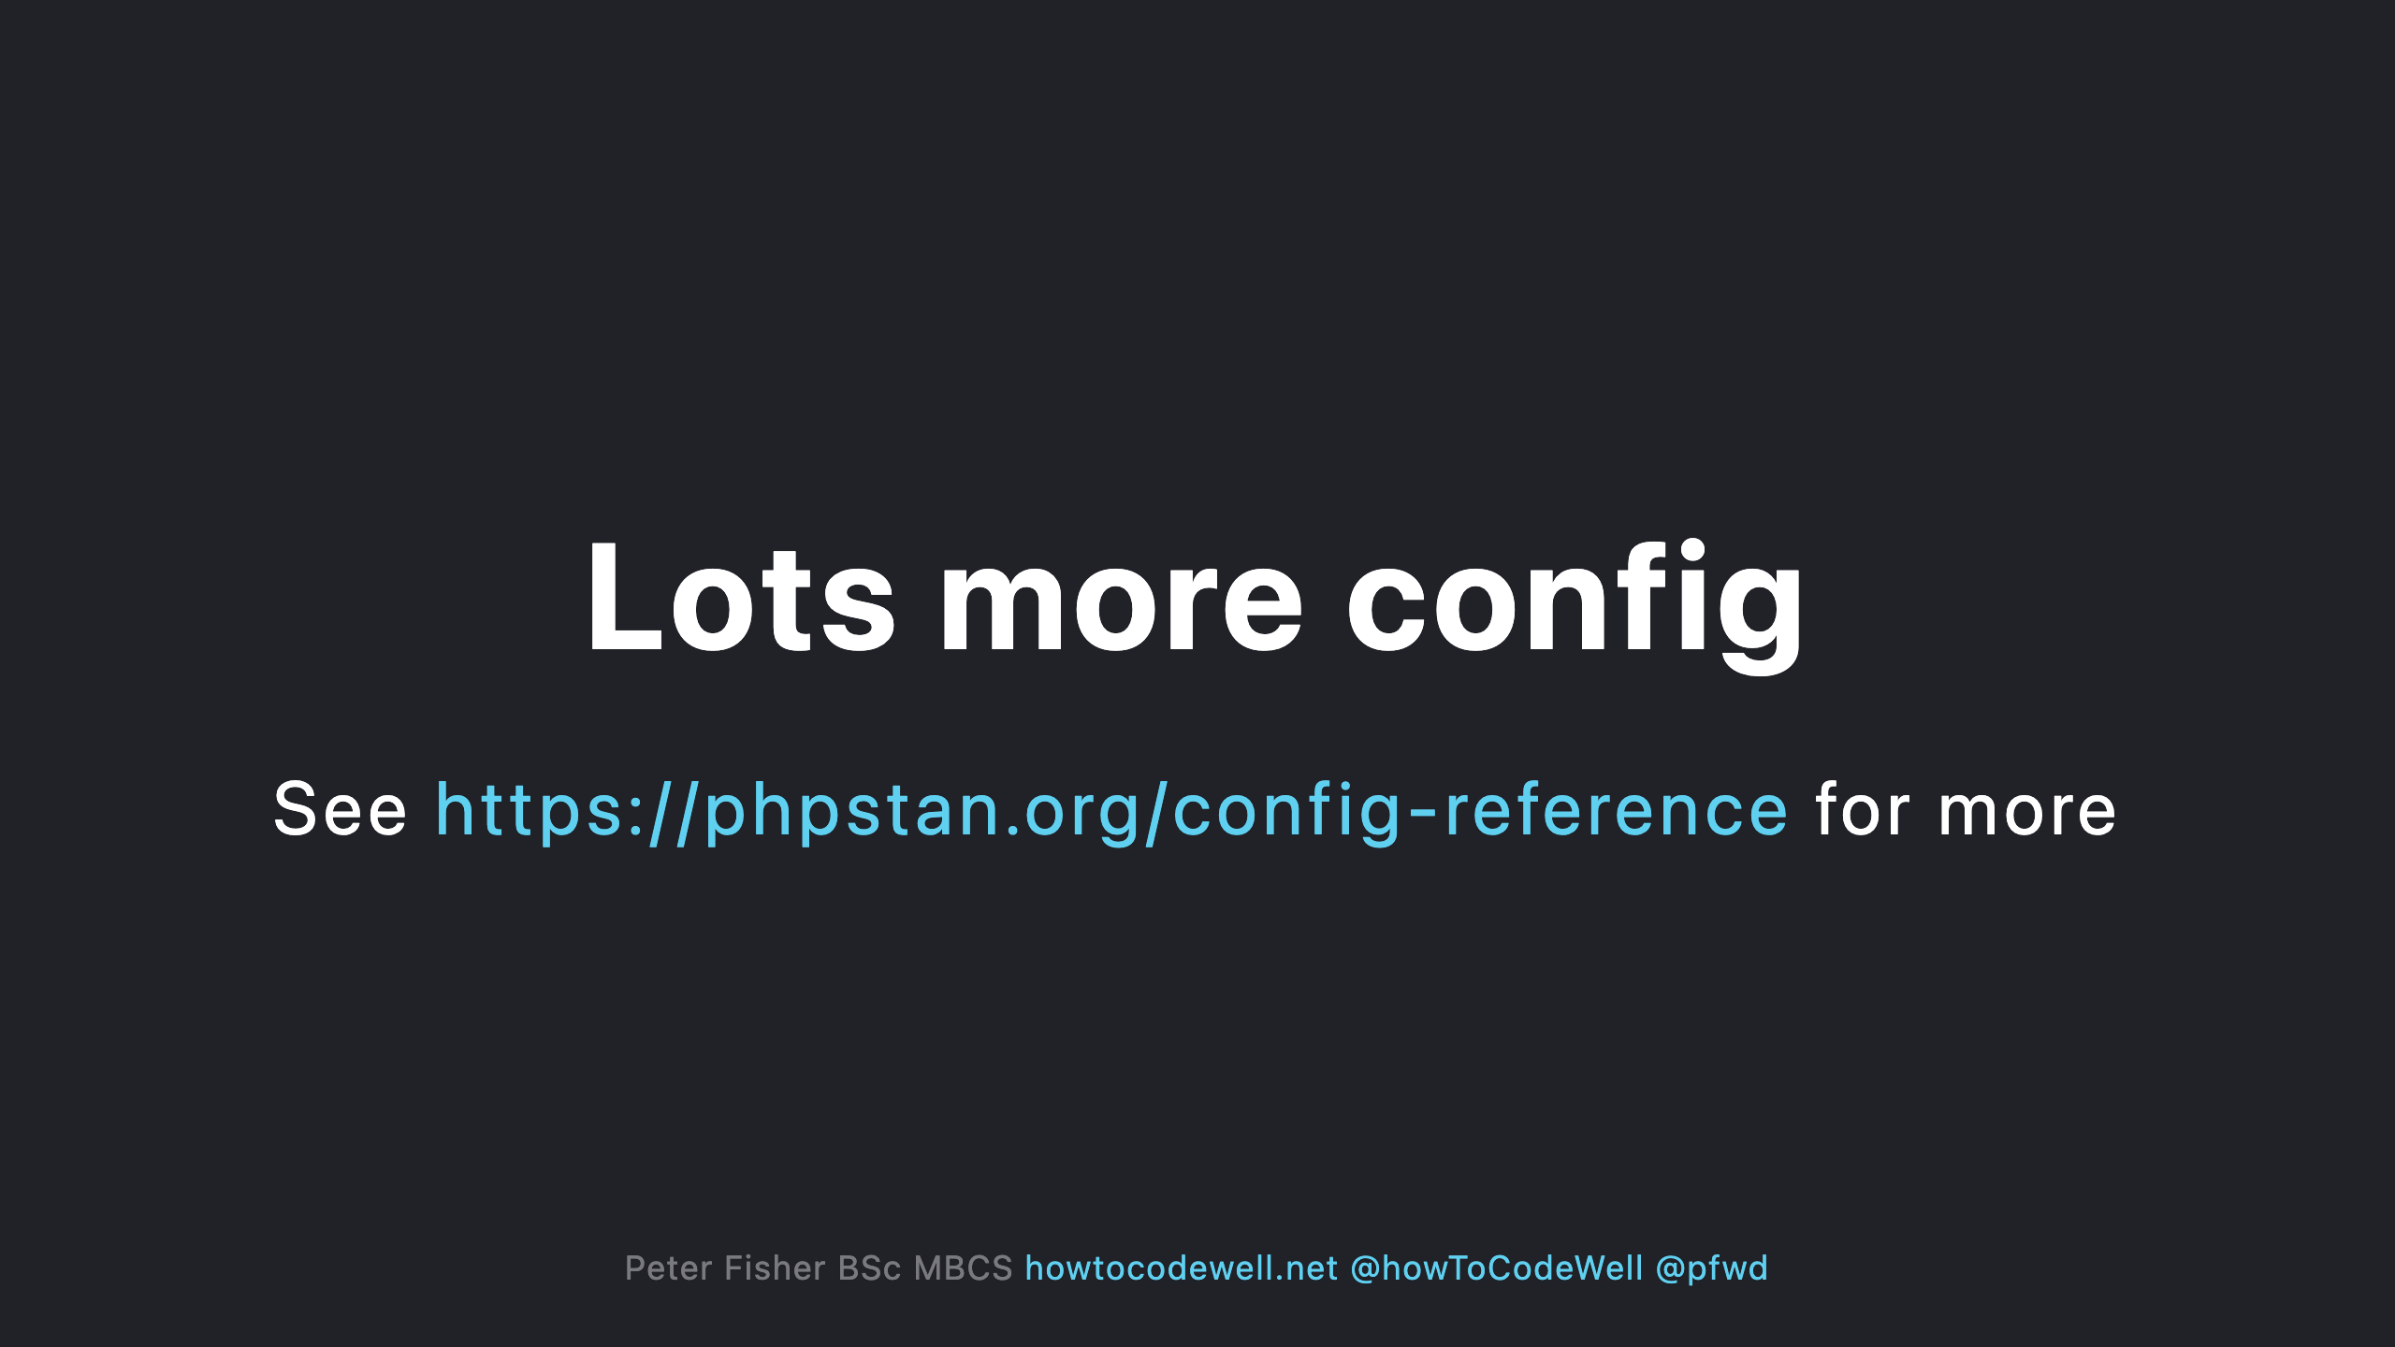
Notes:
Includes config switches to turn certain checks on and off

Slide 40
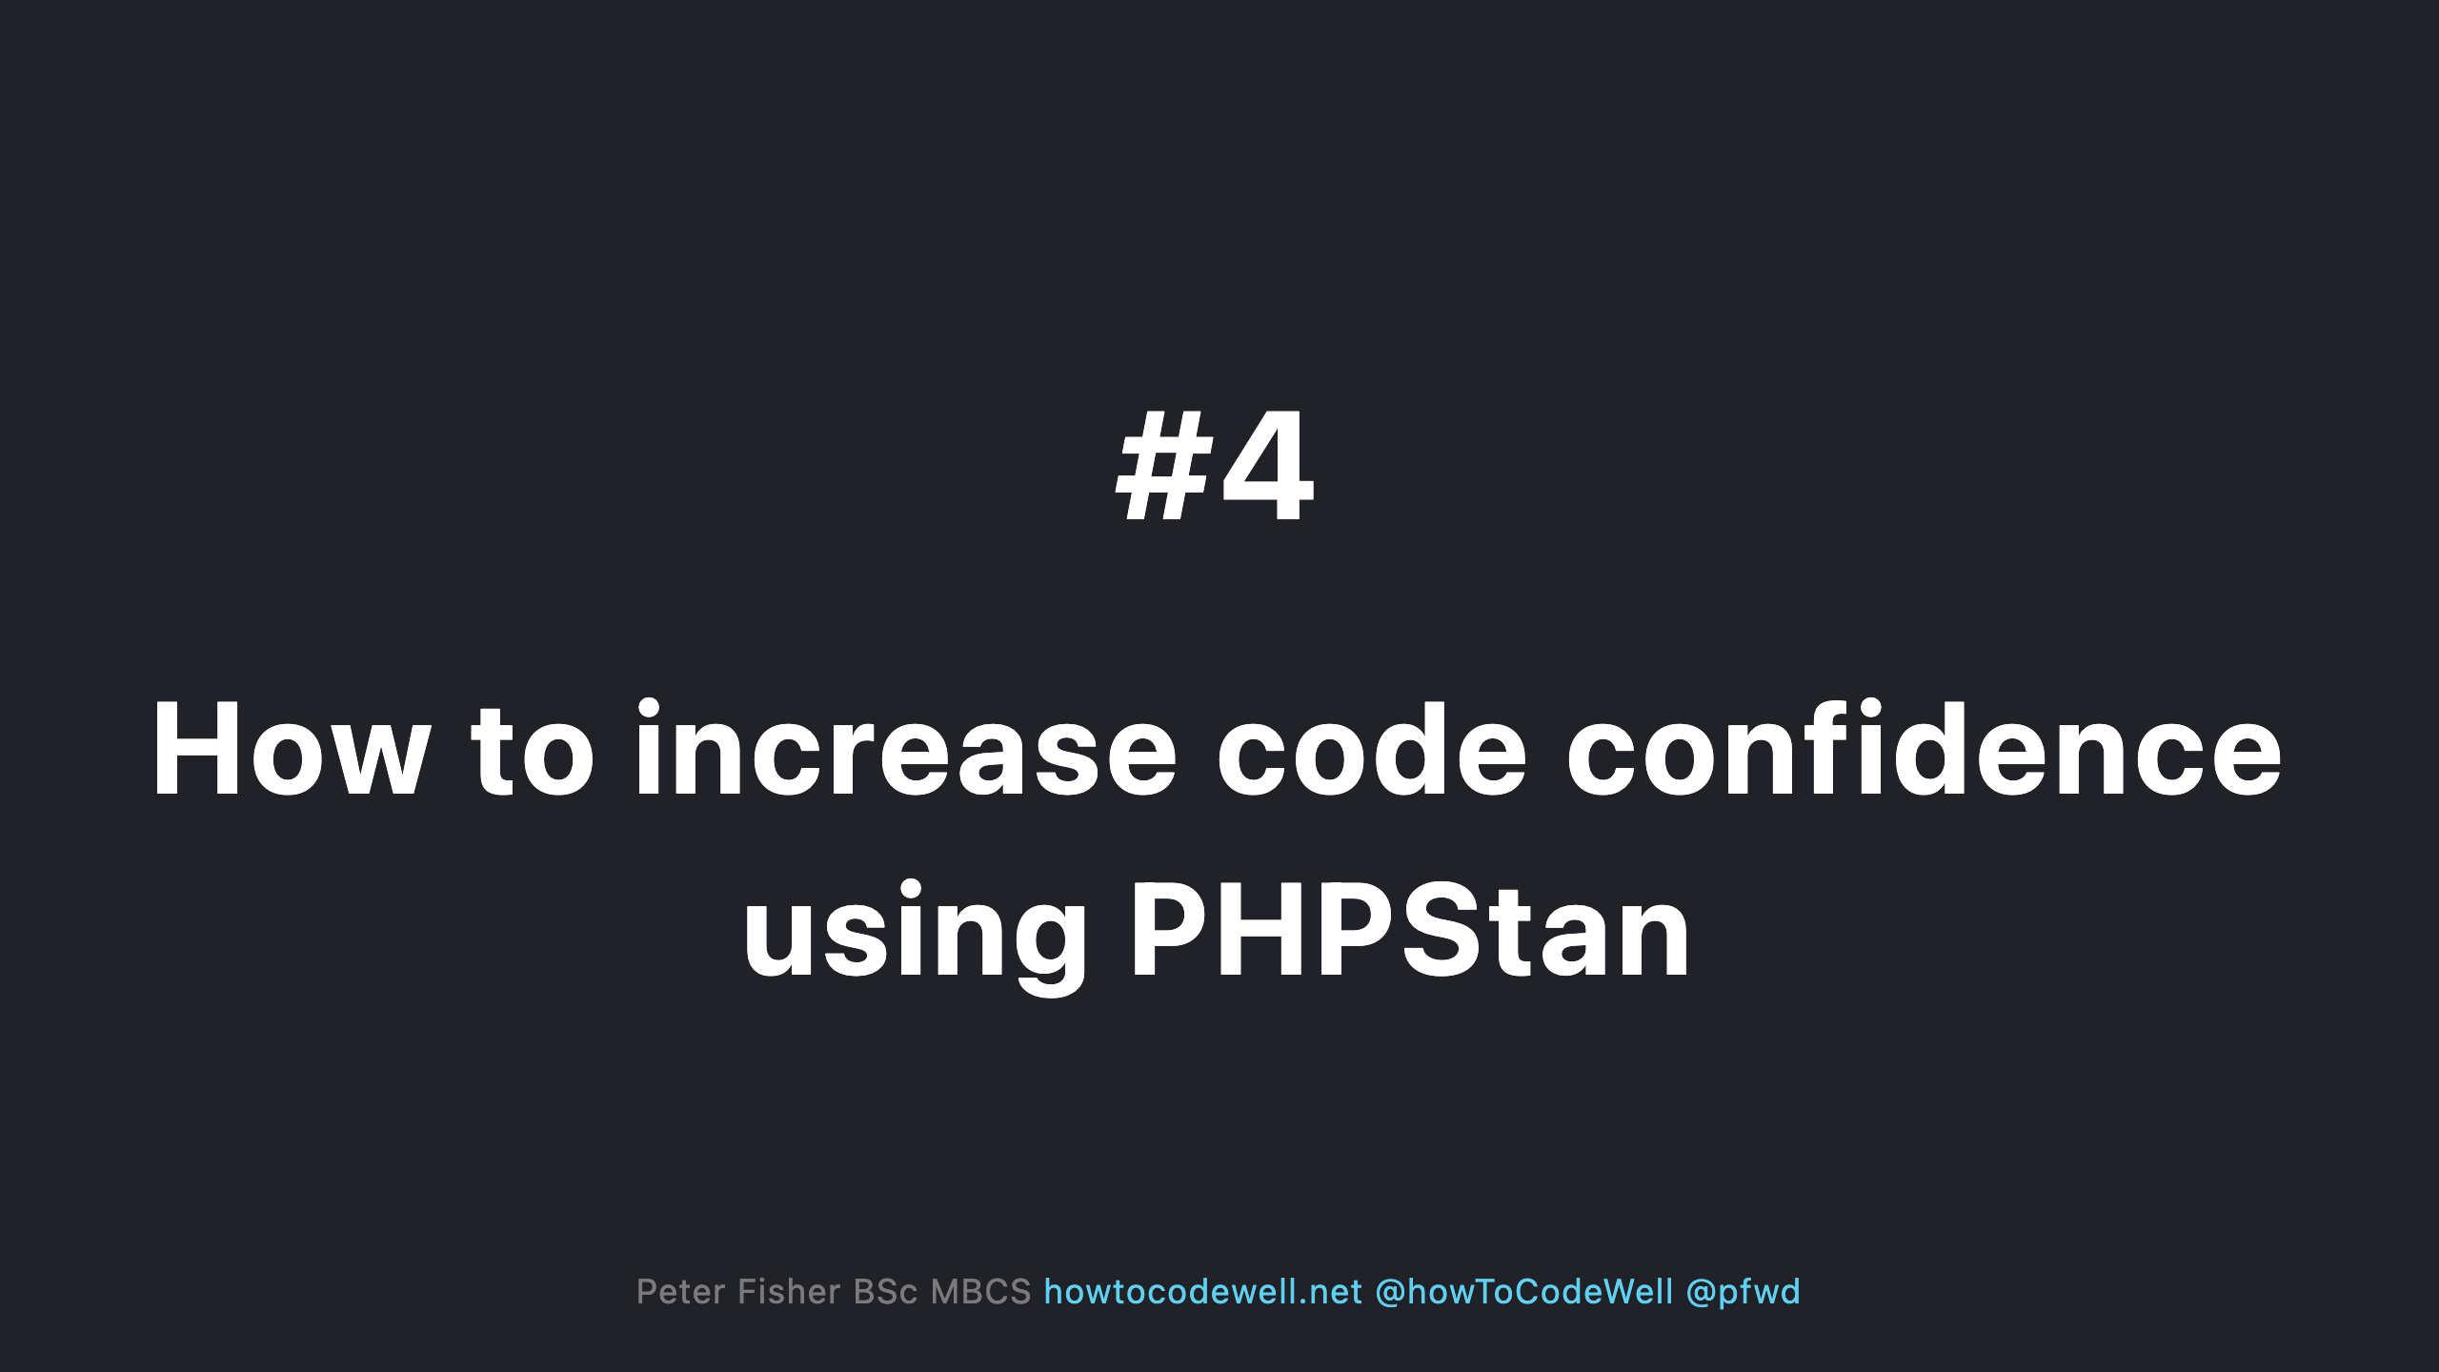

Slide 41
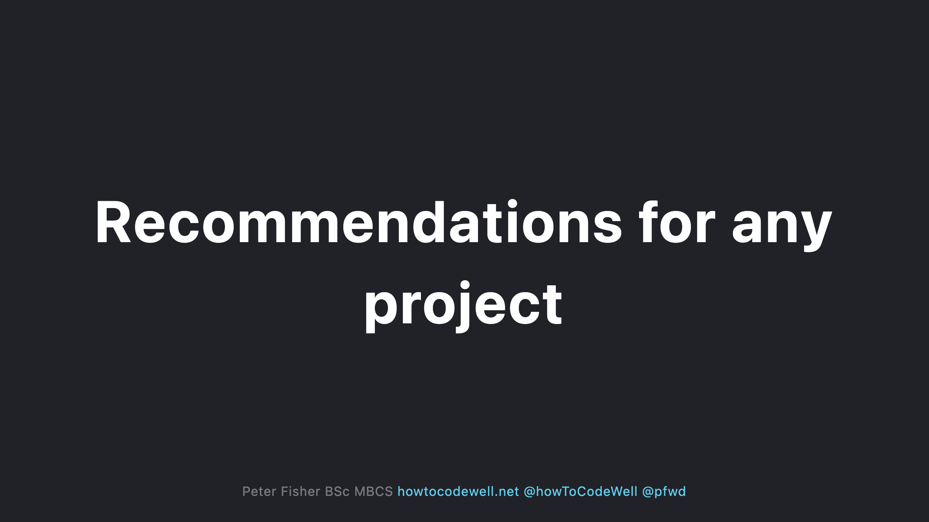

Slide 42
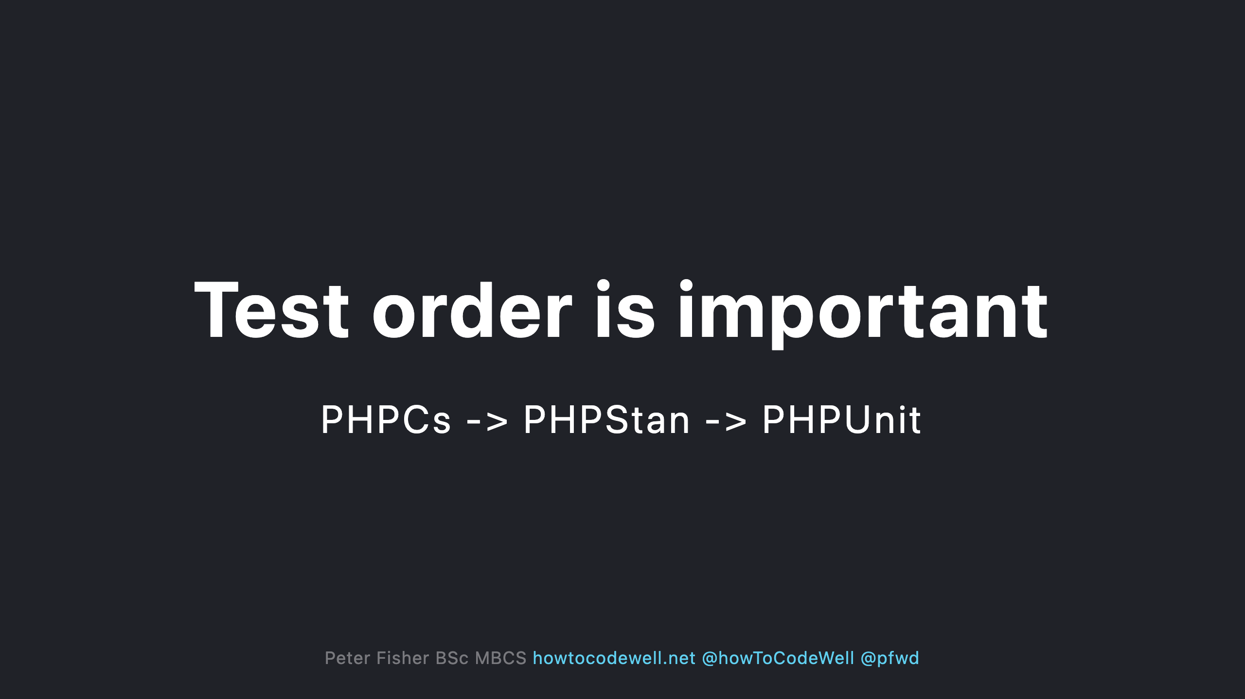

Slide 43
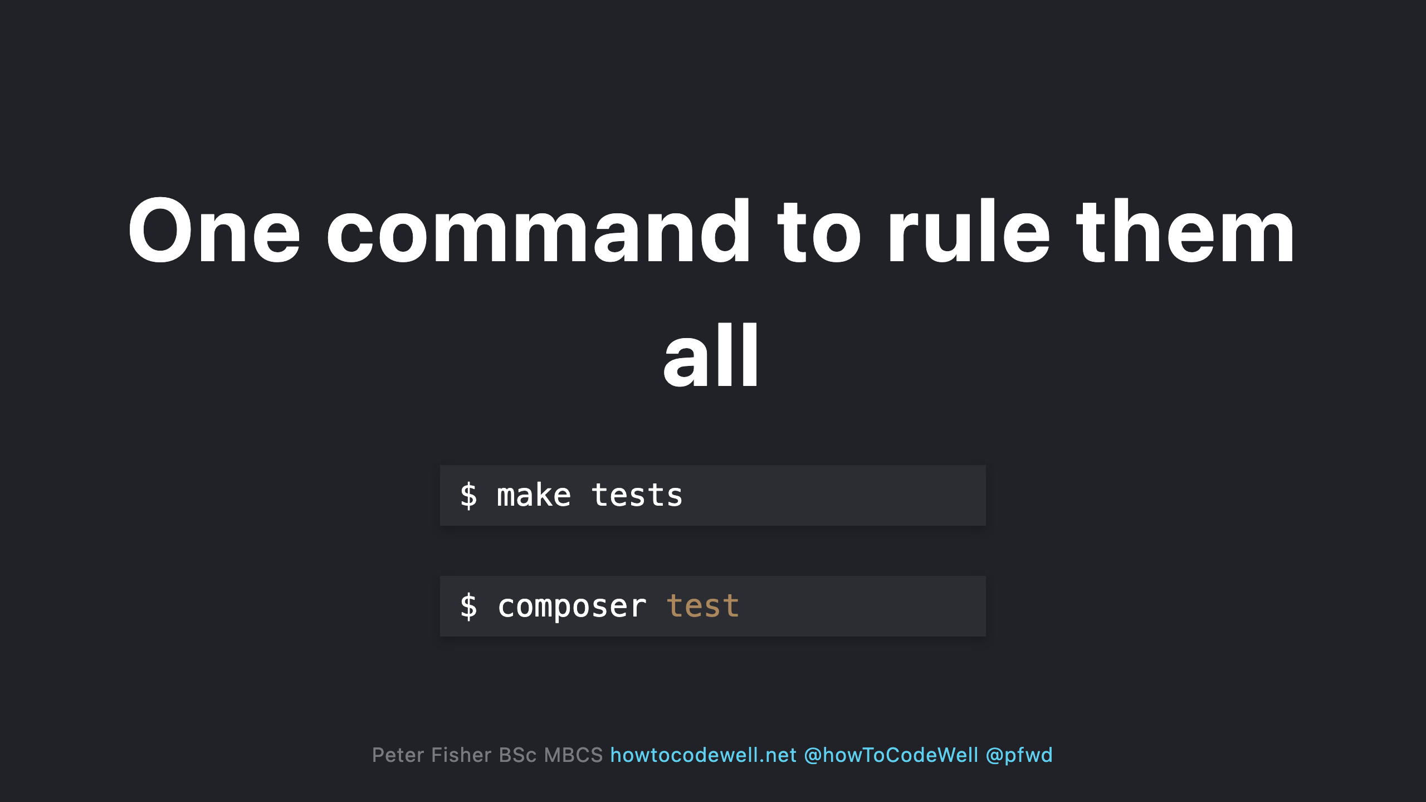

Slide 44
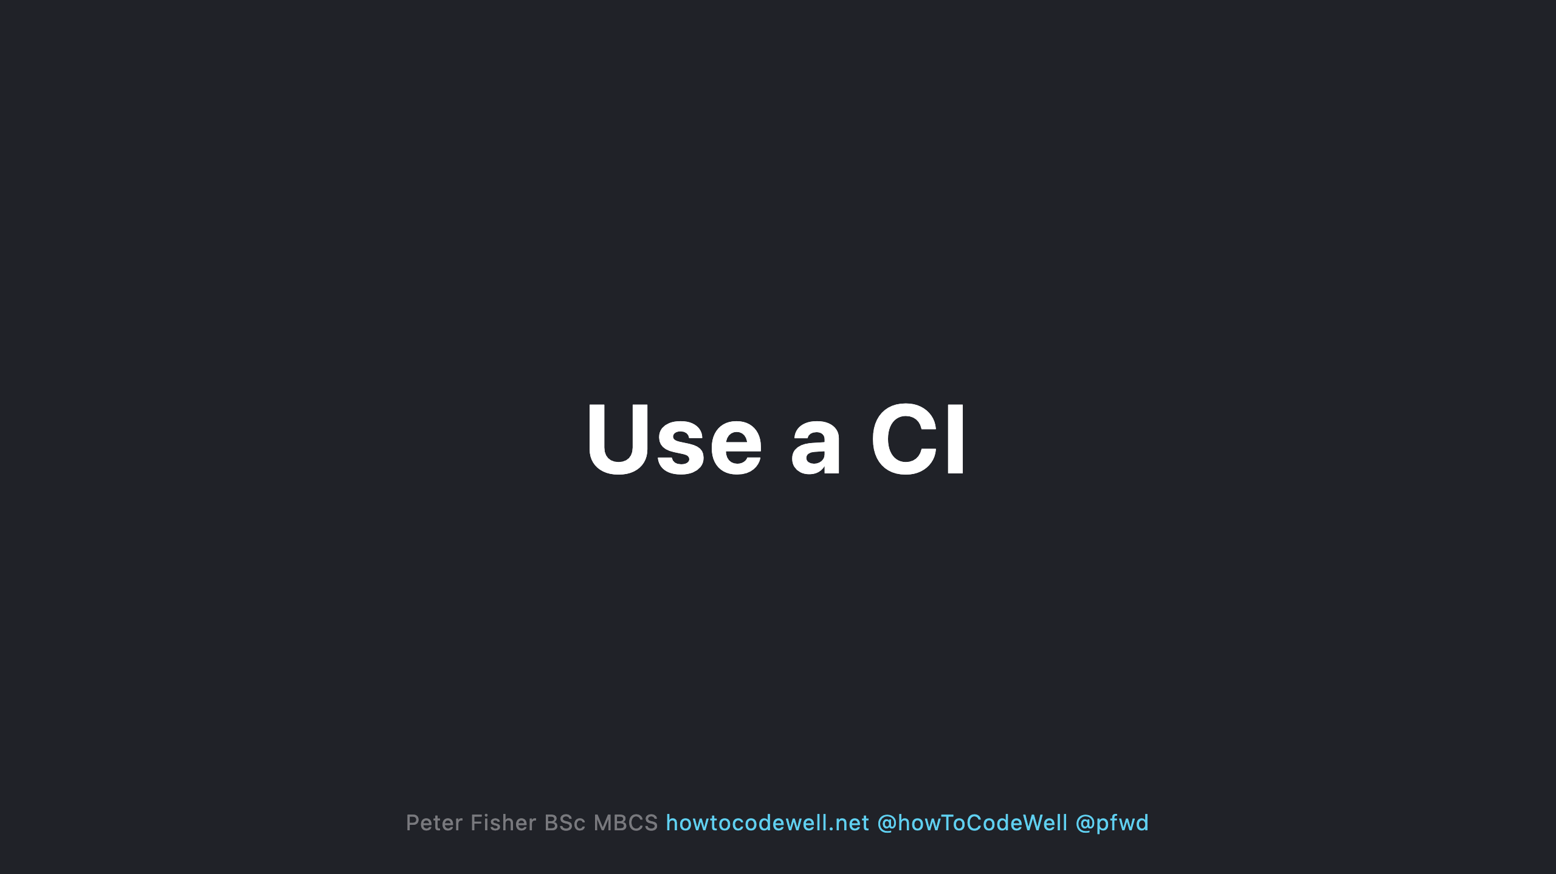
Notes:
- Enforce that no code can be merged into the main branches unless the CI fully passes

Slide 45
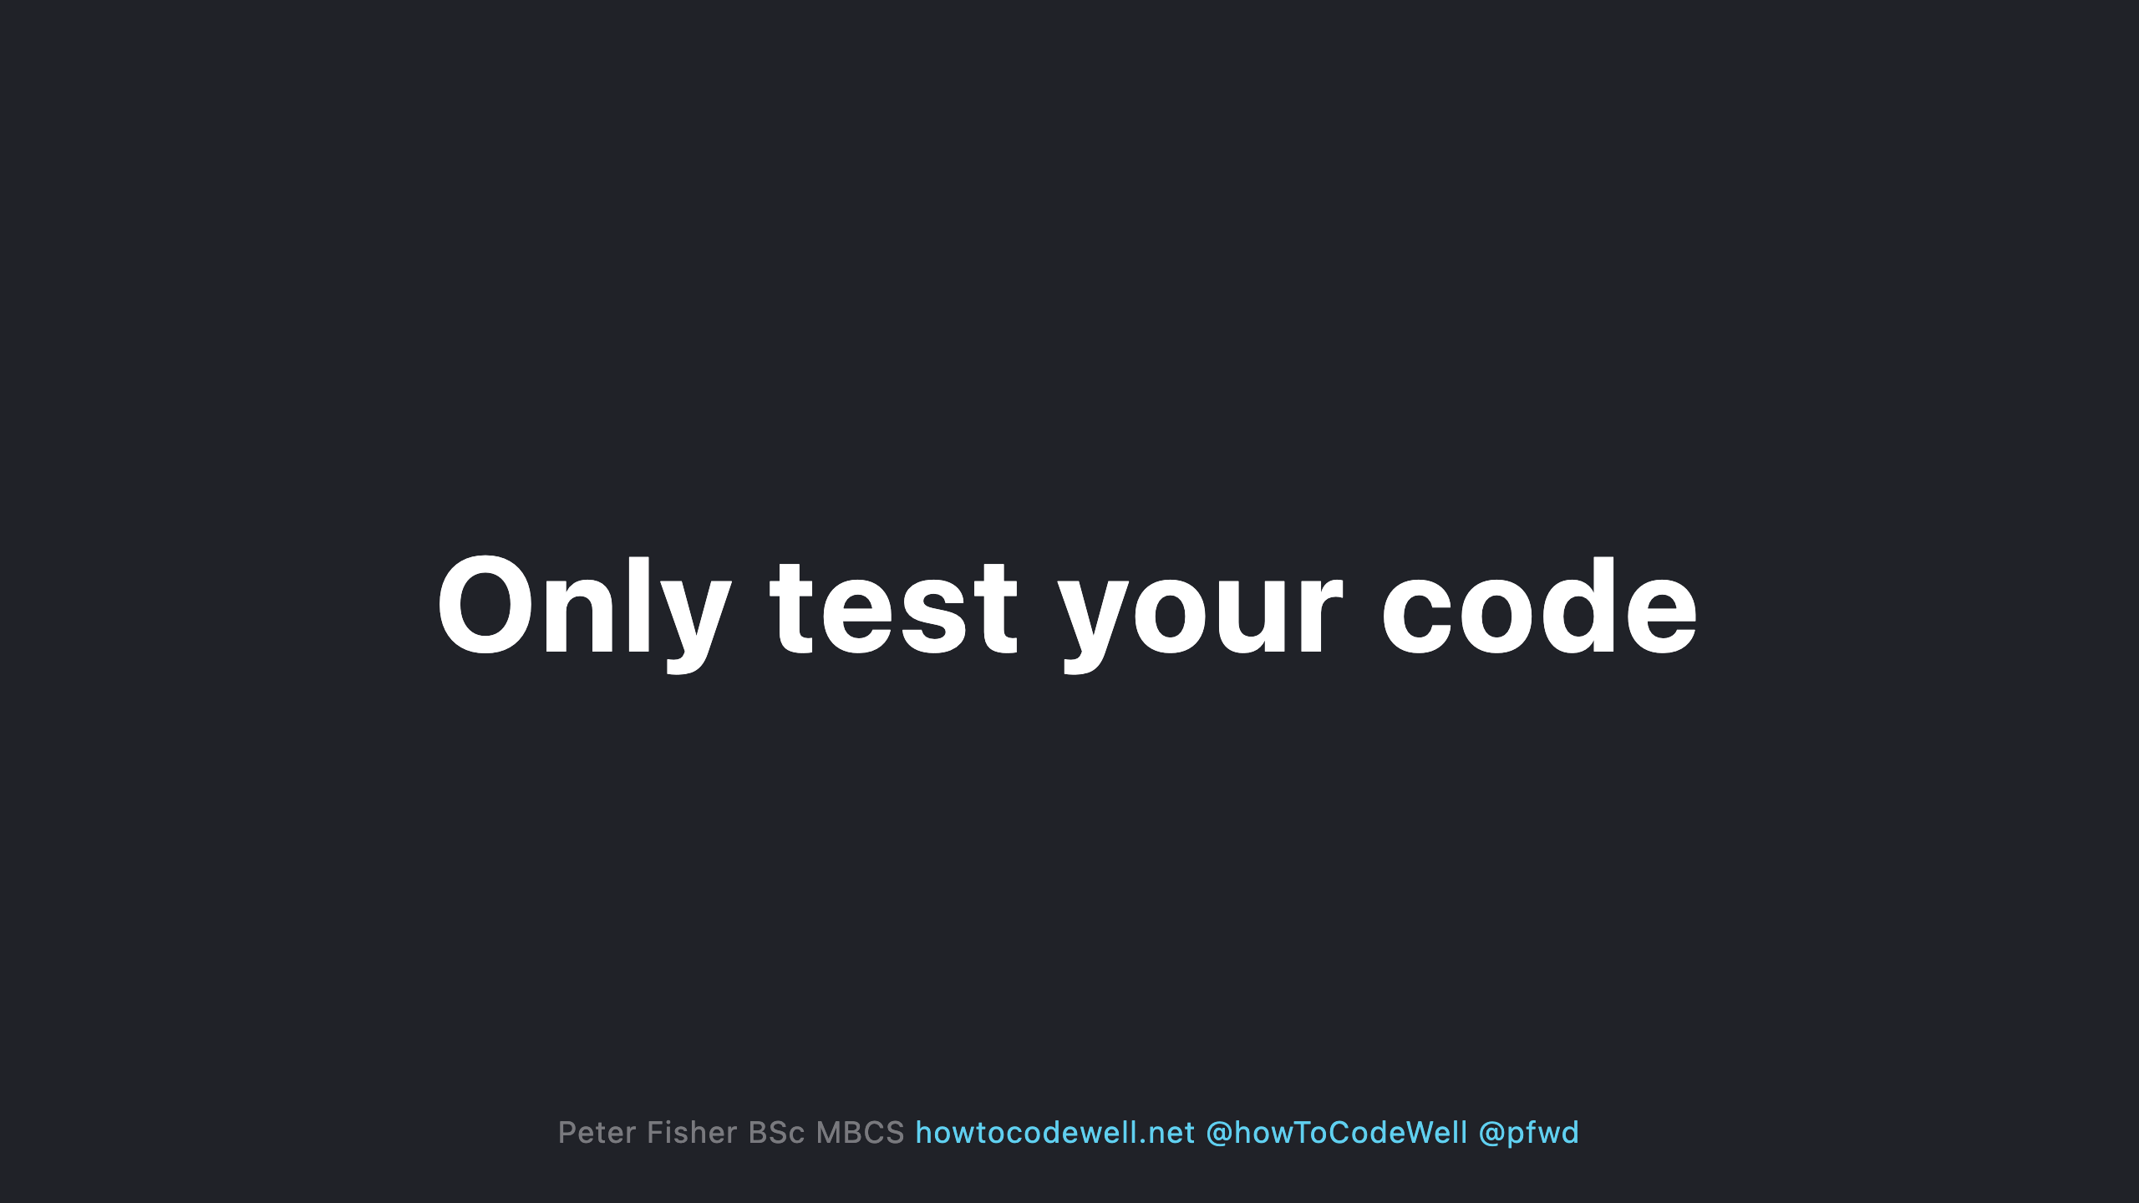
Notes:
- Don't analyse code that you haven't written. - Don't include the vendor - Ignore any code that is automatically generated like migrations

Slide 46
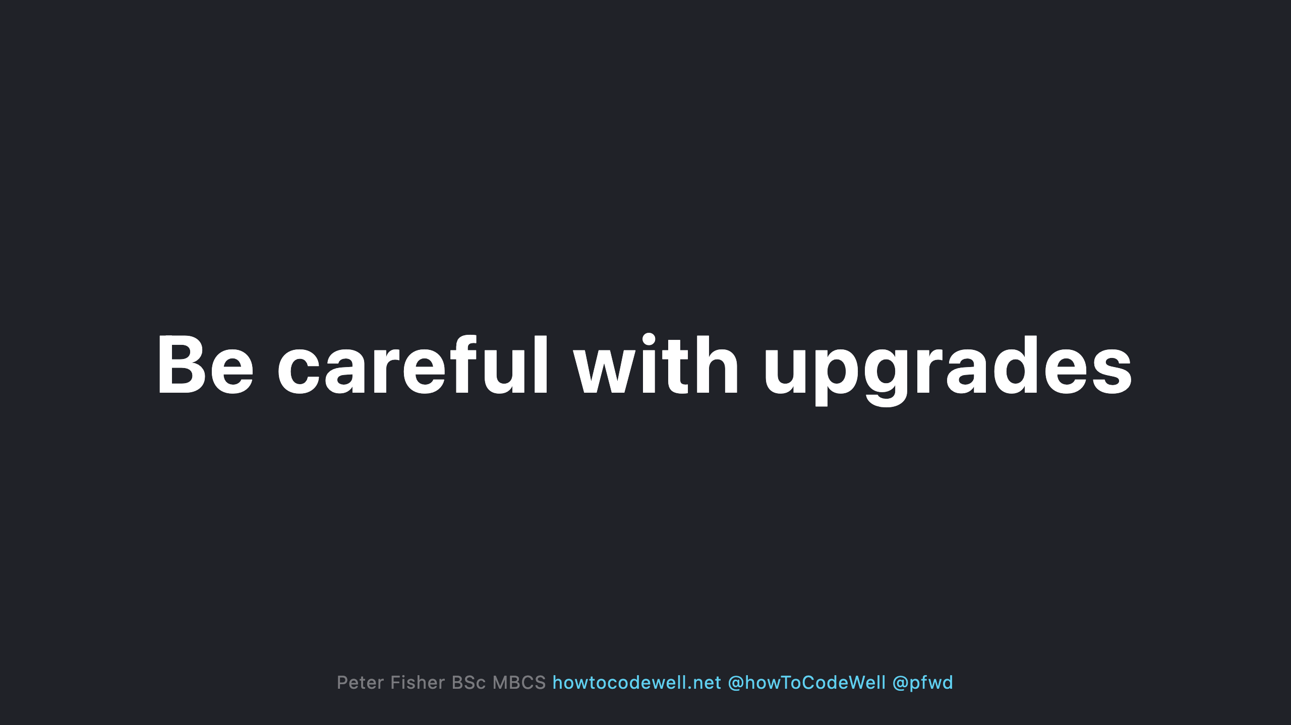
Notes:
- Don't upgrade your framework or PHP version until you have fixed all PHPStan errors - After upgrading your framework or PHP version run PHPStan as you may need to adjust your code - After upgrading PHPStan run PHPStan to check if anything new has been picked up

Slide 47
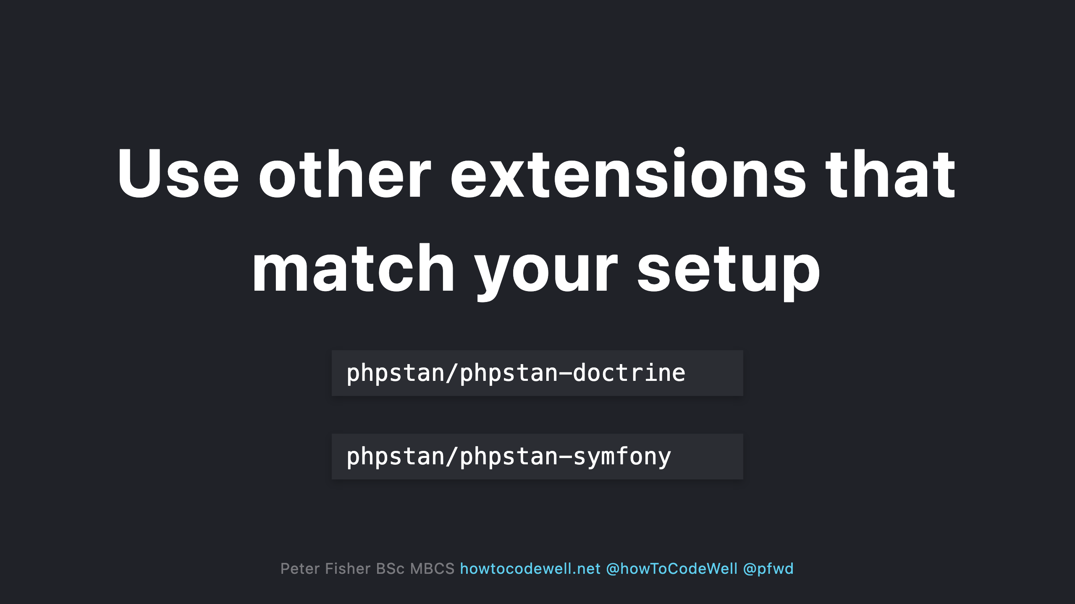

Slide 48
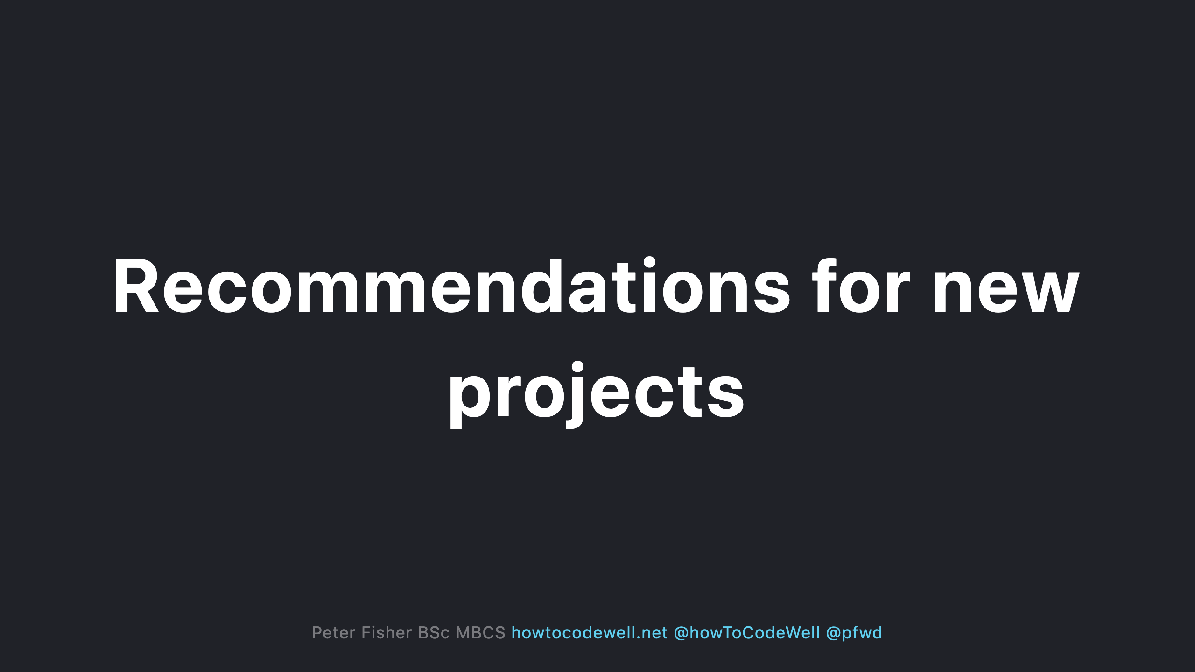
Notes:
- Only reduce the level if you are 100% sure you cannot fix the issue - Ignore one off errors via the config instead of opting to lower the level. You will end up missing other checks - Try to not ignore or exclude any errors

Slide 49
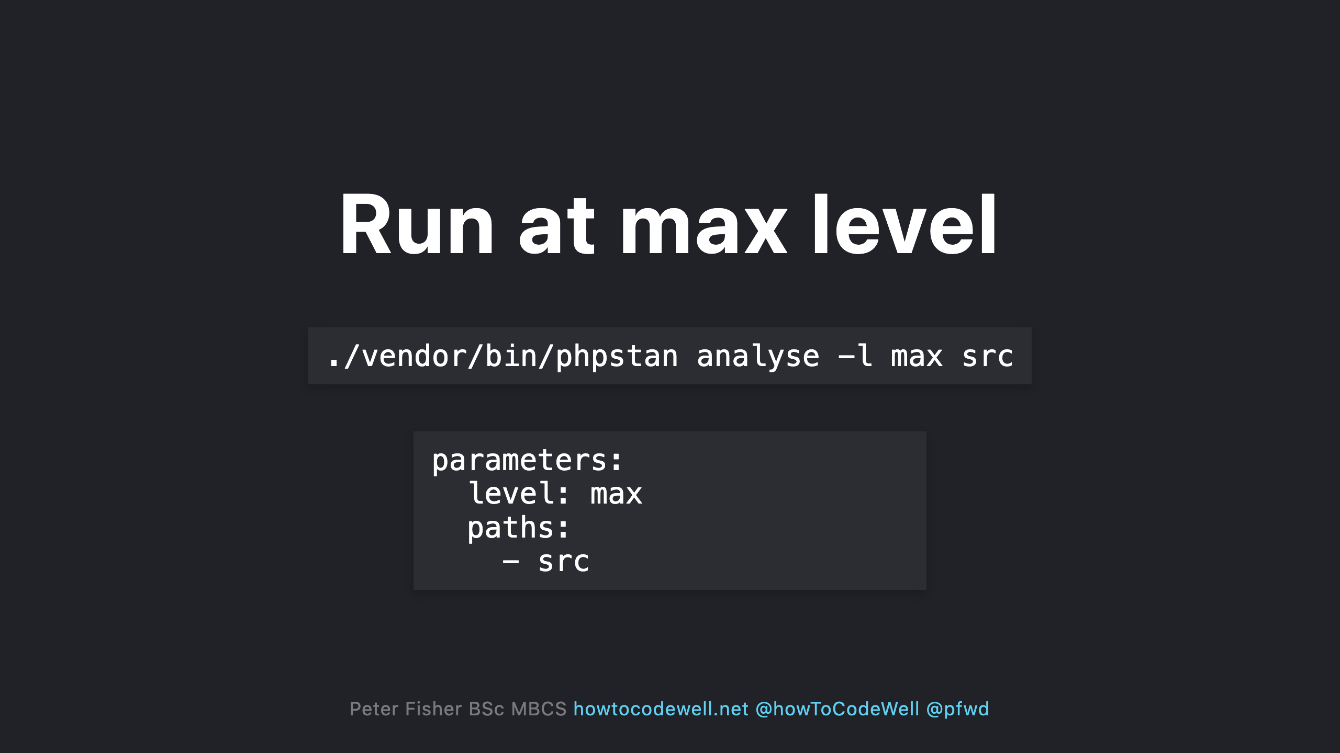
Notes:
- Use the the max level. This will keep you at the highest possible level when PHPstan is upgraded

Slide 50
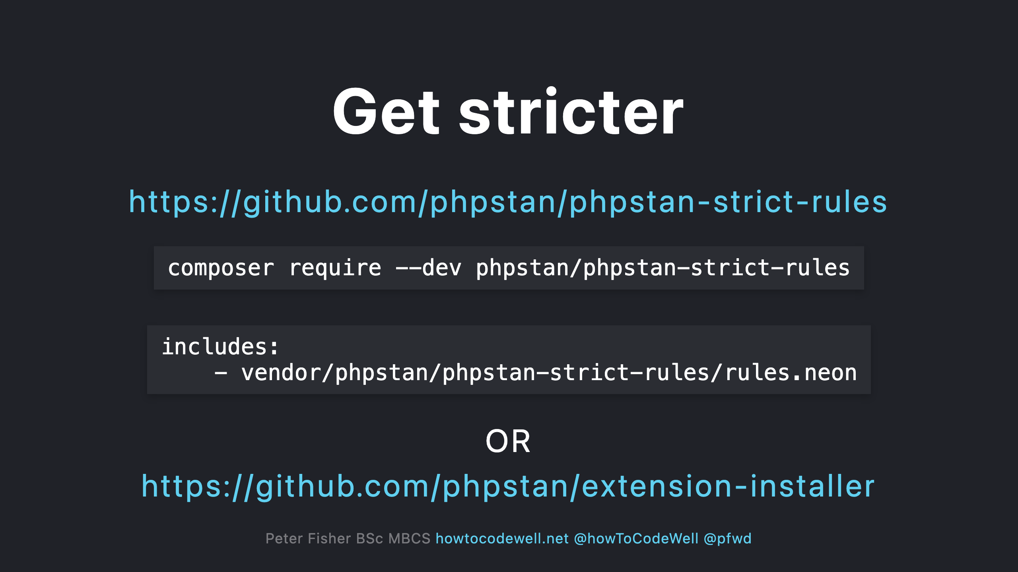

Slide 51
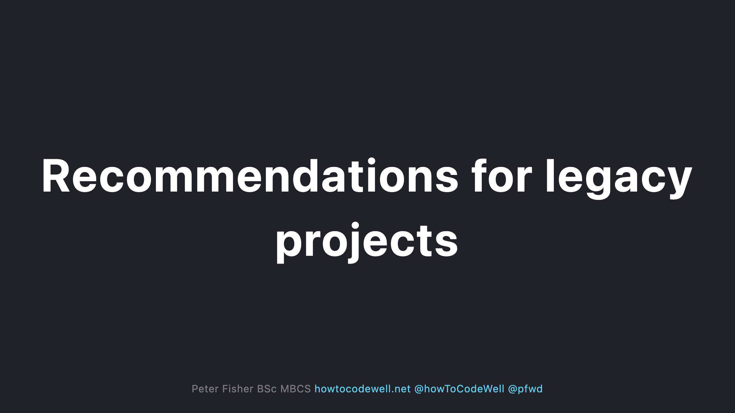
Notes:
- Fix errors in a separate branch which doesn't contain other features/fixes - Ensure you have installed the correct support packages for your libraries and frameworks

Slide 52

Notes:
- This shows you what you are up against - Don't be afraid of what you might find - Keep note of how many errors you have

Slide 53

Notes:
- Do one level at a time - Do it gradually

Slide 54
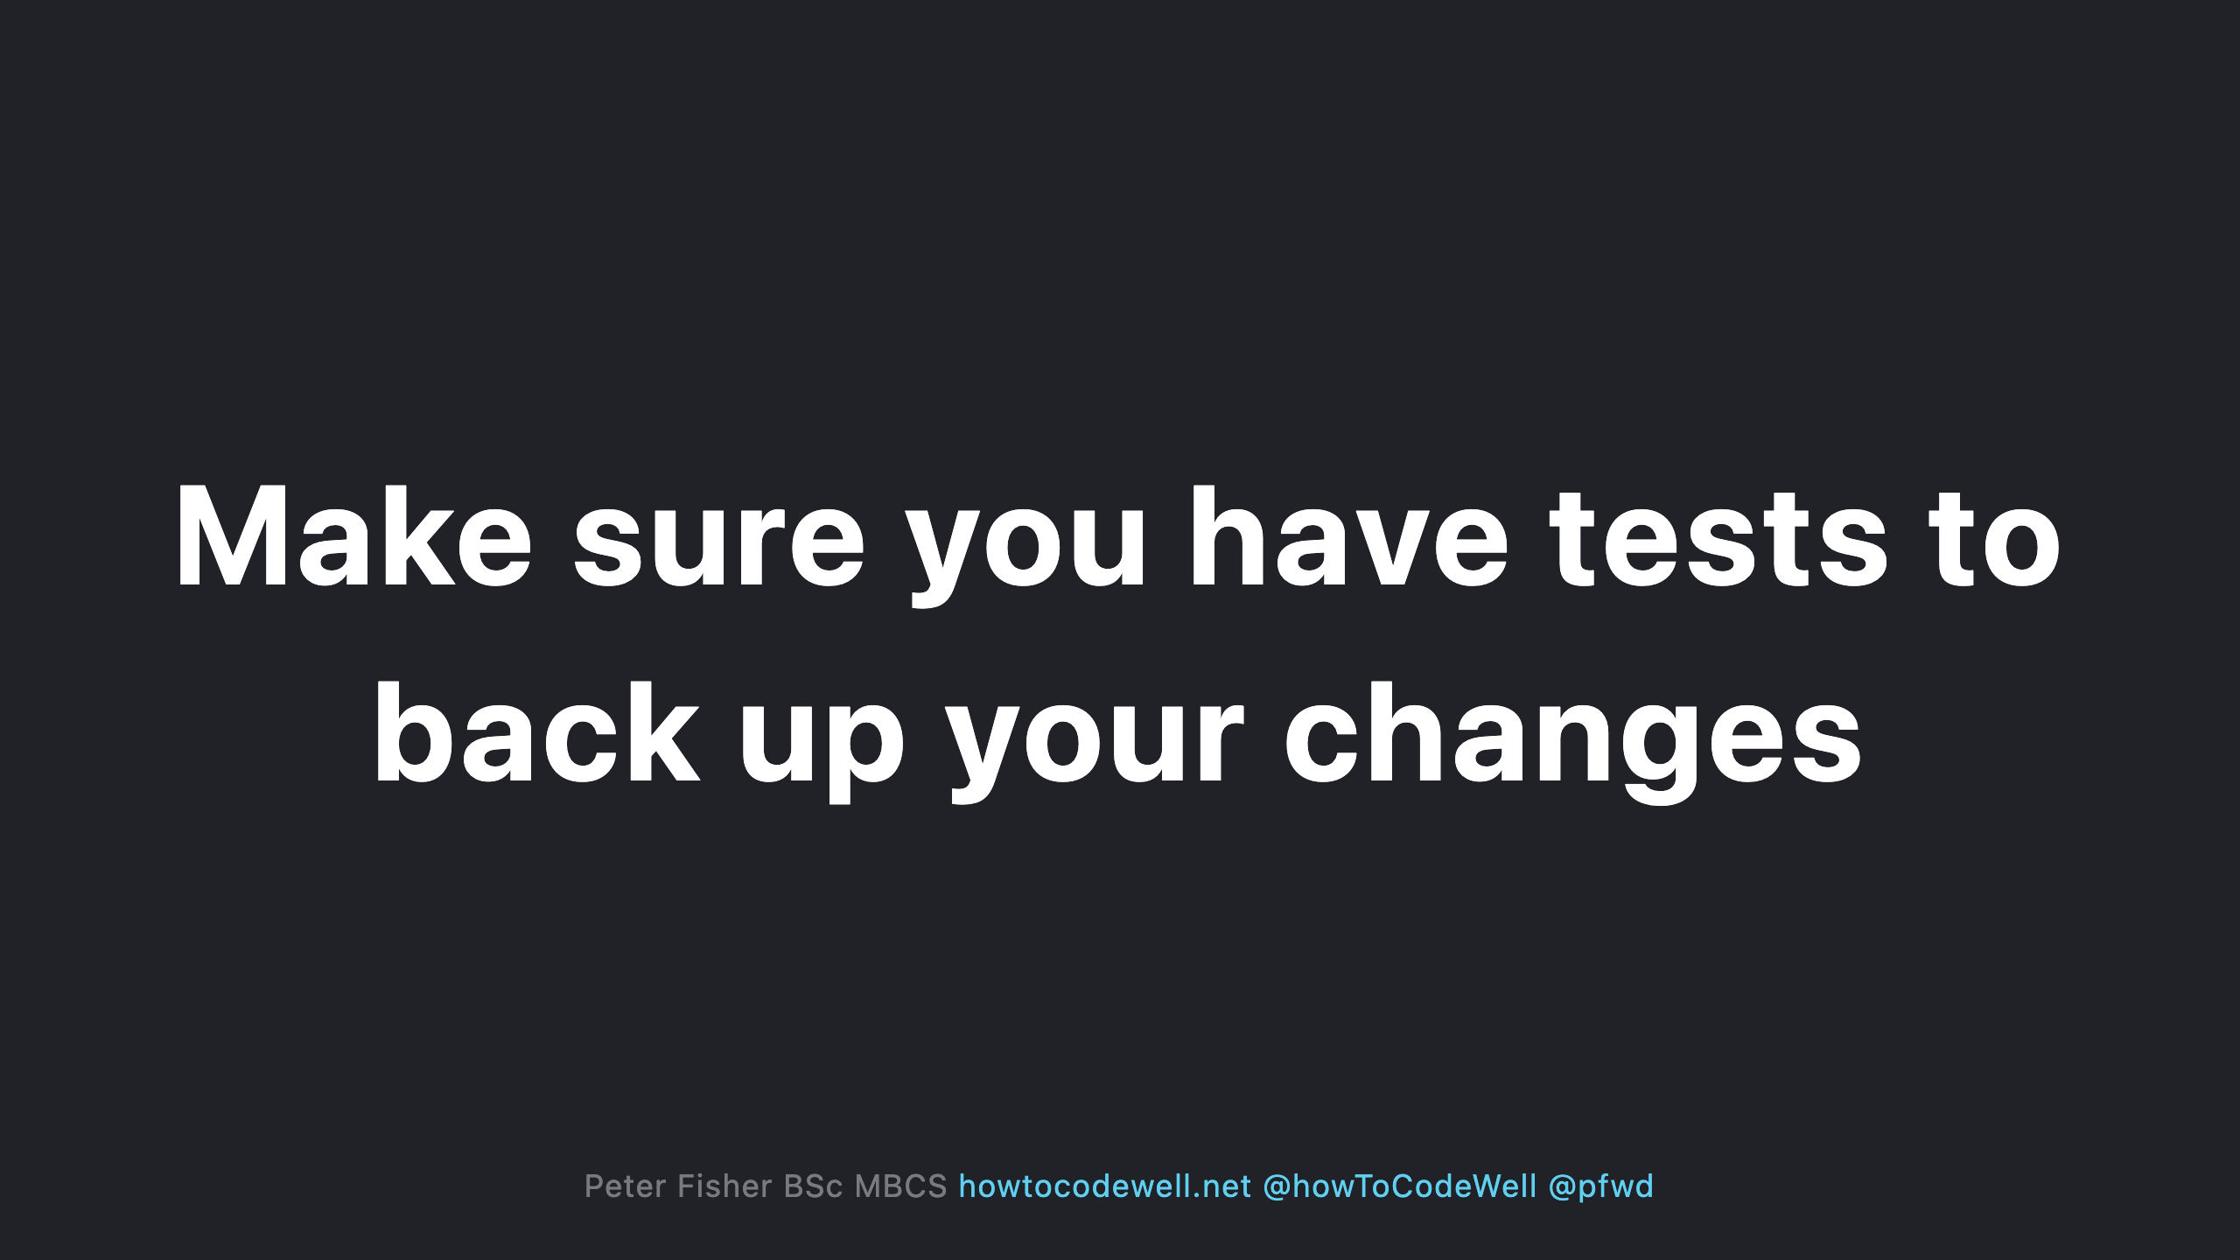
Notes:
- Unit tests - Acceptance tests - Sometimes if its broken it actually works

Slide 55


Slide 56


Slide 57

Notes:
- Run the next base level via phpstan.neon - Mention what needs fixing to the team. They might not be aware that PHPStan has other levels - Attempt to fix a level per sprint - Rinse and repeat

Slide 58

Notes:
- Get the by in of the team - Run at the highest level to see what needs fixing - Run at each level and create a ticket per run level - Attempt to fix a level per sprint - Use phpstan.neon as a means of testing beyond the baseline - Put the fixes in a separate branch/pr - In the PR update the run level in phpstan.neon.dist

Slide 59


Slide 60


Slide 61


Slide 62

Notes:
- Data integrity - What type is $product

Slide 63


Slide 64

Notes:
- Documents the requirements of the array - Autocompletion - Ideally use an interface if this a common occurrence

Slide 65


Slide 66

Notes:
Native type hint wont work for the array shape

Slide 67

Notes:
No need to use an annotation

Slide 68

Notes:
- Bugsnag or Sentry have pricing plans based on the number of events triggered. - The more compliant your code is the less events will be triggered

Slide 69


